Slide 1






CARRY OUT VEHICLE MAINTENANCE OR MINOR REPAIRS
D2.TTO.CL4.02
Notes:
Trainer welcomes students to class.

Slide 2

Carry out vehicle maintenance or minor repairs
This Unit comprises four Elements:
Provide scheduled service to vehicles
Diagnose minor vehicle faults
Undertake minor repairs to vehicles
Complete documentation
Notes:
Trainer advises trainees this Unit comprises four Elements, as listed on the slide explaining:
Each Element comprises a number of Performance Criteria which will be identified throughout the class and explained in detail
Trainees can obtain more detail from their Trainee Manual
At times the course presents advice and information about various protocols but where their workplace requirements differ to what is presented, the workplace practices and standards, as well as policies and procedures must be observed.

Slide 3

Assessment
Assessment for this unit may include:
Oral questions
Written questions
Work projects
Workplace observation of practical skills
Practical exercises
Formal report from employer/supervisor
Notes:
Trainer advises trainees that assessment for this Unit may take several forms, all of which are aimed at verifying they have achieved competency for the Unit as required.
Trainer indicates to trainees the methods of assessment that will be applied to them for this Unit.

Slide 4
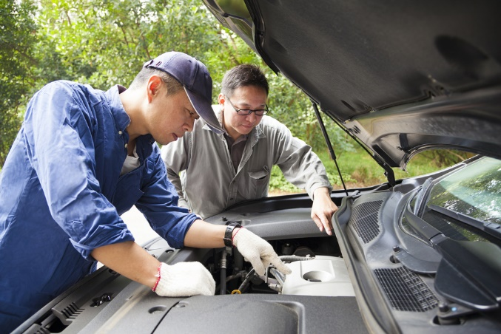
Element 1 – Provide scheduled service to vehicles
Performance Criteria for this Element are:
Identify necessary minor servicing requirements for specific vehicles
Determine situations in which maintenance may need to be carried out
Undertake visual inspections of the vehicle
Check and adjust vehicle structure
(Continued)
Notes:
Trainer identifies for trainees the Performance Criteria for this Element, as listed on the slide.

Slide 5

Element 1 – Provide scheduled service to vehicles
Check and adjust lighting
Check and adjust vision-related items
Check and adjust entrances and exits
Check and adjust vehicle interior
Check and adjust brakes
(Continued)
Notes:
Trainer identifies for trainees the Performance Criteria for this Element, as listed on the slide.

Slide 6

Element 1 – Provide scheduled service to vehicles
Check and adjust steering
Check and adjust exhaust
Check and adjust towing connections
Check and adjust miscellaneous items
Check and adjust load restraints
(Continued)
Notes:
Trainer identifies for trainees the Performance Criteria for this Element, as listed on the slide.

Slide 7

Element 1 – Provide scheduled service to vehicles
Check and replenish on-board emergency equipment and supplies, where necessary
Make arrangements for external service provision where requirements cannot be accommodated internally
Comply with mandated safety requirements while undertaking service
Notes:
Trainer identifies for trainees the Performance Criteria for this Element, as listed on the slide.
Class Activity – General Discussion
Trainer leads a general class discussion by asking questions such as:
What experience do you have with servicing vehicles and undertaking minor repairs?
Where was this and for how long?
What type of vehicles did you work on?

Slide 8

Identify necessary minor servicing requirements for specific vehicles
Important points to note:
This unit will not make you a qualified mechanic
The unit cannot cover all makes and models of vehicles
Cleaning is important to servicing and repairing
The focus is on ‘minor’ things
Notes:
Trainer highlights in relation to this topic it is important to understand:
This unit is not intended to provide the training needed for becoming a fully-qualified/A-grade mechanic
To become a properly trained professional there is a need to undertake a three or four year apprenticeship that covers much more than is contained in this unit and requires many more hours of practical experience
The manual and the notes cannot address the requirements for all types, makes and models of vehicles
There are too many choices in the marketplace, too many variations, and too many after-market and up-grade options
Cleaning is an important element of servicing and repairing vehicles in two ways:
Cleaning prior to performing inspections and repairs will make it easier to identify problems and diagnose issues
Cleaning of certain components is an essential part of the preventative maintenance process as it removes dirt, dust, grit, sand and other materials which can interfere with and damage correct operation of items
The title of the unit gives an indication about the focus of the unit – it is focussed on carrying out basic maintenance and minor repairs.

Slide 9

Identify necessary minor servicing requirements for specific vehicles
‘Vehicles’ – may :
Be used to carry tour passengers
Be used to move tour resources, gear and equipment
Facilitate daily work operations
Be diesel, petrol or gas
Commercial or private
Notes:
Trainer discusses ‘vehicles’ which may be serviced/repaired stating for the purposes of this unit ‘vehicles’ can relate to any means of transport used to:
Carry tour passengers and tour staff – on tour
Move tour resources – such as activity gear, food, camping equipment, tools, mobile facilities
Facilitate the day-to-day activities of the organisation – such as:
Picking up and moving tour group members – ‘transfers’
Travelling to see potential customers/clients and make presentations/pitches
Collecting items from suppliers, going to the bank, and doing the ‘hundred and one’ small things required in every business
The vehicle will generally be a commercial vehicle (as distinct to a private one)
It may be powered by petrol, diesel or gas.
Classroom Activity – Question and Answer session
Trainer asks class to identify types of vehicles which may require service or repairs.
Possible answers:
Cars and a range of two-wheel drive vehicles
Four-wheel drives
SUVs
Utilities
Station wagons
Vans
Light trucks
Heavy commercial vehicles
Combination vehicles
Buses/coaches
Trailers.

Slide 10

Identify necessary minor servicing requirements for specific vehicles
‘Service’ = preventative maintenance, which is done to:
Help extend working life of the vehicle
Increase reliability of the vehicle
Reduce operating costs
Present a better-looking vehicle to tour groups
Notes:
Trainer discusses vehicle ‘service’ noting:
Providing ‘service’ to vehicles refers to providing preventative maintenance
It is different to ‘repairing’ a vehicle which is done when damage has occurred/been identified
Provision of regular service and maintenance will/can:
Help extend working life of the vehicle
Increase reliability of the vehicle
Reduce operating costs
Present a better-looking vehicle to tour groups – which increases confidence in the tour staff and tour operator.

Slide 11
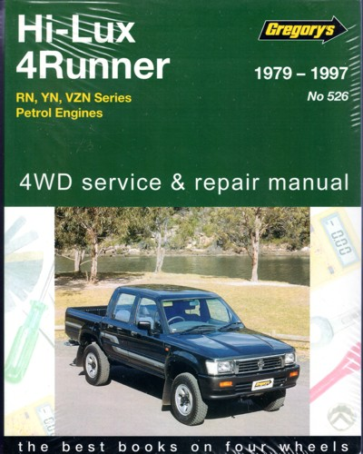

Identify necessary minor servicing requirements for specific vehicles
Ways to identify service requirements:
Read relevant manuals
Identify internal organisational service periods and/or requirements
(Continued)
Notes:
Trainer identifies ways to identify service requirements:
Researching/reading manufacturer requirements in relation to routine servicing periods and items to be checked and serviced – as prescribed in:
Warranties and guarantees
Service manuals
Owner manuals
Repair manuals
Identifying internal vehicle service periods and requirements that may override stated manufacturer’s requirements – this highlights:
Some organisations elect to service their vehicles more frequently/differently to specifications in owner manuals/manufacturer’s specifications
The condition of roads over which some vehicles are driven necessitate more frequent attention
The use some vehicles are put to puts increased stress on the vehicles and demands more frequent service.
Class Activity – General Discussion
Trainer distributes and discusses sample manuals identified on slide.

Slide 12

Identify necessary minor servicing requirements for specific vehicles
Referring to previous service history
Talking with vehicle operators
Identifying applicable host country legislation
Notes:
Trainer continues identifying ways to identify service requirements:
Referring to documentation relating to previous servicing that has taken place – which will provide:
Target date or distance (odometer reading) for the next scheduled service
Indicate issues which were identified at the last service and flagged for attention at the next service
Talking with vehicle operators – in order to identify:
Any on-the-road repairs which may have been made by tour staff or third party providers to the vehicle while (for example) it was on tour
Items they believe/know require attention
Issues they have identified as emerging and which, if dealt with, will avoid them becoming an actual problem
Identifying host country legislation that applies to the maintenance of commercial vehicles used for passenger transport – in order to ensure the safe transport of passengers.
Class Activity – Guest Speaker
Trainer arranges for representative from local vehicle registration authority to attend and discuss legislated requirements regarding vehicle service and maintenance.

Slide 13

Identify necessary minor servicing requirements for specific vehicles
Spare parts:
May be obtained from:
Authorised dealers or Specialist parts shops
Car/auto wreckers
Attention must be paid to obtaining the right part for the appropriate make and model details – refer to:
Owner’s manual
Registration sticker
VIN plate
Notes:
Trainer talks about vehicle spare parts observing:
Spare parts for vehicles may be obtained from:
Authorised dealers
Specialist parts shops
Car wreckers
Always ensure spare parts are suitable for the make, model and year of the vehicle being serviced or repaired
Ways to identify include reference to:
Vehicle Owner’s Manual
Registration sticker
VIN plate.
Class Activity – Guest Speaker
Trainer shows class a VIN plate and helps them interpret the information it contains.

Slide 14

Identify necessary minor servicing requirements for specific vehicles
Additional context for this unit:
It is very much a practical, hands-on unit
Service/maintenance required can also be determined by:
The way the vehicle has been driven and by whom
Age of the vehicle
History of the vehicle
Local, organisational and manufacturer requirements take precedence over the notes
Notes:
Trainer provides more context for the unit identifying:
This unit is very much a practical unit – where the focus will be on actually carrying out maintenance and performing minor repairs
Service and maintenance required for some vehicles can also be determined (to an extent/partially) by:
The way the vehicle has been driven/who has driven it – the simple fact of life is some drivers are harder on their equipment than others
Age of the vehicle – generally speaking older vehicles require more frequent service
History of the vehicle – in terms of the result of combining factors such as distances travelled over time, conditions the vehicle was used in, previous services provided, accidents or incidents the vehicle has been involved in and any damage which has occurred to the vehicle
Regardless of what is presented in these notes there is always a need to – as appropriate:
Follow manufacturer’s instructions
Adhere to organisational SOPs
Conform to workshop manuals and/or service manuals and/or owner manuals
Use qualified staff to provide nominated maintenance and/or repairs
Comply with all local legislation regarding safety and roadworthiness requirements.

Slide 15

Determine situations in which maintenance may need to be carried out
Maintenance or repairs may need to be undertaken:
Day or night
In all weather
In tight/confined areas
(Continued)
Notes:
Trainer explains maintenance to and/or minor repairs to tour and travel vehicles may need to be carried out in a range of operating conditions, including:
Operations conducted at day or night – meaning:
Not all breakdowns or problems occur during the day
There is a need to have lighting equipment available to allow work to be carried out on vehicles at night time – such as floodlights, inspection lights, torches
All weather conditions – meaning there may be a need to take action in the heat of the day, during rain or a storm, and/or in high winds. These conditions may require:
Waiting – until unacceptable conditions pass and it is safe/safer to take action
Seeking shade from the sun – or moving the vehicle to a shaded location
Erecting barricades against the wind/dust/sand – and/or moving the vehicle to a protected position
Placing the vehicle under cover or putting up a cover of some description – to avoid rain
In tight or confined spaces – such as:
In situ in a parking area or parking bay
When wedged/stuck in an off-road situation – prior to taking other action to retrieve the vehicle.

Slide 16

Determine situations in which maintenance may need to be carried out
In closed and controlled conditions – such as a workshop
In open spaces such as outdoors/on tour
Notes:
Trainer continues explaining different conditions under which service or repairs may be required:
In closed and controlled locations as well as in exposed and open environments – where:
Closed and controlled locations can refer to a workshop, depot, base, warehouse or client workplace (office, pick-up or transfer point, muster area) or other position where:
There is no danger from passing vehicles
There is no adverse impact from the environment/climatic conditions
Significant tools and equipment are readily available
There is a ready source of spare parts and fluids
The vehicle can be moved around, and maintained/repaired in, the location where it is parked
Exposed and open environments refers to on-the-road and on-tour locations where:
Other vehicles are passing or over-taking the vehicle
The vehicle is open to the elements – and other factors which might include dangers/risks posed by animals, crowds, rising water
Only on-board tools, spare parts and fluids are available
The vehicle may need to be moved to a different position in order to allow work to be safely and effectively undertaken – such as off a grade, or away from/out of mud or sand.

Slide 17

Undertake visual inspections of the vehicle
Activities in the visual inspection process:
Look at and under the vehicle – lift the vehicle off the ground if possible
Light the areas being inspected
(Continued)
Notes:
Trainer describes activities involved in the inspection process:
Looking at and under the vehicle and closely checking all aspects of the vehicle – while it is:
On the ground, and/or
On a hoist or over an inspection pit – if a hoist or inspection pit is not available the inspection can occur by using:
Trolley jacks
Car stands
Under-vehicle car trolleys/creepers
Lighting the areas being inspected – with:
Inspection lights
Torches.
Classroom Activity – Demonstration and Practical
Trainer demonstrates and explains the vehicle inspection activities shown on the slide and provides opportunity for students to do the same.

Slide 18
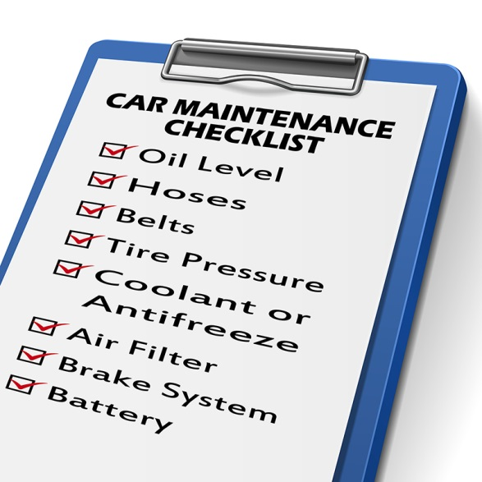
Undertake visual inspections of the vehicle
Use a ‘Vehicle Inspection Checklist’
Inspect the vehicle in pairs
(Continued)
Notes:
Trainer continues describing activities involved in the inspection process:
Using a checklist – to:
Provide evidence the inspection occurred
Note defects and matters requiring attention
Inspecting the vehicle in pairs – so that:
Issues can be analysed/discussed
A more effective inspection takes place – that is, there is less chance something will be missed if two people do the inspection.
Classroom Activity – Handout
Trainer distributes and discusses use of sample vehicle inspection checklist.

Slide 19

Undertake visual inspections of the vehicle
Look for signs of damage
Look for missing parts
(Continued)
Notes:
Trainer continues describing activities involved in the inspection process:
Looking for signs of damage to the vehicle – as these signs can indicate:
Where a more detailed inspection needs to occur to determine:
If the damage has caused a problem/further problem
Whether the damage is a result of another issue
Need for immediate action – to:
Fix the cause
Take temporary action to reduce/prevent further damage
Keep the vehicle on-the-road/operational
Need to take later action – which may not be immediately necessary to
Possible cause or source of the damage
What may be needed/possible to prevent recurrence
Checking for missing parts – from:
Inside the cabin
Inside the passenger area
On the exterior of the vehicle
Under the hood/bonnet.
Classroom Activity – Demonstration and Practical
Trainer demonstrates and explains the vehicle inspection activities shown on the slide and provides opportunity for students to do the same.

Slide 20

Undertake visual inspections of the vehicle
Note leaking fluids
Identify projections from the vehicle
Take on-the-spot action to fix simple problems
Check condition of vehicle instruments, knobs and pedals
Notes:
Trainer continues describing activities involved in the inspection process:
Noting leaking fluids – as this can:
Identify type of fluid
Identify location of leak
Indicate severity of problem
Determine, to an extent, the type of problem needing to be addressed
Identifying projections from the vehicle – this relates to:
Body parts which have been worked loose, damaged or snagged and are hanging loose or sticking out from beyond the normal dimensions of the vehicle presenting a danger to other vehicles, people or structures
Items caught up under the vehicle or under wheel wells, around wheels and brake lines, in the engine bay or from vehicle protection bars or lighting bars
Taking immediate action to rectify problems – which can be quickly and easily fixed on-the-spot, such as:
Clearing blockages
Tightening screws, nuts, bolts and fittings
Checking condition of vehicle instruments – while this is not just a visual inspection it involves a visual element in relation to, for example:
Confirming travel of pedals and freedom from blockages/interference
Activating knobs and switches and seeing they function as required.
Classroom Activity – Demonstration and Practical
Trainer demonstrates and explains the vehicle inspection activities shown on the slide and provides opportunity for students to do the same.

Slide 21
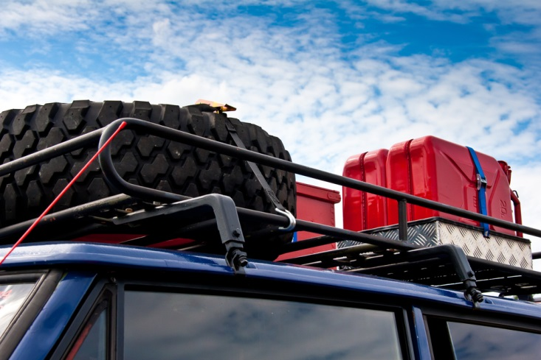
Check and adjust vehicle structure
The aim is to identify:
If there is damage which might impact appearance and structural integrity
Problems with stability and suspension
Issues with luggage and pack racks
(Continued)
Notes:
Trainer states in essence this check seeks to identify:
If there is damage – to panels (which adversely impact the appearance of the vehicle – and/or the structure integrity of the vehicle (which may compromise strength, tracking and handling)
If there are problems with vehicle stability and suspension – which can present handling, ride comfort and safety problems
If there are issues with luggage and pack racks – which may cause units to work loose from the vehicle and damage the body, or become separated from the vehicle.

Slide 22

Check and adjust vehicle structure
Important points relating to vehicle appearance:
Most vehicles have company name on them
People draw inferences about the organisation from the way a vehicle looks
Tour groups expect well-presented vehicle
Notes:
Trainer explains in relation to the physical appearance of the vehicle it must be remembered:
The vehicle nearly always has the name of the tour company on it – so people judge the business by the way the vehicle looks (and the way it is driven)
People (including tour group members) draw inferences about the tour and the tour organisation based on the way the vehicle looks – as in:
A well-presented, clean, undamaged vehicle tends to generate confidence in the tour staff and the tour operator
A poorly presented vehicle that looks dirty and lacking in maintenance will cause concern among tour group members and often cause them to look for problems elsewhere with the tour
Tour group members expect their tour vehicles to be clean and properly maintained when they commence a tour – and be appropriately serviced as required while on tour.

Slide 23

Check and adjust vehicle structure
Inspecting panels – walk around vehicle and:
Inspect in systematic fashion
Use a checklist
Identify and note damage
Determine if damage is causing problems
(Continued)
Notes:
Trainer indicates checking the panels involves a visual inspection highlighting the best way is to walk around the vehicle and:
Inspect in a systematic fashion
Use a checklist to record observations
Identify and note the location and type of any damage observed
Determine if obvious panel damage is causing/has already caused operational issues for other components of the vehicle.
Classroom Activity – Demonstration and Practical
Trainer shows students how to undertake activities listed on the slide and provides an opportunity for them to do the same.

Slide 24

Check and adjust vehicle structure
Determine if damage has potential to cause further problems
Hammer out damage causing operational issues
Remove panels causing potential threat
Consider sending to panel shop for serious work
Notes:
Trainer continues discussing panel inspections:
Work out if the panel damage has the potential to cause operational issues or further damage to other components
Hammer out damage which is preventing proper use of the vehicle – or using a pull bar or suction device
Unbolt or cut away panels which are seriously damaged and present a clear threat to the further operation and/or safety of the vehicle.
More permanent repairs to panels (such as properly removing and filling dents) and other serious panel work, replacing panels, and spray painting, needs to be undertaken by a fully qualified panel beater.
Classroom Activity – Demonstration and Practical
Trainer shows students how to undertake activities listed on the slide and provides an opportunity for them to do the same.

Slide 25

Check and adjust vehicle structure
Basic inspection procedures for chassis:
Wash/clean the chassis/vehicle
Get the vehicle off the ground
Remove the wheels and tyres
Focus on corners, wheel arches and bottom of doors
Notes:
Trainer notes basic inspection procedures for chassis are:
Wash/clean the chassis/vehicle
Get the vehicle off the ground – a hoist is preferable
Remove the wheels and tyres
Focus on corners, wheel arches and bottom of doors.
Classroom Activity – Demonstration and Practical
Trainer shows students how to undertake activities listed on the slide and provides an opportunity for them to do the same.

Slide 26

Check and adjust vehicle structure
Chassis (and other) checks can require:
Visual assessment
Aural assessment
Functional assessment
Notes:
Trainer notes chassis checks can require the use of three basic diagnostic tools/assessments:
Visual assessment – by getting under the vehicle or raising it on a hoist
Aural assessment – by listening to the vehicle as it travels over uneven ground
Functional assessment – by gauging the operation/performance of the vehicle on-the-road.

Slide 27

Check and adjust vehicle structure
Assessments should be used to detect:
Damage
Wear
Breakage
Notes:
Trainer states assessments should be used to detect:
Damage – caused by impact with obstacles
Wear – normal wear and tear occasioned by use of the vehicle
Breakage – due to stress, misuse, or age.

Slide 28

Check and adjust vehicle structure
Issues to look for:
Sharp edges due to rusted panels or body damage, or protrusions
Rust or cracks in structural members
Damage/modifications impacting structural integrity
Evidence body has been cut and joined
(Continued)
Notes:
Trainer indicates issues to look for:
Exterior body work and fittings have sharp edges due to rusted panels or body damage, or protrusion of any after-market object of fittings, not technically essential to the operation of the vehicle which protrudes from any part of the vehicle that could cause injury to a person coming into contact with the vehicle
Any structural member such as a sub frame, floor panel, door sill, seat or seat belt anchorage, is cracked or has advanced rust
Unrepaired damage or modifications affecting the structural integrity of the vehicle
Any evidence that body has been cut and joined.
Classroom Activity – Demonstration and Practical
Trainer shows students how to undertake activities listed on the slide and provides an opportunity for them to do the same.

Slide 29
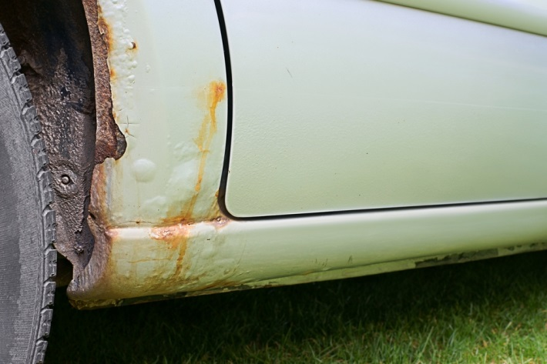
Check and adjust vehicle structure
Doors have advanced rust
Chassis frame members or supporting members are cracked, loose, sagging or broken
Frame members in load areas are missing, damaged or unsecured
Repairs do not retain original strength of the component/section
Any component adversely affecting vehicle safety or driver’s view
Notes:
Trainer continues indicating issues to look for:
The doors of a vehicle have advanced rust
Chassis frame members or supporting members are cracked, loose, sagging or broken
Frame members in load areas are missing, damaged or unsecured
Any repairs carried out do not retain the original strength of the component/section
Any component that adversely affects the safety of the vehicle, and in particular, obscures the drivers view.
Classroom Activity – Demonstration and Practical
Trainer shows students how to undertake activities listed on the slide and provides an opportunity for them to do the same.

Slide 30

Check and adjust vehicle structure
Suspension system options:
Gas
Hydraulic
Pneumatic
Mechanical
Rubber suspension
Notes:
Trainer discusses suspension systems identifying may be:
Gas
Hydraulic
Pneumatic
Mechanical
Rubber suspension.
Classroom Activity – Presentation
Trainer presents and differentiates between suspension types.

Slide 31
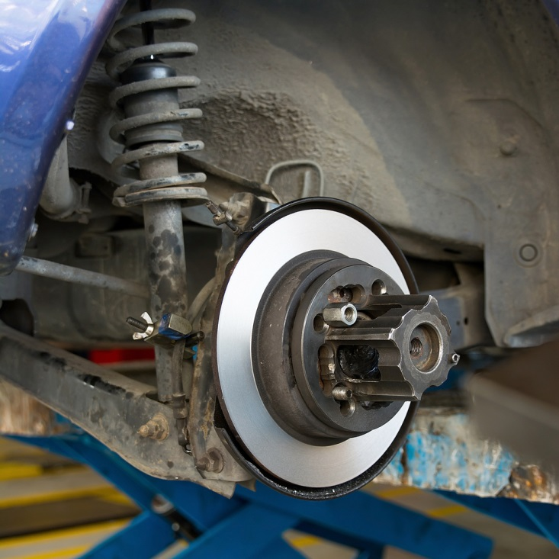
Check and adjust vehicle structure
Suspension components include:
Lateral and longitudinal/control arms
Springs
Dampers
Shock absorbers
(Continued)
Notes:
Trainer identifies suspension system components:
Lateral and longitudinal/control arms
Springs – coil, leaf, torsion bars or air springs (to absorb energy)
Dampers – to dissipate energy
Shock absorbers.
Classroom Activity – Presentation
Trainer presents and describes function of suspension components shown on slide.

Slide 32

Check and adjust vehicle structure
Linkages
Ball joints
Self-levelling devices
Ride and height controls
Notes:
Trainer continues identifying suspension system components:
Linkages
Ball joints
Self-levelling devices
Ride and height controls.
Classroom Activity – Presentation
Trainer presents and describes function of suspension components shown on slide.

Slide 33
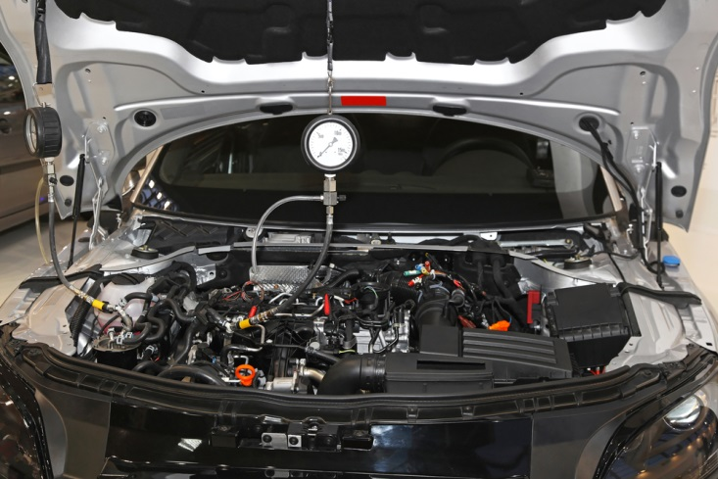
Check and adjust vehicle structure
Possible diagnostic methods:
Functional testing
Pressure testing
Electrical and/or electronic testing
Visual, aural and functional assessments
Notes:
Trainer indicates diagnostic methods include:
Functional testing of the vehicle
Pressure testing of air systems
Electrical and/or electronic testing
Visual, aural and functional assessments – with checks for physical damage, corrosion, fluid levels, fluid and grease leaks, air leaks, wear, alignment.
Classroom Activity – Demonstration and Practical
Trainer shows students how to undertake activities listed on the slide and provides an opportunity for them to do the same.

Slide 34

Check and adjust vehicle structure
Reasons for concerns with suspension:
Any suspension component that is broken, cracked, bent, misaligned, cut, missing, not secured or can be seen to have been repaired or modified by heating or welding
Any shock absorber is missing, inoperative or is leaking fluid
Any shock absorber is not securely mounted
(Continued)
Notes:
Trainer indicates reasons for concern with suspension:
Any suspension component that is broken, cracked, bent, misaligned, cut, missing, not secured or can be seen to have been repaired or modified by heating or welding
Any shock absorber is missing, inoperative or is leaking fluid
Any shock absorber is not securely mounted.
Classroom Activity – Demonstration and Practical
Trainer shows students how to undertake activities listed on the slide and provides an opportunity for them to do the same.

Slide 35
Check and adjust vehicle structure
Maintenance of suspension may require:
Adjustment of shock absorbers
Greasing ball joints, tie rod ends, sway bar links, drag links, centre links, idler arms and Pitman arms
Inspecting ball joints for play
Checking wear indicators
(Continued)
Notes:
Trainer indicates maintenance can include:
Adjustment of shock absorbers
Greasing ball joints, tie rod ends, sway bar links, drag links, centre links, idler arms and Pitman arms
Inspecting ball joints for play
Checking wear indicators.
Classroom Activity – Demonstration and Practical
Trainer shows students how to undertake activities listed on the slide and provides an opportunity for them to do the same.

Slide 36
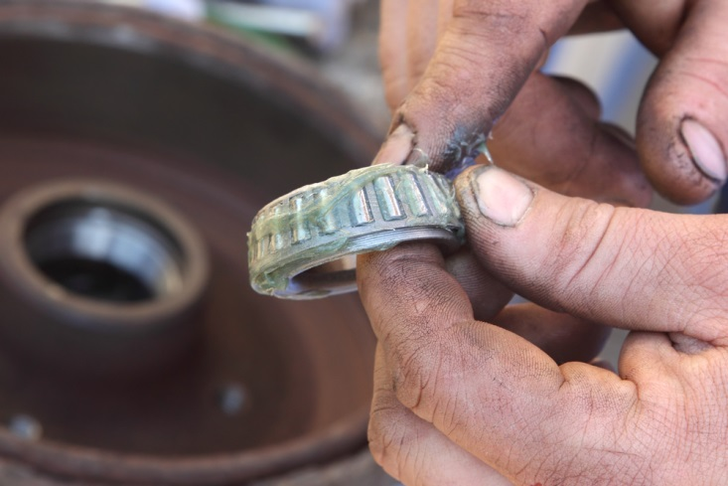
Check and adjust vehicle structure
Checking and greasing bearings
Removing and replacing wheel bearings
Replacing ball joints and boots
Checking tyre wear and wheel alignment
Notes:
Trainer continues indicating possible suspension maintenance:
Checking and greasing bearings
Removing and replacing wheel bearings
Replacing ball joints and boots
Checking tyre wear and wheel alignment.
Classroom Activity – Demonstration and Practical
Trainer shows students how to undertake activities listed on the slide and provides an opportunity for them to do the same.

Slide 37
Check and adjust vehicle structure
Checks to make on luggage and pack racks:
Making sure connections are tight
Cleaning as required
Replacing missing end plugs
Checking roof gutters for wear/corrosion – and re-fitting and re-painting where necessary
Notes:
Trainer discusses checks which need to be made of luggage and pack racks attached to vehicles:
Making sure connections are tight
Cleaning as required
Replacing missing end plugs
Checking roof gutters for wear/corrosion – and re-fitting and re-painting where necessary.

Slide 38

Check and adjust vehicle structure
Replacement of rubber supports and inserts
Replacement of frayed/damaged straps
Oiling moving parts – doors, hinges
Cleaning roof and rack gutters
Notes:
Trainer continues discussing checks which need to be made of luggage and pack racks attached to vehicles:
Replacement of rubber supports and inserts
Replacement of frayed/damaged straps
Oiling moving parts – doors, hinges
Cleaning roof and rack gutters.

Slide 39

Check and adjust lighting
Headlight checks:
Correct colour
Globes not blown
High beam – good strength and accurate alignment/focus, and illuminate when activated
Dipped – good strength and accurate alignment, and dip and return to high beam when activated: high beam lamps must extinguish when lights are dipped
(Continued)
Notes:
Trainer discusses headlight checks:
Correct colour
Globes not blown
High beam – they have good strength and accurate alignment/focus, and illuminate when activated
Dipped – they have good strength and accurate alignment, and dip and return to high beam when activated: high beam lamps must extinguish when lights are dipped.
Classroom Activity – Demonstration and Practical
Trainer shows students how to undertake activities listed on the slide and provides an opportunity for them to do the same.

Slide 40

Check and adjust lighting
Lenses clean and not tarnished or cracked
Lights are correctly aimed
No water damage
Assembly is secure and complete
Notes:
Trainer continues discussing headlight checks:
Lenses clean and not tarnished or cracked
Lights are correctly aimed
No water damage
Assembly is secure and complete.
Classroom Activity – Demonstration and Practical
Trainer shows students how to undertake activities listed on the slide and provides an opportunity for them to do the same.

Slide 41

Check and adjust lighting
Parking light checks:
Front and rear are all working
Lights are clear and clean
Correct colour
They illuminate when turned on
Notes:
Trainer discusses parking light checks:
Front and rear are all working
Lights are clear and clean
Correct colour
They illuminate when turned on.
Classroom Activity – Demonstration and Practical
Trainer shows students how to undertake activities listed on the slide and provides an opportunity for them to do the same.

Slide 42
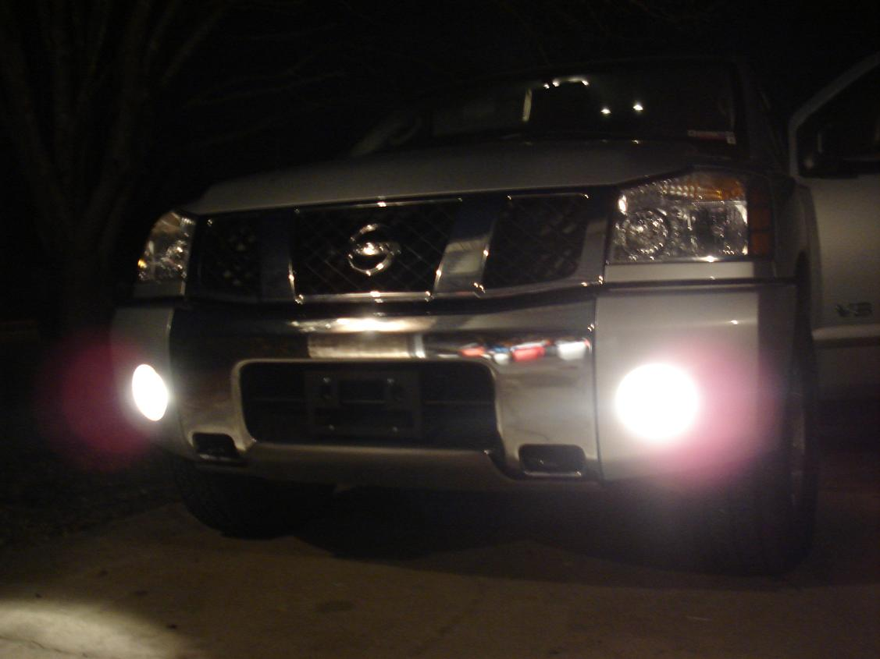
Check and adjust lighting
Fog light checks:
Correct colour (white or yellow)
Globes not blown
Not mounted above level of headlights of vehicle
Operated on separate switch
Dip when high beams are dipped
(Continued)
Notes:
Trainer discusses fog light checks (front and rear):
Correct colour (white or yellow)
Globes not blown
Not mounted above level of headlights of vehicle
Operated on separate switch
Dip when high beams are dipped.
Classroom Activity – Demonstration and Practical
Trainer shows students how to undertake activities listed on the slide and provides an opportunity for them to do the same.

Slide 43

Check and adjust lighting
Do not present a protrusion hazard
Separated by required gap
Do not sit above the bull bar
Forward facing and correctly aligned/focussed
Lenses clean and not tarnished or cracked
After-market lights are tightly connected to vehicle
Notes:
Trainer continues discussing fog light checks:
Do not present a protrusion hazard
Separated by required gap (for example, 600 mm)
Do not sit above the bull bar (where fitted)
Forward facing and correctly aligned/focussed
Lenses clean and not tarnished or cracked
After-market lights are tightly connected to vehicle.
Classroom Activity – Demonstration and Practical
Trainer shows students how to undertake activities listed on the slide and provides an opportunity for them to do the same.

Slide 44
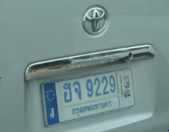
Check and adjust lighting
Number plate light checks:
Correct colour (white)
Operates when lights turned on
Illuminates number plate
Clean globe
Notes:
Trainer discusses number plate light checks (front and rear):
Correct colour (white)
Operates when lights turned on
Illuminates number plate
Clean globe.
Classroom Activity – Demonstration and Practical
Trainer shows students how to undertake activities listed on the slide and provides an opportunity for them to do the same.

Slide 45

Check and adjust lighting
Driving light checks:
Correct colour (white or yellow)
Not mounted above level of headlights
Fitted in pairs
Maximum four
Operated on separate switch
Dip when high beams are dipped
(Continued)
Notes:
Trainer discusses driving light checks:
Correct colour (white or yellow)
Not mounted above level of headlights of vehicle
Fitted in pairs
Maximum four per vehicle
Operated on separate switch
Dip when high beams are dipped.
Classroom Activity – Demonstration and Practical
Trainer shows students how to undertake activities listed on the slide and provides an opportunity for them to do the same.

Slide 46
Check and adjust lighting
Do not present a protrusion hazard
Do not have a separate on/off switch
Do not sit above the bull bar
Forward facing and correctly aimed
Lenses clean and not tarnished or cracked
After-market lights tightly connected to vehicle
Notes:
Trainer continues discussing driving light checks:
Do not present a protrusion hazard
Do not have a separate on/off switch
Do not sit above the bull bar (where fitted)
Forward facing and correctly aligned and aimed
Lenses clean and not tarnished or cracked
After-market lights are tightly connected to vehicle.
Classroom Activity – Demonstration and Practical
Trainer shows students how to undertake activities listed on the slide and provides an opportunity for them to do the same.

Slide 47

Check and adjust lighting
Turning light checks – front and rear, left and right:
Correct colour (yellow or red)
Operate when activated
Clean and clear
Accompanied by audible signal when activated
Notes:
Trainer discusses turning light checks (front and rear, left and right)
Correct colour (yellow or red)
Operate when activated
Clean and clear
Accompanied by audible signal when activated.
Classroom Activity – Demonstration and Practical
Trainer shows students how to undertake activities listed on the slide and provides an opportunity for them to do the same.

Slide 48

Check and adjust lighting
Side marker light checks:
Correct colour (white)
Illuminate when activated
Spaced correctly
Clean and clear
Notes:
Trainer discusses side marker light checks:
Correct colour (white)
Illuminate when activated
Spaced correctly (for example, no less than 400 mm apart)
Clean and clear.
Classroom Activity – Demonstration and Practical
Trainer shows students how to undertake activities listed on the slide and provides an opportunity for them to do the same.

Slide 49

Check and adjust lighting
Brake light checks:
Correct colour (red)
Positioned at correct height
Activated when brake pedal is depressed
Clean and clear
No white light showing
Lenses in good condition
Notes:
Trainer discusses brake light checks:
Correct colour (red)
Positioned at correct height
Activated when brake pedal is depressed
Clean and clear
No white light shows through the red cover of the light
Lenses in good condition.
Classroom Activity – Demonstration and Practical
Trainer shows students how to undertake activities listed on the slide and provides an opportunity for them to do the same.

Slide 50
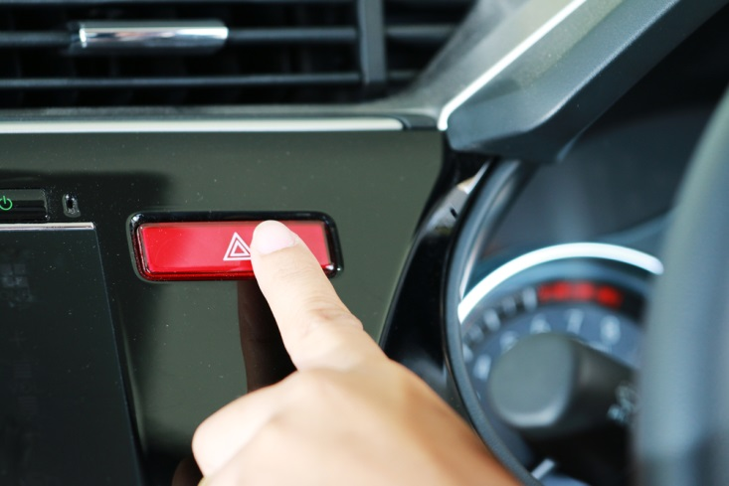
Check and adjust lighting
Hazard warning light checks:
Operate when activated
All globes operational
Accompanied by audible signal when activated
Not incorporated with turn indicators
Clean and clear
Notes:
Trainer discusses hazard warning light checks:
Operate when activated
All globes operational
Accompanied by audible signal when activated
Not incorporated with turn indicators
Clean and clear.
Classroom Activity – Demonstration and Practical
Trainer shows students how to undertake activities listed on the slide and provides an opportunity for them to do the same.

Slide 51

Check and adjust lighting
Reversing light checks:
Activates when reverse gear selected
Not operated by an independent switch
Clean and clear
Activates reversing warning device (where fitted)
Notes:
Trainer discusses reversing light checks:
Activates when reverse gear selected
Not operated by an independent switch
Clean and clear
Activates reversing warning device (where fitted).
Classroom Activity – Demonstration and Practical
Trainer shows students how to undertake activities listed on the slide and provides an opportunity for them to do the same.

Slide 52

Check and adjust lighting
Spotlight checks:
Local regulations are complied with
Light bars are securely attached
No blown globes
Sufficient intensity
Notes:
Trainer discusses spotlight checks:
Local regulations are complied with – there is usually a ban on fitting spotlights to vehicles other than as in compliance with the requirements for driving lights although some tour vehicles may carry hand-held spotlights which run off the vehicle
Light bars are securely attached
No blown globes
Sufficient intensity.
Classroom Activity – Demonstration and Practical
Trainer shows students how to undertake activities listed on the slide and provides an opportunity for them to do the same.

Slide 53

Check and adjust lighting
Rear reflector checks:
Clean and clear
Not discoloured
Not dislodged
In position
Notes:
Trainer discusses rear reflector checks:
These need to be checked to ensure they are clean and have not become discoloured or dislodged
Dirty reflectors need to be cleaned and those which are discoloured or missing must be replaced or tightened.
Classroom Activity – Demonstration and Practical
Trainer shows students how to undertake activities listed on the slide and provides an opportunity for them to do the same.

Slide 54

Check and adjust lighting
Internal vehicle light checks:
Operate when turned on/off
Clean and clear – globes and covers
No blown globes
Notes:
Trainer discusses internal lights checks:
Operate when turned on/off
Clean and clear – globes and covers
No blown globes.
Classroom Activity – Demonstration and Practical
Trainer shows students how to undertake activities listed on the slide and provides an opportunity for them to do the same.

Slide 55
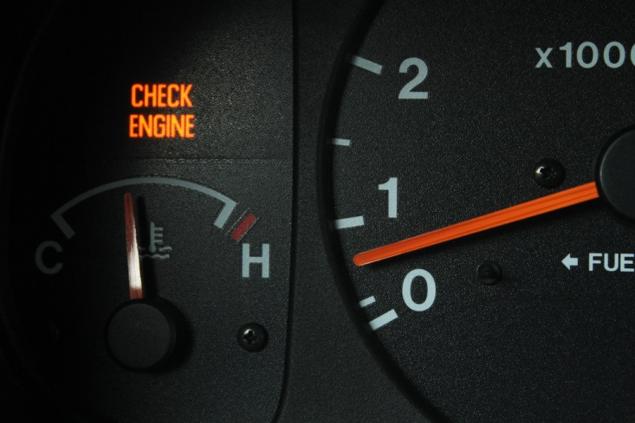
Check and adjust lighting
Dashboard and instrument illumination checks:
Illuminates when lights are activated
Dimming facility operates (where fitted)
Notes:
Trainer discusses dashboard and instrument illumination checks:
Illuminates when lights are activated
Dimming facility operates (where fitted)
Warning (or ‘tell tale’) lights (the owner manual needs to be consulted to ensure there is complete knowledge of all warning lights fitted to the vehicle) – check to ensure, for example:
Seatbelt light and audible warning activates if seat belts are not connected
Dashboard warning activates when hazard warning lights are operated
Turn signal dashboard light illuminates when turn signal used – left and right
Required lights (for example: oil, temperature, brake system, temperature, battery and others) illuminate:
As required
When vehicle is turned on.
Classroom Activity (1) – Demonstration and Practical
Trainer shows students how to undertake activities listed on the slide and provides an opportunity for them to do the same.
Classroom Activity (2) – internet Research
Trainer facilitates research and discussion of:
http://www.2pass.co.uk/dashboard-lights.htm#.VRnnqI6ddh8

Slide 56

Check and adjust lighting
Possible lighting adjustments:
Replace blown globes
Clean lenses and reflectors
Align/focus headlights, driving lights and fog lights as/if required
Replace wiring or re-wire lights as required to conform to requirements
(Continued)
Notes:
Trainer identifies possible lighting adjustments:
Replace blown globes
Clean lenses and reflectors
Align/focus headlights, driving lights and fog lights as/if required
Replace wiring or re-wire lights as required to conform to requirements.
Classroom Activity – Demonstration and Practical
Trainer shows students how to undertake activities listed on the slide and provides an opportunity for them to do the same.

Slide 57
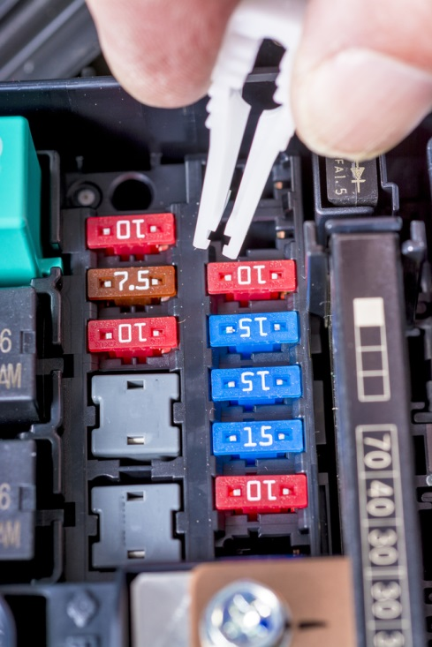
Check and adjust lighting
Replace fuses
Replace wiring
Replace connectors
Tighten loose fittings
Service by an auto-electrician may be required
Notes:
Trainer continues identifying possible lighting adjustments:
Replace fuses
Replace wiring
Replace connectors
Tighten loose fittings.
Technical adjustments may require the services of a qualified auto electrician.
Classroom Activity – Demonstration and Practical
Trainer shows students how to undertake activities listed on the slide and provides an opportunity for them to do the same.

Slide 58

Check and adjust vision-related items
Glazing checks:
No excessive tinting
No crazes, cracks or fractures in driver’s field of vision
Windows/glass are in place
Notes:
Trainer discusses glazing checks:
Tinting is not excessive and permits sufficient light to pass in accordance with local regulations – that is, tinting for front and front-side windows must not be ‘too dark’
There may be no restrictions for:
Passenger windows located rear of the driver
A limited band (say, maximum 10% of the total windscreen) at the top of the windscreen
No cracks, crazes, fractures in field of vision of driver
Windows/glass are in place.
Classroom Activity – Demonstration and Practical
Trainer shows students how to undertake activities listed on the slide and provides an opportunity for them to do the same.

Slide 59
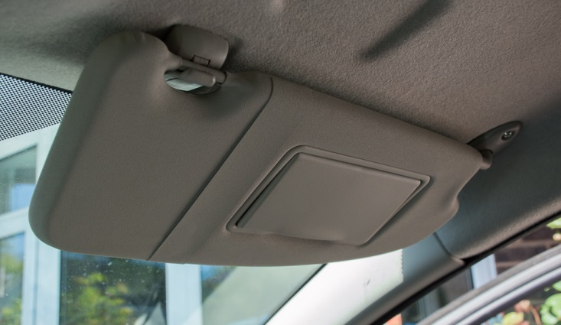
Check and adjust vision-related items
Sun visor checks:
Fully operational
Stay in position
Securely affixed
Additions are clean and secure
Notes:
Trainer discusses sun visor checks:
Fully operational and easy/smooth to use – in terms of:
Flipping down and up
Moving laterally – where appropriate
They will stay in the position required by the user
They are securely affixed to the vehicle
Additions (mirrors, pockets, attachments) are clean and secure.
Classroom Activity – Demonstration and Practical
Trainer shows students how to undertake activities listed on the slide and provides an opportunity for them to do the same.

Slide 60

Check and adjust vision-related items
Windscreen wipers and washing system checks:
Fully functional on all settings
Wipers return to rest position when turned off
Water jets correctly aimed and operating properly
Blades make proper contact with windscreen
Blades in good condition
Notes:
Trainer discusses windscreen wipers and washing system checks:
System is fully functional at all settings – and blades return to their resting position when the system is turned off
Water jets are correctly aimed and of sufficient pressure
Water jets are operating properly and are not blocked or disconnected
Wipers and washers can be operated from the driver’s seat
Blades of the wipers make contact with/sweep only the glass and no other part of the vehicles
Blades are in place and in good condition – that is, they are not dried, cracked or otherwise damaged or defective.
Classroom Activity – Demonstration and Practical
Trainer shows students how to undertake activities listed on the slide and provides an opportunity for them to do the same.

Slide 61

Check and adjust vision-related items
Demister checks:
Operates when activated
Removes interior condensation from windscreen
Notes:
Trainer discusses demister checks:
The demister operates correctly when turned on – and removes condensation from inside the windscreens as required for the individual design and requirements of the vehicle.
Classroom Activity – Demonstration and Practical
Trainer shows students how to undertake activities listed on the slide and provides an opportunity for them to do the same.

Slide 62

Check and adjust vision-related items
Mirror checks:
Provides view of rear of the vehicle from driver’s seat
Securely mounted and able to be adjusted
Reflective surface not cracked, broken or peeled
Primary mirror must be flat but additional curved ones may be fitted
Notes:
Trainer discusses mirror checks:
The rear view mirrors must provide a view of the rear of the vehicle from the driver’s seat
Mirrors must be securely mounted and able to be adjusted
The reflective surface must not be cracked, broken or peeled
The primary rear vision mirror must be flat but additional curved ones may be fitted.
Classroom Activity – Demonstration and Practical
Trainer shows students how to undertake activities listed on the slide and provides an opportunity for them to do the same.

Slide 63

Check and adjust vision-related items
Possible adjustments:
Cleaning
Tightening or re-affixing connections and fixtures
Replacement of faulty or defective items
Professional service by qualified technician to electrical/electronic items
Notes:
Trainer describes adjustments:
Cleaning
Tightening or re-affixing connections and fixtures
Replacement of faulty or defective items
Professional service by qualified technician to electrical/electronic items.
Classroom Activity – Demonstration and Practical
Trainer shows students how to undertake activities listed on the slide and provides an opportunity for them to do the same.

Slide 64

Check and adjust entrances and exits
Items to check:
Vehicle doors
Bonnet and boot
Cargo holds and side-drop doors
Areas allied to entries – steps, ramps, supports
Emergency exits
Notes:
Trainer identifies items which may need to be checked:
The operation of all doors of the vehicle – including:
Hinged doors
Sliding doors
Pneumatic doors
The operation of other opening panels/parts of the vehicle – such as:
Bonnet
Boot
Cargo holds
Side/drop doors
Aspects of the vehicle allied to entrances and exits – such as:
Entry steps
Ramps and hoists
Pneumatic supports – used to keep doors open
Emergency exits.

Slide 65

Check and adjust entrances and exits
Possible checks:
Latches and catches are mounted securely, in good condition and operating correctly
Doors controlled by driver can be opened and closed from driving position
Attachments are secure
Handles and locks operate as required
(Continued)
Notes:
Trainer identifies possible checks:
Ensuring latches and catches are mounted securely, in good condition and operating correctly and effectively as required – every door/opening (left and right, front and back – and top of vehicle, were sun-roofs are fitted) needs to be physically tested
Making sure doors which are controlled by the driver can be opened and closed from the driving position
Checking to make sure all door attachments/fittings and fixtures are securely attached – and do not present a protrusion hazard
Testing and checking the operation of door handles and locks – including the operation of remote opening/locking devices.
Classroom Activity – Demonstration and Practical
Trainer shows students how to undertake activities listed on the slide and provides an opportunity for them to do the same.

Slide 66

Check and adjust entrances and exits
Verifying bonnets hinged at the of bonnet have an effective secondary bonnet mechanism
Making sure gas/pneumatic struts support panels/vehicle sections they are intended to support
Ensuring entrances and exits are free from tripping hazards
Verifying steps are fitted with skid- or slip-resistant covering
(Continued)
Notes:
Trainer continues identifying possible checks:
Verifying bonnets which are hinged at the rear of the bonnet (near the windscreen) have an effective secondary bonnet mechanism (catch or straps) in place – to prevent the bonnet flying up if the primary catch fails
Making sure gas/pneumatic struts support the panels/vehicle sections they are intended to support – and do not allow that area to drop or unintentionally lower slowly or close without notice
Ensuring entrances and exits are free from tripping hazards – such as worn rubber, torn carpet, or lifted seals/strips
Verifying steps are fitted with skid- or slip-resistant covering.
Classroom Activity – Demonstration and Practical
Trainer shows students how to undertake activities listed on the slide and provides an opportunity for them to do the same.

Slide 67

Check and adjust entrances and exits
Checking illumination of steps and lighting of other spaces accessed by doors is functioning correctly
Checking presence and stability of hand rails and hand straps for passengers
Operating devices (steps, ramps, hoists) to determine devices work as required
Notes:
Trainer continues identifying possible checks:
Checking illumination of steps (as/if fitted) and lighting of other spaces accessed by doors is functioning correctly – and there are no blown globes
Checking presence and stability of hand rails and hand straps for passengers – at entrances/exist and at each seat (where provided)
Operating mechanical and pneumatic devices provided on the vehicle (which may include steps, ramps, hoists) – to determine devices work as required (all functions – stop, start, hold, up, down and other as relevant) using all control unit options (such as those in the driving cabin as well as remote or hand-held units.
Classroom Activity – Demonstration and Practical
Trainer shows students how to undertake activities listed on the slide and provides an opportunity for them to do the same.

Slide 68

Check and adjust entrances and exits
Emergency exit checks:
Emergency exits are clearly identified/signed and have clear operating instructions posted
Equipment/items to operate/access the exit are in place – such as tools to break windows
Exits are free from obstructions and physically undamaged
Notes:
Trainer discusses emergency exit checks:
Emergency exits are clearly identified/signed and have clear operating instructions posted
Equipment/items to operate/access the exit are in place – such as tools to break windows
Exits are free from obstructions and physically undamaged.
Classroom Activity – Demonstration and Practical
Trainer shows students how to undertake activities listed on the slide and provides an opportunity for them to do the same.

Slide 69

Check and adjust entrances and exits
Possible adjustments:
Cleaning
Removing obstacles
Greasing and oiling moving parts
Using dry lube for door strikers
(Continued)
Notes:
Trainer presents possible adjustments:
Cleaning
Removing obstacles
Greasing and oiling moving parts
Using dry lube for door strikers.
Classroom Activity – Demonstration and Practical
Trainer shows students how to undertake activities listed on the slide and provides an opportunity for them to do the same.

Slide 70

Check and adjust entrances and exits
Using powdered graphite on door locks
Replacing batteries on remote locking devices/keys
Replacing seals
Changing blown globes
(Continued)
Notes:
Trainer continues presenting possible adjustments:
Using powdered graphite on door locks
Replacing batteries on remote locking devices/keys
Replacing seals
Changing blown globes.
Classroom Activity – Demonstration and Practical
Trainer shows students how to undertake activities listed on the slide and provides an opportunity for them to do the same.

Slide 71

Check and adjust entrances and exits
Re-gassing struts
Providing scheduled maintenance to pneumatic and mechanical devices as prescribed by the manufacturer
Tightening or re-affixing connections and fixtures
Replacing faulty or defective items
Obtaining professional service by qualified technician to mechanical and/or pneumatic items
Notes:
Trainer continues presenting possible adjustments:
Re-gassing struts
Providing scheduled maintenance to pneumatic and mechanical devices as prescribed by the manufacturer
Tightening or re-affixing connections and fixtures
Replacing faulty or defective items
Obtaining professional service by qualified technician to mechanical and/or pneumatic items.
Classroom Activity – Demonstration and Practical
Trainer shows students how to undertake activities listed on the slide and provides an opportunity for them to do the same.

Slide 72

Check and adjust vehicle interior
Seat checks:
Seat anchorage points are not cracked or rusted
No missing parts/fasteners in frames or anchorage points
No exposed/sharp edges or protrusions
Every seat has a seat cushion and backrest
Seat adjustments fully functional and hold required position
Required space in front and between seats
Notes:
Trainer discusses seat checks:
Seat anchorage points are not cracked or rusted
There are no missing parts/fasteners in the seat frames or anchorage points
There are no exposed/sharp edges or protrusions – which may cut/harm people
Every seat has a seat cushion and backrest – and will provide basic/required level of comfort for passengers
Seat adjustments (for example, seat height and angle, lumbar support, position of backrest, forward and rear movement/slides) are fully functional – and hold the designated position as required
Required space around (in front of and in between) seats is provided – in accordance with the type and size of the vehicle as prescribed by relevant transport authority.
Classroom Activity – Demonstration and Practical
Trainer shows students how to undertake activities listed on the slide and provides an opportunity for them to do the same.

Slide 73

Check and adjust vehicle interior
Head restraints checks:
All seats are fitted with a head restraint/head rest
Every head rest is securely fitted and in good condition
Head rests can be adjusted as required and maintain the position they are adjusted to
Notes:
Trainer discusses head restraint checks:
All seats are fitted with a head restraint/head rest
Every head rest is securely fitted and in good condition
Head rests can be adjusted as required – and maintain the position they are adjusted to.
Classroom Activity – Demonstration and Practical
Trainer shows students how to undertake activities listed on the slide and provides an opportunity for them to do the same.

Slide 74

Check and adjust vehicle interior
Aisle checks:
Clear of obstructions
No torn/ripped of frayed carpet
Lights illuminate the aisle
Compliant height for the aisle
Minimum width for the vehicle type is complied with
Notes:
Trainer discusses aisle checks:
It is clear of obstructions
There is no torn/ripped of frayed carpet or floor covering – to present a tripping hazard
Lights illuminate the aisle – where fitted
Compliant height for the aisle – which can vary between bus types (and their use) and can (for example) range from a minimum floor-to-roof height of 1.2 metres (for very small buses) through different measurements up to 1.8 metres for large buses
Minimum width for the vehicle type is complied with – these can range from (for example) 300 mm in a small bus up to 380 mm in a larger bus.
Classroom Activity – Demonstration and Practical
Trainer shows students how to undertake activities listed on the slide and provides an opportunity for them to do the same.

Slide 75
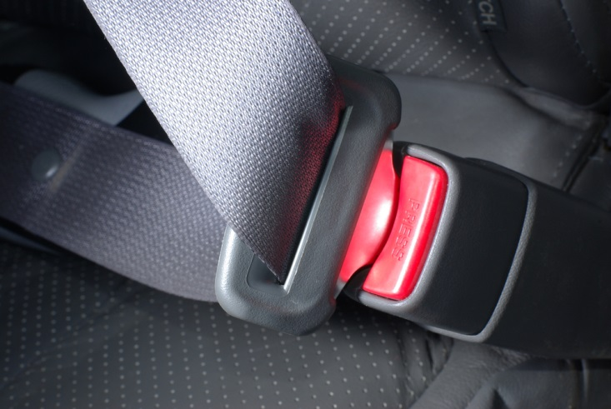
Check and adjust vehicle interior
Seat belt checks:
Seat belt anchorage points are not cracked, damaged, distorted or rusted
No part of the unit is missing
The retractor mechanism, locking mechanism, buckle, tongue or adjustment is working correctly/effectively
Seatbelt webbing is not damaged or defective
Notes:
Trainer discusses seat belt checks:
Seat belt anchorage points are not cracked, damaged, distorted or rusted
No part of the unit is missing
The retractor mechanism, locking mechanism, buckle, tongue or adjustment device is working correctly and effectively
Seatbelt webbing is not:
Damaged
Frayed
Stretched
Tied in a knot
Twisted
Split
Torn
Cut
Altered or modified
Severely deteriorated
Burnt
Not correctly and firmly secured to each end fitting
Has webbing/stitching which is detached at any point.
Classroom Activity – Demonstration and Practical
Trainer shows students how to undertake activities listed on the slide and provides an opportunity for them to do the same.

Slide 76
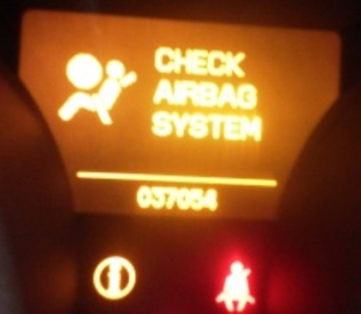
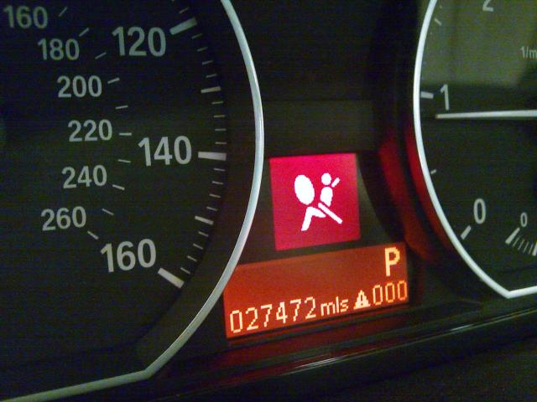
Check and adjust vehicle interior
Air bag checks:
If the warning light for airbags is illuminated and stays lit (or flashes) when the engine is started
If the airbag has been deployed or tampered with
Bull bars fitted have been done such that the effectiveness and operation of the airbags has not been compromised
Relevant seats are correctly positioned
(Continued)
Notes:
Trainer discusses air bag checks:
If the warning light for airbags is illuminated and stays lit (or flashes) when the engine is started – after the system has performed it own self-test
If the airbag has been deployed or tampered with
That bull bars fitted to the vehicle have been done such that the effectiveness and operation of the airbags has not been compromised
Relevant seats are correctly positioned – according to manufacturer’s instructions – there are optimum/recommended positions for driver and passenger seats.
Classroom Activity – Demonstration and Practical
Trainer shows students how to undertake activities listed on the slide and provides an opportunity for them to do the same.

Slide 77

Check and adjust vehicle interior
Vehicles carry necessary advisory signs regarding availability and location of vehicle airbags
Nothing has been attached to the airbag cover
No-one has disconnected the airbags which were supplied with the vehicle
Death and serious injury has resulted from the accidental deployment of airbags during service/maintenance by unqualified persons
Notes:
Trainer continues discussing air bag checks:
Vehicles carry necessary advisory signs regarding availability and location of vehicle airbags
Nothing has been attached to the airbag cover – which could become dangerous projectiles in the event of airbag deployment
No-one has disconnected the airbags which were supplied with the vehicle.
Important note: Death and serious injury has resulted from the accidental deployment of airbags during service/maintenance by unqualified persons.
Classroom Activity – Demonstration and Practical
Trainer shows students how to undertake activities listed on the slide and provides an opportunity for them to do the same.

Slide 78

Check and adjust vehicle interior
Heating and ventilation checks:
Full operational effectiveness of system
No leaks or drips from the system
No collapsed, perished, disconnected or kinked leads or hoses
Windows/roof hatches can be easily opened and closed
No harmful gases are introduced
(Continued)
Notes:
Trainer discusses heating and ventilation checks:
Operational effectiveness of the heating and cooling system:
At all settings
In all sections of the vehicle
From all operator panels
No leaks or drips from the system
No collapsed, perished, disconnected or kinked leads or hoses
Windows and roof hatches can be easily opened and closed
No harmful gases are introduced as a result of any heating or cooling process.
Classroom Activity – Demonstration and Practical
Trainer shows students how to undertake activities listed on the slide and provides an opportunity for them to do the same.

Slide 79

Check and adjust vehicle interior
Temperatures generated are suitable
The demister operates correctly when turned on
No strange noises
Advisory lights illuminate
No air locks in the system
Notes:
Trainer continues discussing heating and ventilation checks:
Temperatures generated are suitable – for the requirements of the business/tour operator
The demister operates correctly when turned on – and removes condensation from inside the windscreens as required for the individual design and requirements of the vehicle
No strange noises – when the system is operated
Advisory lights illuminate (where fitted) – when system activated
No air locks in the system.
Classroom Activity – Demonstration and Practical
Trainer shows students how to undertake activities listed on the slide and provides an opportunity for them to do the same.

Slide 80

Check and adjust vehicle interior
On-board signs and instructions checks:
All required signs are in place
Instructions are in place
Information is legible
Metal signs do not present hazard
Firmly affixed
(Continued)
Notes:
Trainer discusses on-board signs and instructions checks:
All required signs are in place – in the required locations, to indicate for example:
On-board toilets
Fire extinguishers
First aid kits
All instructions are in place – in the required locations, to indicate for example, how to use:
Fire suppression equipment
On-board entertainment and leisure items
Vehicle facilities
Information is legible
Metal signage do present skin penetration hazards
Signs are firmly affixed.
Classroom Activity – Demonstration and Practical
Trainer shows students how to undertake activities listed on the slide and provides an opportunity for them to do the same.

Slide 81

Check and adjust vehicle interior
Audible warning checks:
Is fitted and operational when used
Is sufficiently loud enough
Can be activated easily from the driver’s seat
Produces a continual, single-pitch tone
Notes:
Trainer discusses audible warning checks:
Is fitted and operational when used
Is sufficiently loud enough
Can be activated easily from the driver’s seat
Produces a continual, single-pitch tone.
Classroom Activity – Demonstration and Practical
Trainer shows students how to undertake activities listed on the slide and provides an opportunity for them to do the same.

Slide 82
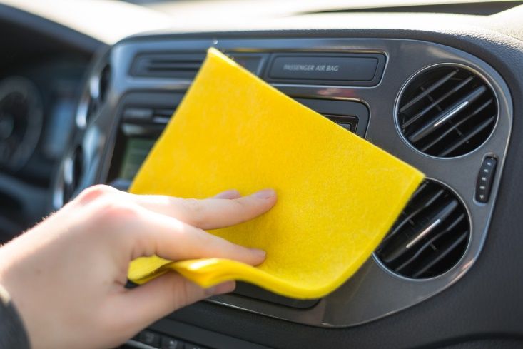
Check and adjust vehicle interior
Possible adjustments:
Cleaning including removing leaves, dirt and debris from component parts
Repairing/replacing torn/damaged seating, carpet, floor coverings and other internal fabrics/coverings
Tightening loose fittings
Replacing deployed or malfunctioning airbags
(Continued)
Notes:
Trainer presents adjustments:
Cleaning including removing leaves, dirt and debris from component parts
Repairing and/or replacing torn/damaged seating, carpet, floor coverings and other internal fabrics/coverings
Tightening loose fittings
Replacing deployed or malfunctioning airbags.
Classroom Activity – Demonstration and Practical
Trainer shows students how to undertake activities listed on the slide and provides an opportunity for them to do the same.

Slide 83
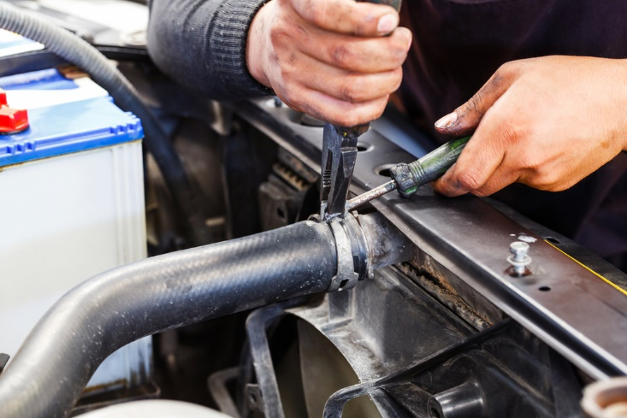
Check and adjust vehicle interior
Replacing worn, faulty or perished hoses and connections
Removing items placed over airbag covers
Replacing seatbelts which have been used when the vehicle was involved in an accident
Draining hoses and units
(Continued)
Notes:
Trainer continues presenting adjustments:
Replacing worn, faulty or perished hoses and connections
Removing items placed over airbag covers
Replacing seatbelts which have been used when the vehicle was involved in an accident
Draining hoses and units.
Classroom Activity – Demonstration and Practical
Trainer shows students how to undertake activities listed on the slide and provides an opportunity for them to do the same.

Slide 84
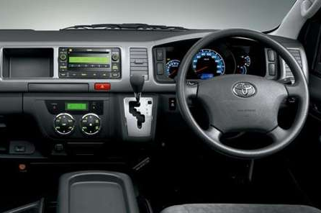
Check and adjust vehicle interior
Re-charging air conditioning units with gas – or making arrangements for same
Re-priming heating systems
Acquiring, replacing and/or (re-) affixing signs
Notes:
Trainer continues presenting adjustments:
Re-charging air conditioning units with gas – or making arrangements for same
Re-priming heating systems
Acquiring, replacing and/or (re-) affixing signs.
Classroom Activity – Demonstration and Practical
Trainer shows students how to undertake activities listed on the slide and provides an opportunity for them to do the same.

Slide 85
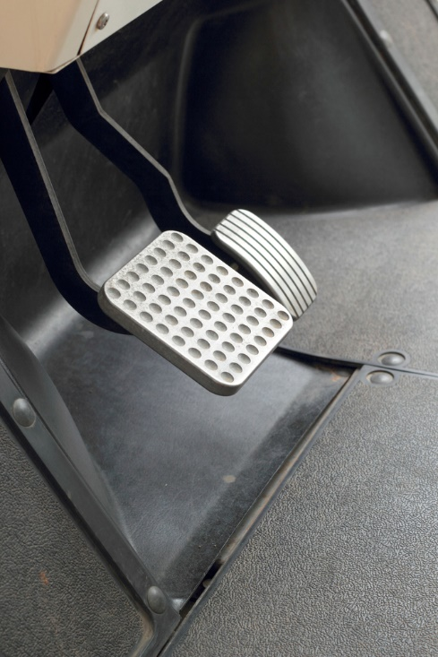
Check and adjust brakes
Brake checks:
Brake pedal is properly covered with rubber
Verify rubber on brake pedal has anti-slip surface
Brake pedal or hand brake is not physically broken
Check travel/height of brake is within specifications
Determine if brake pedal moves towards floor when steady pressure applied for 10 seconds
(Continued)
Notes:
Trainer discusses brake checks:
Ensure brake pedal is properly covered with rubber and there is no metal showing through
Verify rubber on brake pedal has anti-slip surface and that surface is sufficient and in good condition
Ensure the brake pedal or the hand brake is not physically broken
Check the travel/height of the brake pedal when applied and ensure it is within manufacturer specifications – for example, less than 20% travel
Determine if the brake pedal moves to the floor/towards the floor (or if the brake indicator/warning light comes on) when steady pressure is applied for 10 seconds.
Classroom Activity – Demonstration and Practical
Trainer shows students how to undertake activities listed on the slide and provides an opportunity for them to do the same.

Slide 86


Check and adjust brakes
Brake warning light illuminates when engine is turned on
Warning light illuminates when hand brake is applied
Hand brake stays locked in position when applied
Brake pedal and hand brake return to the fully released position when not being used
They slow/stop the vehicle as required (within stated requirements/distances/speeds)
(Continued)
Notes:
Trainer continues discussing brake checks:
Ensure brake warning light illuminates when engine is turned on
Ensure hand brake warning light illuminates when hand brake is applied – and extinguishes when the hand brake is released
Make sure the hand brake stays locked in position when applied
Make sure the brake pedal and the hand brake return to the fully released position when not being used
Test the brakes to ensure they slow/stop the vehicle as required (within stated requirements: that is, within a given distance from a nominated speed – for example, within 11 metres from a speed of 35 kph).
Classroom Activity – Demonstration and Practical
Trainer shows students how to undertake activities listed on the slide and provides an opportunity for them to do the same.

Slide 87
Check and adjust brakes
Inspect pipes, hoses and connections for damage/deterioration
Verify pipes, hoses and connections securely mounted
Inspect looking for signs components are broken, excessively worn, leaking, contaminated
Verify hydraulic lines are sufficient length to allow for full range of steering and suspension movement
Check repairs made to lines have been made in accordance with applicable standards
(Continued)
Notes:
Trainer continues discussing brake checks:
Inspect the brake pipes, hoses and connections for signs of damage or severe deterioration, kinks, crimping, heat damage or visible signs of leakage, swelling or bulging
Inspect the brake pipes, hoses and connections to verify they are securely mounted, and not cracked or broken
Inspect visible brake components looking for signs they are broken, excessively worn, leaking, contaminated or not securely mounted
Verify hydraulic lines are of sufficient length to allow for the full range of steering and suspension movement, and are not twisted
Check any repairs made to hydraulic lines have been made in accordance with applicable standards (for example, they have not been made through heating or welding, and parts used comply with required ratings/standards).
Classroom Activity – Demonstration and Practical
Trainer shows students how to undertake activities listed on the slide and provides an opportunity for them to do the same.

Slide 88
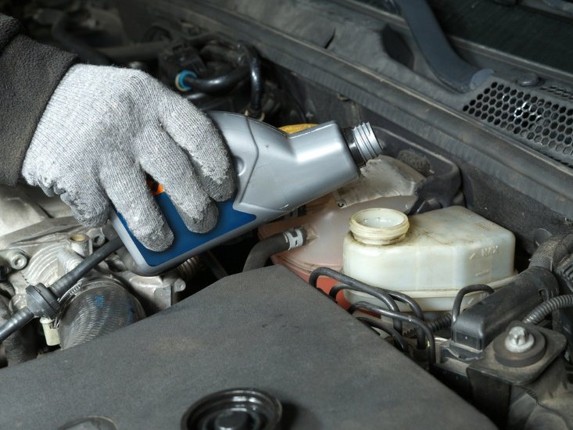
Check and adjust brakes
Verify brake fluid at required level
Check visible brake lining material
Inspect power/vacuum assistance
Check to ensure compressors, vacuum pumps and/or pulley belts are not cracked, loose or worn
Look for evidence of leaks from the system (any joint, component or seal)
Notes:
Trainer continues discussing brake checks:
Check brake fluid and verify it is at required level
Check visible brake lining material to ensure it is worn to less than manufacturers limits or if the limits are not known 0.8mm above bonded shoe or pad mounting surface and level with the rivet or bolt heads on riveted or bolted lining
Inspect power/vacuum assistance for brakes to make sure they are operating properly
Check to ensure compressors, vacuum pumps and/or pulley belts are not cracked, loose or worn
Look for evidence of leaks from the system (any joint, component or seal).
Classroom Activity – Demonstration and Practical
Trainer shows students how to undertake activities listed on the slide and provides an opportunity for them to do the same.

Slide 89

Check and adjust brakes
Trailer brake checks:
Appropriate to weight/size
Visible checks as for vehicle brakes
Test over-ride brakes (and vehicles without them)
Test parking brake
Inspect emergency braking system/brake away braking system
Notes:
Trainer discusses trailer brake checks:
Verify the trailer has brakes which conform to requirements relating to weight/size and year of manufacture
Inspect the visible components of the system – checking:
There are no leaks
Mountings are secure
Cables are operative, effective and in good condition
Wiring for electrical brakes is in good condition
Brake fluid it is at required level
Brake fluid reservoir for hydraulic brakes is appropriately sealed
Brake lines are in good condition – no bulges, leaks, corrosion
All repairs made to hydraulic lines have been made in accordance with applicable standards
No brake component is seized, severely corroded or inoperative or, where visible, is worn beyond manufacturer’s limits
Test trailers fitted with over-ride brakes – by compressing the brake-actuating device and attempting to move the trailer (usually this can only be carried out where a parking brake is fitted to the trailer)
Test parking brake (with towing vehicle in neutral and its brakes off) – where fitted to ensure the trailer cannot move when brake is applied, and the brake stays in the required position
Test trailers fitted with brakes other than override brakes – by attaching the trailer to a tow vehicle, applying the trailer service brake and attempting to move the trailer forward: the brake should stop movement of the trailer
Inspect emergency braking system/brake away braking system – where fitted the emergency braking system/brake away braking system should automatically apply when the trailer is detached from the towing vehicle.
Classroom Activity – Demonstration and Practical
Trainer shows students how to undertake activities listed on the slide and provides an opportunity for them to do the same.

Slide 90

Check and adjust brakes
Possible adjustments:
Replace rubber on the brake pedal
Replace broken, damaged, defective, worn or suspect parts
Take the vehicle to an auto electrician to have electrical/warning light problems fixed
Top-up brake fluid
(Continued)
Notes:
Trainer presents adjustments:
Replace rubber on the brake pedal
Replace broken, damaged, defective, worn or suspect parts – as opposed to repairing them
Take the vehicle to an auto electrician – to have electrical/warning light problems or frayed electrical wiring replaced/fixed
Top-up brake fluid.
Classroom Activity – Demonstration and Practical
Trainer shows students how to undertake activities listed on the slide and provides an opportunity for them to do the same.

Slide 91

Check and adjust brakes
Replace leaking seals using required kits
Arrange for, or perform, machining and/or re-conditioning of brake drums and brake disc rotors
Adjust the hand brake – which may require renewing cables
Replace brake pads (disc brakes) or shoes (drum brakes)
(Continued)
Notes:
Trainer continues presenting adjustments:
Replace leaking seals using required kits
Arrange for, or perform, machining and/or re-conditioning of brake drums and brake disc rotors
Adjust the hand brake – which may require renewing cables
Replace brake pads (disc brakes) or shoes (drum brakes).
Classroom Activity – Demonstration and Practical
Trainer shows students how to undertake activities listed on the slide and provides an opportunity for them to do the same.

Slide 92
Check and adjust brakes
Replace the brake fluid (bleed the brakes and re-fill the system)
Replace wheel cylinder (drum brakes)
Replace the master cylinder and servo unit
Replace brake hoses
Adjust disc brakes
Notes:
Trainer continues presenting adjustments:
Replace the brake fluid (bleed the brakes and re-fill the system)
Replace wheel cylinder (drum brakes)
Replace the master cylinder and servo unit
Replace brake hoses
Adjust disc brakes.
Classroom Activity – Demonstration and Practical
Trainer shows students how to undertake activities listed on the slide and provides an opportunity for them to do the same.

Slide 93
Check and adjust steering
Steering checks:
With engine running check operation of steering wheel:
No excessive play in steering wheel
No structural damage
No loose attachments
Airbags have not been deployed
Steering wheel firmly attached
(Continued)
Notes:
Trainer presents steering checks:
With the engine running, check the operation of the steering by moving the steering wheel – to ensure:
There is here is no more than 50 mm rotational free play in the wheel
The steering wheel is free from structural damage
Any accessories fitted to steering wheels (padded hubs, covers etc.) are not loose
The steering wheel is securely attached to the steering column
Where a SRS airbag is fitted, there is any evidence airbags or other SRS system are operative: check the indicator light, where fitted - this usually illuminates when the ignition is first switched “on” and extinguishes after the system passes a self-test.
Classroom Activity – Demonstration and Practical
Trainer shows students how to undertake activities listed on the slide and provides an opportunity for them to do the same.

Slide 94

Check and adjust steering
Visually inspect under bonnet and vehicle:
No missing, damaged/defective components
No non-compliant repairs
No missing or insecure nuts, bolts or locking devices
Secure tie rod and drag link ends
No movement in steering column spline
(Continued)
Notes:
Trainer continues presenting steering checks:
Visually inspect all steering components under the bonnet and under the vehicle – to ensure:
No steering component is missing, cracked or broken or is worn beyond manufacturer’s limits
No steering component can be seen to have been repaired or modified by bending, heating or welding (unless in accordance with manufacturer’s specifications)
No nut, bolt or locking device is missing or insecure
Tie rod and drag link ends are secured in both the rod and taper with fasteners suitably locked (e.g. split pins, lock-wire, tabs or self locking nuts)
There is no movement on the spline between Pitman arm and the steering box or between any thread or tapered joint.
Classroom Activity – Demonstration and Practical
Trainer shows students how to undertake activities listed on the slide and provides an opportunity for them to do the same.

Slide 95
Check and adjust steering
No free play in any steering component exceeding specifications
No power steering leaks
Steering components secure
No loose, defective or missing belts
(Continued)
Notes:
Trainer continues presenting steering checks:
(Continued) With the engine running, check the operation of the steering by moving the steering wheel – to ensure:
No free play due to wear in any steering component which exceeds manufacturer’s specification (if that specification is not known, free play exceeds 3 mm)
Power steering has no leaks, no defects and is not inoperative
Any manual or power steering componentry is securely mounted and free from excessive side or end play, roughness, or binding
Power steering belts are not loose, broken, frayed, missing, or cracked through to reinforcing plies.
Classroom Activity – Demonstration and Practical
Trainer shows students how to undertake activities listed on the slide and provides an opportunity for them to do the same.

Slide 96
Check and adjust steering
Check anti-theft/steering lock:
Ignition key cannot be removed in any position except lock position
When engaged, anti-theft lock prevents at least one of the following:
Steering the vehicle
Engaging the forward drive gears
Release of the brakes
Notes:
Trainer continues presenting steering checks:
Check the operation of the anti-theft/steering lock – to ensure:
The ignition key cannot be removed in any position except the “anti-theft” (lock) position
When engaged, the anti-theft lock prevents at least one of the following actions:
Steering the vehicle
Engaging the forward drive gears
Release of the brakes.
Classroom Activity (1) – Demonstration and Practical
Trainer shows students how to undertake activities listed on the slide and provides an opportunity for them to do the same.
Classroom Activity (2) – internet Research
Trainer facilitates research and discussion of:
http://www.howacarworks.com/steering

Slide 97

Check and adjust steering
Possible adjustments:
Arrange for professional where serious issues are identified or airbags need attention
Replace worn/loose steering wheel covers
Replace damaged steering wheels
Tighten nuts, bolts, connections, fasteners and steering wheel accessories
(Continued)
Notes:
Trainer presents adjustments:
Arrange for professional repairs to be made where serious issues are identified and/or where work involving airbags needs to be done
Replace worn/loose steering wheel covers
Replace damaged steering wheels
Tighten nuts, bolts, connections, fasteners and steering wheel accessories.
Classroom Activity – Demonstration and Practical
Trainer shows students how to undertake activities listed on the slide and provides an opportunity for them to do the same.

Slide 98
Check and adjust steering
Replace defective/leaking seals
Replace missing, cracked, broken or excessively worn components
Top-up power steering fluid
Secure tie rod and drag link ends
Replace defective hoses, pipes and drive belts
(Continued)
Notes:
Trainer continues presenting adjustments:
Replace defective/leaking seals
Replace missing, cracked, broken or excessively worn components
Top-up power steering fluid
Secure tie rod and drag link ends where required
Replace defective/damaged hoses, pipes and drive belts.
Classroom Activity – Demonstration and Practical
Trainer shows students how to undertake activities listed on the slide and provides an opportunity for them to do the same.

Slide 99
Check and adjust steering
Adjust and replace power steering drive belt
Adjust toe alignment on wheels
Lubricate steering swivel joints
Replace track rods and (track rod end) ball joints
Set the tracking
Notes:
Trainer continues presenting adjustments:
Adjust and replace power steering drive belt
Adjust toe alignment on wheels
Lubricate steering swivel joints
Replace track rods and (track rod end) ball joints
Set the tracking.
Classroom Activity – Demonstration and Practical
Trainer shows students how to undertake activities listed on the slide and provides an opportunity for them to do the same.

Slide 100

Check and adjust exhaust
Checks include:
There are no visible cracks
The system is securely mounted
An effective silencer if fitted and operational with all exhaust gases passing through it
(Continued)
Notes:
Trainer discusses exhaust checks:
There are no visible cracks
The system is securely mounted – across its entyre length
An effective silencer if fitted and operational with all exhaust gases passing through it – so vehicle noise is not excessive in accordance with local regulations/mandated noise levels.
Classroom Activity – Demonstration and Practical
Trainer shows students how to undertake activities listed on the slide and provides an opportunity for them to do the same.

Slide 101
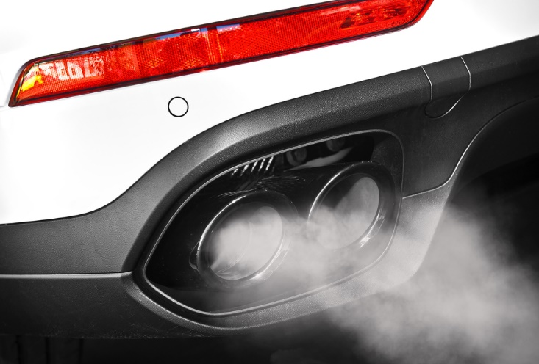
Check and adjust exhaust
Outlet of the exhaust pipe is to the rear of passenger side doors and opening windows
Exhaust discharges to rear or correct side
No leaks, holes or corrosion in the system
(Continued)
Notes:
Trainer continues discussing exhaust checks:
Outlet of the exhaust pipe is to the rear of passenger side doors and opening windows
Exhaust discharges:
Rear of vehicle
To the correct side of the vehicle (left or right) depending on which side of the road the vehicle is driven on – fumes/exhaust must not be directed at footpath-side
No leaks, holes or corrosion in the system – apart from intentional drain holes provided by manufacturers in mufflers.
Classroom Activity – Demonstration and Practical
Trainer shows students how to undertake activities listed on the slide and provides an opportunity for them to do the same.

Slide 102

Check and adjust exhaust
Exhaust pipe exit extends beyond the vehicle body but not beyond the overall plan of the vehicle
System does not interfere with or obstruct any part of the steering, suspension, brake or fuel system
Entyre system at lowest points clears the road surface by the required distance
(Continued)
Notes:
Trainer continues discussing exhaust checks:
The exhaust pipe exit extends beyond the vehicle body but not beyond the overall plan of the vehicle – so the pipe does not end under the body but extends to under the rear bumper bar
The system does not interfere with or obstruct any part of the steering, suspension, brake or fuel system
The entyre system at its lowest points clears the road surface by the required distance – for example, 100 mm.
Classroom Activity – Demonstration and Practical
Trainer shows students how to undertake activities listed on the slide and provides an opportunity for them to do the same.

Slide 103
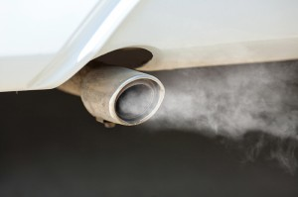
Check and adjust exhaust
Exhaust does not let out sparks, flames, excessive gases, oil or fuel residue
No visual emissions from the exhaust for longer than 10 seconds after engine started
Where fitted, emission control equipment is all present and fully operational
LPG fuel lines are separated from exhaust components by the required distance or protected by shield and separated by a lesser distance
Notes:
Trainer continues discussing exhaust checks:
The exhaust does not let out sparks, flames, excessive gases, oil or fuel residue
No visual emissions from the exhaust for longer than 10 seconds after the engine has been started
Where fitted, emission control equipment is all present and fully operational
LPG fuel lines are separated from exhaust components by the required distance (say 150 mm) and/or protected by a shield and separated by a lesser distance, say 50 mm.
Classroom Activity (1) – Demonstration and Practical
Trainer shows students how to undertake activities listed on the slide and provides an opportunity for them to do the same.
Classroom Activity (2) – internet Research
Trainer facilitates research and discussion of page 6 of:
https://www.vicroads.vic.gov.au/searchresultpage?q=toadworthiness%20requirements

Slide 104

Check and adjust exhaust
Possible adjustments:
Replacing seals
Replacing mountings
Replacing damaged, sub-standard and defective parts – rather than repairing them, or patching leaks/holes
(Continued)
Notes:
Trainer presents possible adjustments:
Replacing seals
Replacing mountings
Replacing damaged, sub-standard and defective parts – rather than repairing them, or patching leaks/holes.
Classroom Activity – Demonstration and Practical
Trainer shows students how to undertake activities listed on the slide and provides an opportunity for them to do the same.

Slide 105
Check and adjust exhaust
Attaching missing parts/components
Re-routing the system – to comply with legally imposed requirements
Tuning the vehicle
Notes:
Trainer continues presenting possible adjustments:
Attaching missing parts/components
Re-routing the system – to comply with legally imposed requirements
Tuning the vehicle.
Classroom Activity – Demonstration and Practical
Trainer shows students how to undertake activities listed on the slide and provides an opportunity for them to do the same.

Slide 106

Check and adjust towing connections
Checks include:
There are no cracks or other visible physical damage in any part of the towing attachment
The towing attachment is secure/not loose
Towing bar is fastened securely to the vehicle
No visible corrosion on bolts/any part of the towing connection
(Continued)
Notes:
Trainer discusses towing connection checks:
There are no cracks or other visible physical damage in any part of the towing attachment
The towing attachment is secure/not loose
Towing bar is fastened securely to the vehicle
No visible corrosion on bolts/any part of the towing connection.
Classroom Activity – Demonstration and Practical
Trainer shows students how to undertake activities listed on the slide and provides an opportunity for them to do the same.

Slide 107
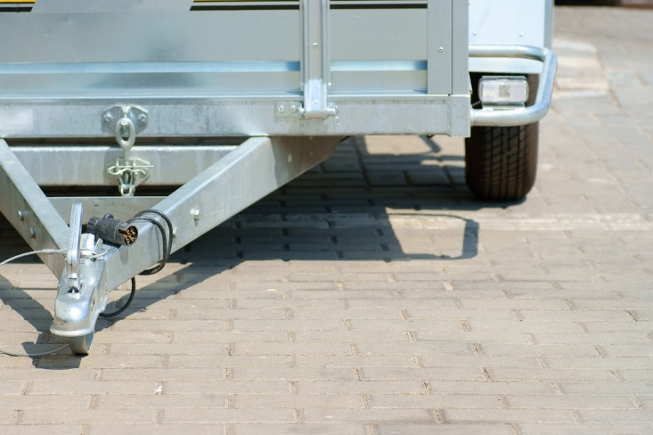
Check and adjust towing connections
Towing connection is suitable for the weight to be towed
No temporary repairs or welds
Electrical wiring, couplings and connectors are securely fastened and in good condition
An effective secondary locking system for the trailer
(Continued)
Notes:
Trainer continues discussing towing connection checks:
Towing connection is suitable for the weight to be towed – and the vehicle displays (where and as required) an appropriate label to this effect
No temporary repairs or welds (especially where drawbar is marked ‘Do Not Weld’ by the manufacturer) have been made to the connection
Electrical wiring, couplings and connectors are securely fastened and in good condition
An effective secondary locking system for the trailer.
Classroom Activity – Demonstration and Practical
Trainer shows students how to undertake activities listed on the slide and provides an opportunity for them to do the same.

Slide 108
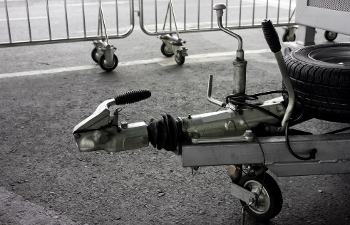
Check and adjust towing connections
Tow-ball assembly is securely attached
Safety chains in good condition – and:
Can be affixed so cannot be accidentally detached
Are securely attached to the drawbar
Safety chains are rated for weight to be drawn and in required number
All required parts of detachable tow units are present
Jockey wheel in position, firmly attached, functional
Notes:
Trainer continues discussing towing connection checks:
Tow-ball assembly is securely attached
Safety chains and/or cables are in good condition – and:
Can be affixed so they cannot be accidentally detached
Are securely attached to the drawbar
Safety chains are rated for the weight to be drawn – and in the required number
All required parts of detachable tow units are in position/present in the assembly
Jockey wheel is in position, firmly attached and fully functional.
Classroom Activity – Demonstration and Practical
Trainer shows students how to undertake activities listed on the slide and provides an opportunity for them to do the same.

Slide 109

Check and adjust towing connections
Possible adjustments:
Replacing defective parts
Removing un-rated chains and replacing them with chains which are stamped and correctly rated
Cleaning and greasing the jockey wheel
Notes:
Trainer presents possible adjustments:
Replacing defective parts – rather than repairing them
Removing un-rated chains and replacing them with chains which are stamped and correctly rated – for the intended towing weight
Cleaning and greasing the jockey wheel.
Classroom Activity – Demonstration and Practical
Trainer shows students how to undertake activities listed on the slide and provides an opportunity for them to do the same.

Slide 110
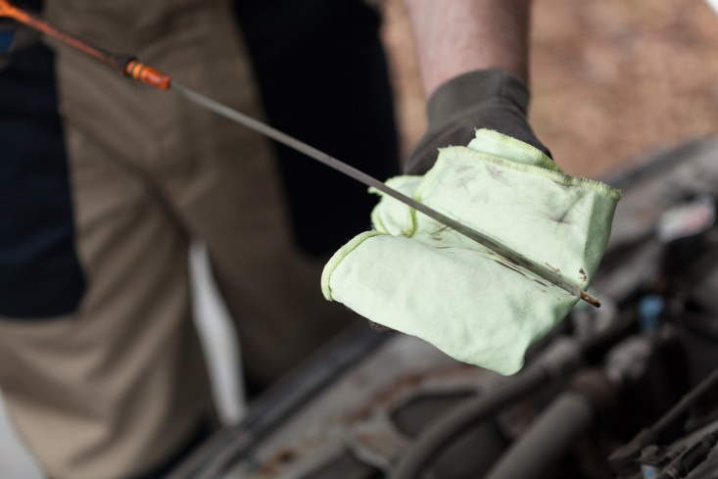
Check and adjust miscellaneous items
Engine and fuel system checks include:
Checking colour and viscosity of the engine oil
Checking date/odometer reading for timing for draining and replacing engine oil
Checking level of oil in the engine
Checking the oil pump
(Continued)
Notes:
Trainer discusses engine and fuel system checks:
Checking condition (colour and viscosity) of the engine oil
Checking date/odometer reading for timing for draining and replacing engine oil
Checking level of oil in the engine
Checking the oil pump.

Slide 111

Check and adjust miscellaneous items
Checking the fuel pump
Checking for leaks/evidence of leaks
Checking condition of oil filters
Checking overhead valves/clearances
(Continued)
Notes:
Trainer continues discussing engine and fuel system checks:
Checking the fuel pump
Checking for leaks/evidence of leaks
Checking condition of oil filters
Checking overhead valves/clearances.
Classroom Activity – Demonstration and Practical
Trainer shows students how to undertake activities listed on the slide and provides an opportunity for them to do the same.

Slide 112
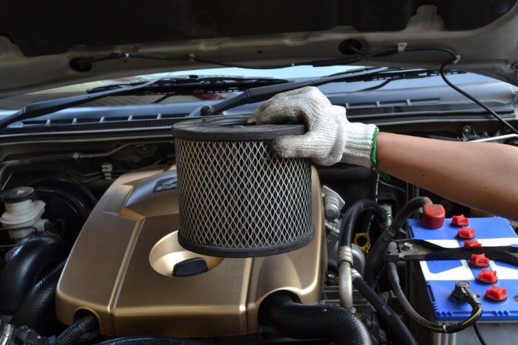
Check and adjust miscellaneous items
Checking condition of air filters
Checking carburettor/s
Checking the points
Checking condition of the distributor and its operation
(Continued)
Notes:
Trainer continues discussing engine and fuel system checks:
Checking condition of air filters
Checking carburettor/s
Checking the points
Checking condition of the distributor and its operation.
Classroom Activity – Demonstration and Practical
Trainer shows students how to undertake activities listed on the slide and provides an opportunity for them to do the same.

Slide 113

Check and adjust miscellaneous items
Checking spark plugs, gaps and distributor leads
Checking idle speed of the motor
Ensuring required grade of oil is being used according to manufacturer recommendations
Checking fuel lines/fuel delivery pipes and clips and connections
Notes:
Trainer continues discussing engine and fuel system checks:
Checking spark plugs, gaps and distributor leads
Checking idle speed of the motor
Ensuring required grade of oil is being used according to manufacturer recommendations (who usually provide a chart for determining the grade of oil to use under different conditions) and intended use of the vehicle:
SAE 10 is thin
SAE 50 is thick
Some are blended/multi-grade: such as 20W/50
Checking fuel lines/fuel delivery pipes and clips and connections.
Classroom Activity (1) – Demonstration and Practical
Trainer shows students how to undertake activities listed on the slide and provides an opportunity for them to do the same.
Classroom Activity (2) – internet Research
Trainer facilitates research and discussion of:
http://www.nairaland.com/1054692/knowledge-101-which-engine-oil

Slide 114
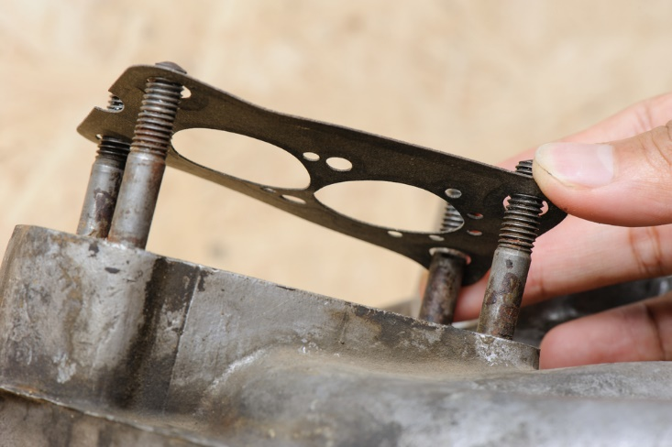
Check and adjust miscellaneous items
Possible adjustments – engine and fuel system:
Taking action to stop/prevent leaks
Replacing gaskets and oil seals
Topping up engine oil
Changing engine oil
(Continued)
Notes:
Trainer presents possible adjustments:
Taking action to stop/prevent leaks
Replacing gaskets and oil seals
Topping up engine oil
Changing engine oil.
Classroom Activity – Demonstration and Practical
Trainer shows students how to undertake activities listed on the slide and provides an opportunity for them to do the same.

Slide 115
Check and adjust miscellaneous items
Changing oil and/or fuel filters
Replacing oil and/or fuel pumps
Cleaning or replacing air filters
Replacing points
(Continued)
Notes:
Trainer continues presenting possible adjustments:
Changing oil and/or fuel filters
Replacing oil and/or fuel pumps
Cleaning or replacing air filters
Replacing points.
Classroom Activity – Demonstration and Practical
Trainer shows students how to undertake activities listed on the slide and provides an opportunity for them to do the same.

Slide 116

Check and adjust miscellaneous items
Cleaning, adjusting and/or fitting kits to carburettors
Replacing exhaust manifold gaskets
Adjusting the tappets/re-set clearances
Adjusting camshaft timing belt
(Continued)
Notes:
Trainer continues presenting possible adjustments:
Cleaning, adjusting and/or fitting kits to carburettors
Replacing exhaust manifold gaskets
Adjusting the tappets/re-set clearances
Adjusting camshaft timing belt.
Classroom Activity – Demonstration and Practical
Trainer shows students how to undertake activities listed on the slide and provides an opportunity for them to do the same.

Slide 117
Check and adjust miscellaneous items
Replacing suspect/damaged hoses
Replacing plugs, cleaning plugs and/or adjusting gaps
Adjusting the ignition timing
(Continued)
Notes:
Trainer continues presenting possible adjustments:
Replacing suspect/damaged hoses
Replacing plugs, cleaning plugs and/or adjusting gaps
Adjusting the ignition timing.
Classroom Activity – Demonstration and Practical
Trainer shows students how to undertake activities listed on the slide and provides an opportunity for them to do the same.

Slide 118

Check and adjust miscellaneous items
Changing fuel mix
Replacing distributor cap and rotor
Tuning the motor
Replacing fuel lines, clips and connections
Notes:
Trainer continues presenting possible adjustments:
Changing fuel mix
Replacing distributor cap and rotor
Tuning the motor
Replacing fuel lines, clips and connections.
Classroom Activity – Demonstration and Practical
Trainer shows students how to undertake activities listed on the slide and provides an opportunity for them to do the same.

Slide 119

Check and adjust miscellaneous items
Transmission checks:
Checking gearbox oil level
Checking axle oil
Looking for leaks
(Continued)
Notes:
Trainer discusses transmission checks:
Checking gearbox oil level
Checking axle oil
Looking for leaks.
Classroom Activity – Demonstration and Practical
Trainer shows students how to undertake activities listed on the slide and provides an opportunity for them to do the same.

Slide 120
Check and adjust miscellaneous items
Checking automatic transmission fluid level and colour
Testing automatic transmission inhibitor switch
Checking clutch cable and linkages
Notes:
Trainer continues discussing transmission checks:
Checking automatic transmission fluid level and colour
Testing automatic transmission inhibitor switch
Checking clutch cable and linkages.
Classroom Activity – Demonstration and Practical
Trainer shows students how to undertake activities listed on the slide and provides an opportunity for them to do the same.

Slide 121
Check and adjust miscellaneous items
Possible transmission adjustments:
Taking action to stop/prevent leaks
Draining and re-filling gearbox
Replacing transmission oil seals
(Continued)
Notes:
Trainer presents adjustments to transmissions:
Taking action to stop/prevent leaks
Draining and re-filling gearbox
Replacing transmission oil seals.
Classroom Activity – Demonstration and Practical
Trainer shows students how to undertake activities listed on the slide and provides an opportunity for them to do the same.

Slide 122
Check and adjust miscellaneous items
Changing rear axle oil/axle oil
Topping-up or changing automatic transmission fluid
Adjusting free-play in, or replacing, the clutch cable
Notes:
Trainer continues presenting adjustments to transmissions:
Changing rear axle oil/axle oil
Topping-up or changing automatic transmission fluid
Adjusting free-play in, or replacing, the clutch cable.
Classroom Activity – Demonstration and Practical
Trainer shows students how to undertake activities listed on the slide and provides an opportunity for them to do the same.

Slide 123
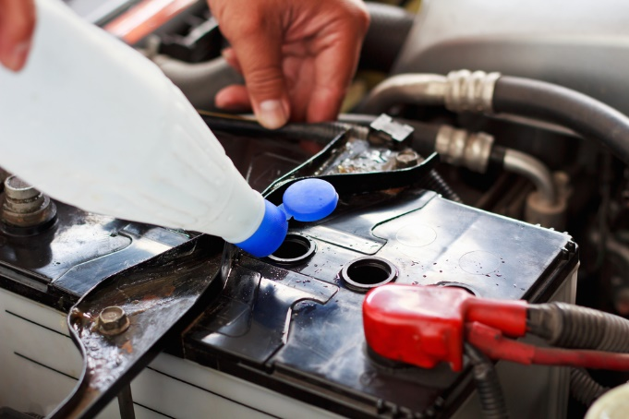
Check and adjust miscellaneous items
Electrical wiring checks:
Testing operation of all electrical items on the vehicle
Visually inspecting visible wiring for scorch or rub marks, exposed wiring or loose or missing connections
Using multi-meter to check current, voltage and resistance readings
Checking battery water level
Checking battery charge
(Continued)
Notes:
Trainer discusses electrical wiring checks:
Testing operation of all electrical items on the vehicle
Visually inspecting all visible wiring looking for scorch or rub marks, exposed wiring or loose or missing connections
Using multi-meter to check current, voltage and resistance readings
Checking battery water level
Checking battery charge.
Classroom Activity – Demonstration and Practical
Trainer shows students how to undertake activities listed on the slide and provides an opportunity for them to do the same.

Slide 124
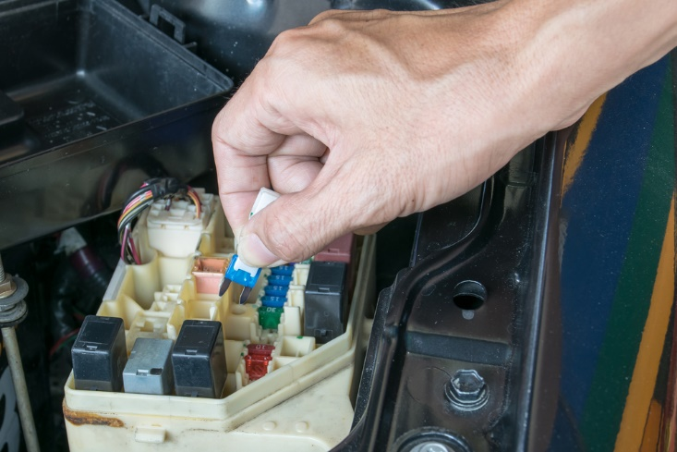
Check and adjust miscellaneous items
Checking battery leads, posts and connections
Checking alternator drive belts/pulleys
Checking brackets and mountings
Checking fuses
Ensuring required spare fuses are in place
Notes:
Trainer continues discussing electrical wiring checks:
Checking battery leads, posts and connections
Checking alternator drive belts/pulleys
Checking brackets and mountings
Checking fuses
Ensuring required spare fuses are in place.
Classroom Activity – Demonstration and Practical
Trainer shows students how to undertake activities listed on the slide and provides an opportunity for them to do the same.

Slide 125

Check and adjust miscellaneous items
Possible wiring adjustments:
Re-wiring the vehicle
Topping up battery water with distilled water
Cleaning terminals and points
Charging and/or replacing batteries
Replacing defective components
Relacing fuses
Notes:
Trainer presents electrical wiring adjustments:
Re-wiring the vehicle
Topping up battery water with distilled water
Cleaning terminals and points
Charging and/or replacing batteries
Replacing defective components
Relacing fuses.
Classroom Activity – Demonstration and Practical
Trainer shows students how to undertake activities listed on the slide and provides an opportunity for them to do the same.

Slide 126
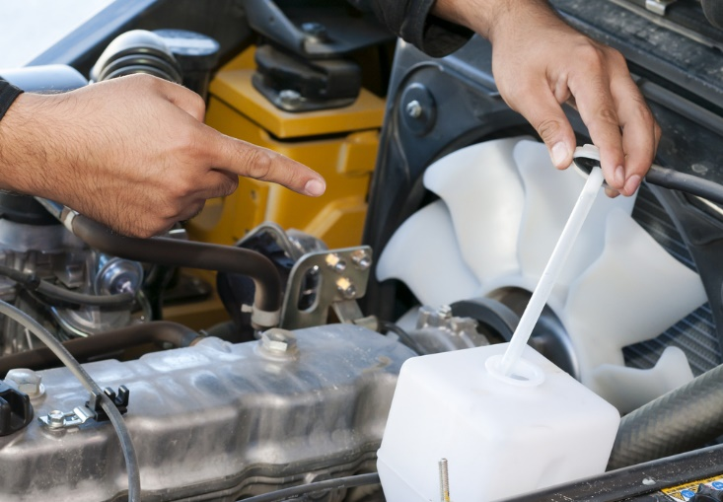
Check and adjust miscellaneous items
Water checks:
Checking level of radiator water
Checking water in windscreen washer reservoir
Checking radiator hoses and connections
Checking radiator cap
(Continued)
Notes:
Trainer discusses water checks:
Checking level of radiator water
Checking water in windscreen washer reservoir
Checking radiator hoses and connections
Checking radiator cap.
Classroom Activity – Demonstration and Practical
Trainer shows students how to undertake activities listed on the slide and provides an opportunity for them to do the same.

Slide 127

Check and adjust miscellaneous items
Checking water pump
Inspecting for leaks and evidence of leaks
Ensuring spare water containers in vehicles are full
Checking operating temperature of engine
Notes:
Trainer continues discussing water checks:
Checking water pump
Inspecting for leaks and evidence of leaks
Ensuring spare water containers in vehicles are full
Checking operating temperature of engine.
Classroom Activity – Demonstration and Practical
Trainer shows students how to undertake activities listed on the slide and provides an opportunity for them to do the same.

Slide 128
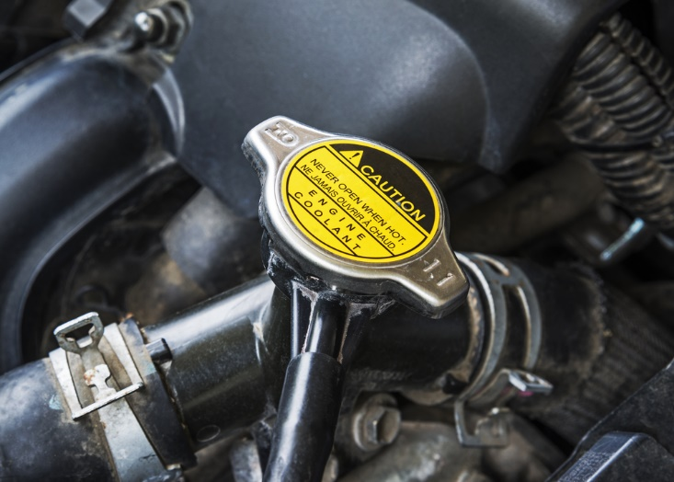
Check and adjust miscellaneous items
Possible water adjustments:
Topping up water to required levels
Adding detergent to windscreen washer water
Flushing radiator
Removing and replacing radiator
(Continued)
Notes:
Trainer presents water adjustments:
Topping up water to required levels
Adding detergent to windscreen washer water
Flushing radiator
Removing and replacing radiator.
Classroom Activity – Demonstration and Practical
Trainer shows students how to undertake activities listed on the slide and provides an opportunity for them to do the same.

Slide 129

Check and adjust miscellaneous items
Draining and re-filling sealed systems
Replacing water pump
Arranging for re-coring of radiator
Replacing thermostat
Adding cooling system additives, if/where required
Notes:
Trainer continues presenting water adjustments:
Draining and re-filling sealed systems
Replacing water pump
Arranging for re-coring of radiator
Replacing thermostat
Adding cooling system additives, if/where required.
Classroom Activity – Demonstration and Practical
Trainer shows students how to undertake activities listed on the slide and provides an opportunity for them to do the same.

Slide 130
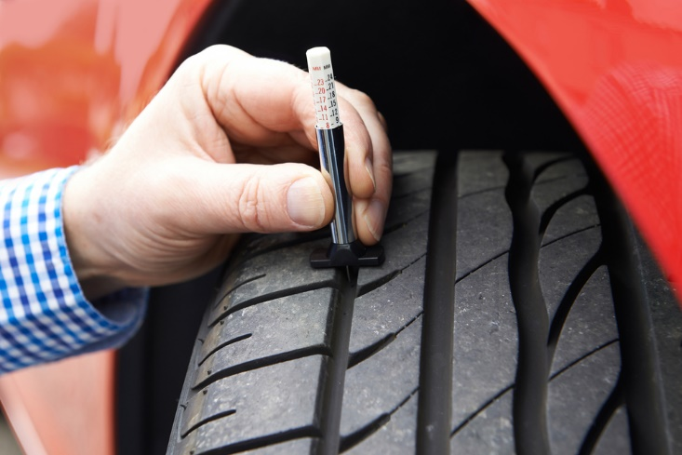
Check and adjust miscellaneous items
Tyre checks:
Checking general condition and wear on each on-road tyre plus spare including condition of sidewalls
Inspecting condition of wheels and rims
Checking tyre pressures
Testing valves for leaks
(Continued)
Notes:
Trainer discusses tyre checks:
Checking general condition and wear on each on-road tyre plus the spare tyre, including condition of sidewalls
Inspecting condition of wheels and rims
Checking tyre pressures
Testing valves for leaks.
Classroom Activity (1) – Demonstration and Practical
Trainer shows students how to undertake activities listed on the slide and provides an opportunity for them to do the same.
Classroom Activity (2) – internet Research
Trainer facilitates research and discussion of:
http://www.howacarworks.com/wheels-and-tyres/avoiding-tyre-wear - Avoiding tyre wear

Slide 131

Check and adjust miscellaneous items
Verifying all tyres are same tread pattern
Verifying all tyres are correct size
Verifying all tyres have sufficient tread
Verifying all tyres are suitably rated for required loads and speeds
(Continued)
Notes:
Trainer continues discussing tyre checks:
Verifying all tyres are of the same tread pattern
Verifying all tyres are the correct size
Verifying all tyres have sufficient tread
Verifying all tyres are suitably rated for required loads and speeds – according to tyre manufacturer charts.
Classroom Activity – Demonstration and Practical
Trainer shows students how to undertake activities listed on the slide and provides an opportunity for them to do the same.

Slide 132

Check and adjust miscellaneous items
Tyre checks:
Testing any on-board compressors or manual or foot-operated pumps
Ensuring on-board tyre repair kits are present and fully stocked
Notes:
Trainer continues discussing tyre checks:
Testing any on-board compressors or manual or foot-operated pumps loaded onto tour vehicles – to:
Verify proper operation
Compare pressure shown on gauges against pressure shown on workshop tyre pressure gauge
Ensuring on-board tyre repair kits are present and fully stocked.
Classroom Activity – Demonstration and Practical
Trainer shows students how to undertake activities listed on the slide and provides an opportunity for them to do the same.

Slide 133
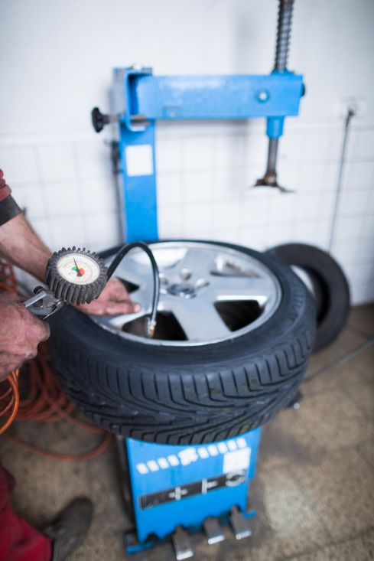
Check and adjust miscellaneous items
Possible tyre adjustments:
Make necessary arrangements with tyre specialists
Re-fit valves
Inflate or reduce pressures as required
Clean tyres and wheels, removing mud and debris inside and out
(Continued)
Notes:
Trainer presents tyre adjustments:
Make arrangements for qualified tyre specialists to:
Do wheel alignment
Do wheel balancing
Fit new tyres and wheels
Repair punctures/leaks
Re-fit valves
Inflate or reduce pressures as required
Clean tyres and wheels, removing mud and debris inside and out.
Classroom Activity – Demonstration and Practical
Trainer shows students how to undertake activities listed on the slide and provides an opportunity for them to do the same.

Slide 134

Check and adjust miscellaneous items
Replace defective compressors
Check/replenish tyre repair kits – comprising plug kits, spare valve cores, caps and the four-way valve tool
Rotate tyres/wheels
Notes:
Trainer continues presenting tyre adjustments:
Replace defective compressors
Check/replenish tyre repair kits – comprising plug kits, spare valve cores, caps and the four-way valve tool
Rotate tyres/wheels.
Classroom Activity – Demonstration and Practical
Trainer shows students how to undertake activities listed on the slide and provides an opportunity for them to do the same.

Slide 135
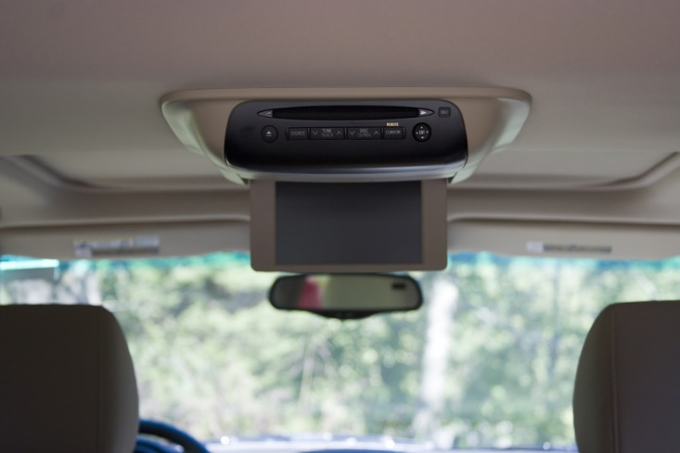
Check and adjust miscellaneous items
On-board services/facilities and systems checks:
Operation of toilets:
Operation of sinks and related items
Operation of radio
(Continued)
Notes:
Trainer discusses on-board services/facilities and systems checks:
Physically checking operation of toilets – Including:
Operation of seat cover
Operation of door and locking mechanism
Physically checking operation of sinks – Including:
Operation of hot water heater
Operation of hot and cold water and taps
Operation of plugs and drainage
Operation of hand drying facilities
Operation of soap dispenser
Physically checking operation of the radio – including:
Operation of station selection and AM/FM selector
Operation of volume and other controls
Visual displays
Condition of speakers – with attention to physical damage and clarity of sound
Condition of the aerial.
Classroom Activity – Demonstration and Practical
Trainer shows students how to undertake activities listed on the slide and provides an opportunity for them to do the same.

Slide 136

Check and adjust miscellaneous items
Operation of television
Operation of audio-tape (or CD) systems
Operation of PA system
(Continued)
Notes:
Trainer continues discussing on-board services/facilities and systems checks:
Physically checking operation of television – including:
Operation of channel selection
Operation of volume controls
Condition of speakers – with attention to physical damage and clarity of sound
Clarity of picture
Operation of DVD facility
Operation of remote control unit
Visual displays
Condition of the antenna
Physically checking operation of audio-tape systems – including:
Operation of volume and other (fast forward, rewind) controls
Condition of speakers – with attention to physical damage and clarity of sound
Operation of remote control unit
Visual displays
Physically checking operation of public address systems – including:
Operation of volume controls
Condition of speakers – with attention to physical damage and clarity of sound
Operation of microphone.
Classroom Activity – Demonstration and Practical
Trainer shows students how to undertake activities listed on the slide and provides an opportunity for them to do the same.

Slide 137
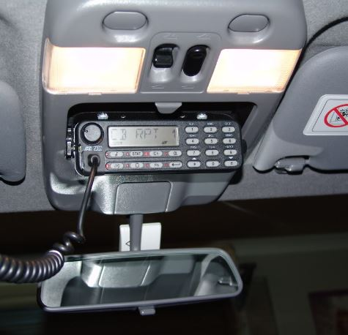
Check and adjust miscellaneous items
Operation of installed two-way (CB and UHF) radios
Operation of all options and facilities for all installed electronic and/or electrical devices
Operation of other items specific to individual types of vehicles
Notes:
Trainer continues discussing on-board services/facilities and systems checks:
Physically checking operation of installed two-way (CB and UHF) radios – including:
Operation of volume controls
Operation of channel selection
Visual displays
Condition of speakers – with attention to physical damage and clarity of sound
Condition of the aerial/s
The maintenance of hand-held communication devices is the responsibility of the persons who use the vehicle/use the units
Physically checking operation of all options and facilities for all installed electronic and/or electrical devices – such as:
Global positioning systems (navigation aids)
On-board cameras and recording equipment
Battery management
ECUs
Asset management (RFID/vehicle tracking)
Physically checking operation of other items specific to individual types of vehicles.
Classroom Activity – Demonstration and Practical
Trainer shows students how to undertake activities listed on the slide and provides an opportunity for them to do the same.

Slide 138

Check and adjust miscellaneous items
Possible on-board services/facilities and systems adjustments:
Cleaning
Replacing tap washers
Lubricating moving parts in toilet and wash systems
Changing batteries in remote-control/hand-held units
(Continued)
Notes:
Trainer presents adjustments:
Cleaning – especially dust and dirt
Replacing tap washers
Lubricating moving parts in toilet and wash systems
Changing batteries in remote-control/hand-held units.
Classroom Activity – Demonstration and Practical
Trainer shows students how to undertake activities listed on the slide and provides an opportunity for them to do the same.

Slide 139

Check and adjust miscellaneous items
Replenishing supplies
Following requirements in Owner/User manual
Making arrangements for qualified repairs
(Continued)
Notes:
Trainer continues presenting adjustments:
Replenishing bathroom/toilet supplies (or this may be done by cleaning staff)
Reading the ‘User Manual’ for the vehicle or for the individual on-board system to:
Identify required service/preventative maintenance requirements
Diagnose the cause of faults/problems
Effect necessary repairs
Making arrangements for qualified service technicians to service/repair the items.
Classroom Activity – Demonstration and Practical
Trainer shows students how to undertake activities listed on the slide and provides an opportunity for them to do the same.

Slide 140

Check and adjust miscellaneous items
Tightening/securing brackets and connectors
Upgrading GPS maps as required
Replacing unserviceable items (or making arrangements for same)
Notes:
Trainer continues presenting adjustments:
Tightening/securing brackets and connectors
Upgrading GPS maps as required
Replacing unserviceable items (or making arrangements for same).
Classroom Activity – Demonstration and Practical
Trainer shows students how to undertake activities listed on the slide and provides an opportunity for them to do the same.

Slide 141

Check and adjust load restraints
Checks to make:
Load anchorages:
Correctly mounted
Not loose
No visible rust/corrosion
(Continued)
Notes:
Trainer discusses checks:
Load anchorages – inspecting and testing to:
Ensure they are securely mounted and have not worked loose
Make sure there is no visible rust/corrosion to the anchorages or surfaces to which they are attached.
Classroom Activity – Demonstration and Practical
Trainer shows students how to undertake activities listed on the slide and provides an opportunity for them to do the same.

Slide 142
Check and adjust load restraints
Retention devices, baggage and cargo restraints:
Securely fitted and not loose
Operate as intended
Effective/suitable for expected load/s
No corrosion
(Continued)
Notes:
Trainer continues discussing checks:
Retention devices, baggage and cargo restraints – inspecting and testing to:
Ensure they remain securely fitted and have not worked loose
Verify operation as intended
Confirm effectiveness and suitability for loads/items to be secured/restrained
Make sure there is no corrosion to steel components.
Classroom Activity – Demonstration and Practical
Trainer shows students how to undertake activities listed on the slide and provides an opportunity for them to do the same.

Slide 143

Check and adjust load restraints
Condition of straps, webbing and nets
Make sure all straps are present
Confirm operation of ratchets and rollers
Confirm D-rings and other attachments are in place and undamaged
(Continued)
Notes:
Trainer continues discussing checks:
(Continued) Retention devices, baggage and cargo restraints – inspecting and testing to:
Check condition of straps, webbing and nets – no rips, missing parts, damage, deterioration
Count/examine number of cords/straps to ensure they are all present
Confirm operation of ratchets and rollers
Make sure D-rings and other attachments/connectors are in place, undamaged and fully-functional.
Classroom Activity – Demonstration and Practical
Trainer shows students how to undertake activities listed on the slide and provides an opportunity for them to do the same.

Slide 144

Check and adjust load restraints
Cab guards:
Mounting points solid
Unit is rigid
Windows protected
No corrosion
No damage which compromises integrity
(Continued)
Notes:
Trainer continues discussing checks:
Cab guards – these are the devices designed to protect people in the cab of a vehicle from intrusion of items coming in through the rear window during an accident or a quick stop/hard braking:
Mounting points are secure and solid
Unit is rigid and fully covering the window being protected
No corrosion/rust near mounting/anchor points
No damage to the unit which compromises its integrity.
Classroom Activity – Demonstration and Practical
Trainer shows students how to undertake activities listed on the slide and provides an opportunity for them to do the same.

Slide 145

Check and adjust load restraints
No loose parts
Mesh/wire does not present cutting hazard
Required vision from driver’s position is not obstructed
(Continued)
Notes:
Trainer continues discussing checks:
(Continued) Cab guards:
No loose parts
Mesh/wire has not broken/become unattached and become a hazard for people to cut themselves on
Required vision from the cab is not obstructed.
Classroom Activity – Demonstration and Practical
Trainer shows students how to undertake activities listed on the slide and provides an opportunity for them to do the same.

Slide 146

Check and adjust load restraints
Headboards, sideboards and tailboards:
Operate as intended
Boards securely attached
Boards can be locked in position
No missing fasteners
(Continued)
Notes:
Trainer continues discussing checks:
Headboards, sideboards and tailboards – inspecting and testing to ensure:
Operation as intended – opening and closing/moving up and down
Boards are securely attached to the vehicle itself
Boards can be securely locked in position
No fasteners are missing or loose.
Classroom Activity – Demonstration and Practical
Trainer shows students how to undertake activities listed on the slide and provides an opportunity for them to do the same.

Slide 147

Check and adjust load restraints
No rust
No cracks or fractures
No significant distortion
(Continued)
Notes:
Trainer continues discussing checks:
(Continued) Headboards, sideboards and tailboards – inspecting and testing to ensure:
No evidence of rust or corrosion – at mounting points and on boards themselves
No evidence of cracks or fractures
No proof of significant damage or distortion – which impacts function and/or presents a hazard.
Classroom Activity – Demonstration and Practical
Trainer shows students how to undertake activities listed on the slide and provides an opportunity for them to do the same.

Slide 148

Check and adjust load restraints
Curtain systems:
Not ripped/torn, deteriorated or damaged
Securely attached
Repairs made are still OK
Correct rating being used
Tensioning components fully functional
Notes:
Trainer continues discussing checks:
Curtain systems – these are the flexible curtains commonly used on the side of vehicles/trucks to contain loads
They are not ripped/torn or have not otherwise deteriorated or been damaged
They are securely attached to the frame which supports them – and the frame is securely attached to the vehicle
Previous repairs made to the fabric/material remain satisfactory
Correct rating system/curtain is being used (where applicable) – and relevant certificate is available
Curtain tensioning components are fully functional, secure and in good condition.
Classroom Activity – Demonstration and Practical
Trainer shows students how to undertake activities listed on the slide and provides an opportunity for them to do the same.

Slide 149

Check and adjust load restraints
Possible adjustments:
Cleaning
Welding broken/damaged parts
Replacing straps, webbing and nets
Replacing anchor points, bolts and/or other connectors
(Continued)
Notes:
Trainer presents adjustments:
Cleaning
Welding broken/damaged parts
Replacing straps, webbing and nets
Replacing anchor points, bolts and/or other connectors.
Classroom Activity – Demonstration and Practical
Trainer shows students how to undertake activities listed on the slide and provides an opportunity for them to do the same.

Slide 150

Check and adjust load restraints
Repairing and/or replacing boards and curtains
Replacing defective parts
Greasing moveable parts
Fitting items
Notes:
Trainer continues presenting adjustments:
Repairing and/or replacing boards and curtains
Replacing defective parts – where repairs cannot be successfully undertaken
Greasing moveable parts
Fitting items where revised use of vehicles indicates need to do so.
Classroom Activity – Demonstration and Practical
Trainer shows students how to undertake activities listed on the slide and provides an opportunity for them to do the same.

Slide 151

Check and replenish on-board emergency equipment and supplies
Checks can include:
Jacks:
Correct type and number for vehicle
All components present
Wheel brace present
Confirm operation
Grease jack screws
(Continued)
Notes:
Trainer discusses checks:
Jack/s for the vehicle – with attention to:
Verifying designated vehicles have the correct type/s of jacks stowed on board – for example, sedans for city/local use may have just one standard jack (as supplied by the car manufacturer) while 4WDs may also be required (under organisational SOPs) to also carry a high-lift jack or some other secondary lifting system
Making sure all components of each jack are present and located in their designated position
Checking a wheel brace is provided
Confirming physical operation of the jacks
Greasing jack screws as required.
Classroom Activity – Demonstration and Practical
Trainer shows students how to undertake activities listed on the slide and provides an opportunity for them to do the same.

Slide 152

Check and replenish on-board emergency equipment and supplies
Tool kit:
In required/designated location
Open it to inspect/check it
All items present
(Continued)
Notes:
Trainer continues discussing checks:
Tool kit – as provided for the vehicle, in terms of:
Confirming presence of all items using a checklist to guide and record the inspection/check
Replacing missing items.
Classroom Activity – Demonstration and Practical
Trainer shows students how to undertake activities listed on the slide and provides an opportunity for them to do the same.

Slide 153

Check and replenish on-board emergency equipment and supplies
Spare parts:
Confirm all required items are present
Replace missing items
Double-check items are correct for the vehicle
Add new items as required
(Continued)
Notes:
Trainer continues discussing checks:
Spare parts – as required for the vehicle, in terms of:
Confirming presence of all items using a checklist to guide and record the inspection/check
Replacing missing items
Adding new items – in accordance with expected/upcoming vehicle use.
Classroom Activity – Demonstration and Practical
Trainer shows students how to undertake activities listed on the slide and provides an opportunity for them to do the same.

Slide 154
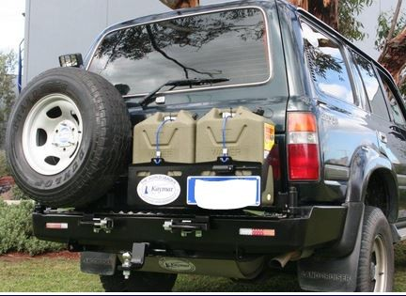

Check and replenish on-board emergency equipment and supplies
Spare tyre/s:
Correct number
Correct type and tread
In good/safe condition
Check inflation
(Continued)
Notes:
Trainer continues discussing checks:
Spare tyre/s – to check:
Inflation
Load and speed rating
Tread pattern and depth
Condition of wheel, rims and sidewall of tyre/s.
Classroom Activity – Demonstration and Practical
Trainer shows students how to undertake activities listed on the slide and provides an opportunity for them to do the same.

Slide 155

Check and replenish on-board emergency equipment and supplies
Tyre chains:
Sufficient/correct number as required
Gloves available
Right size
No missing/damaged hooks or links
(Continued)
Notes:
Trainer continues discussing checks:
Tyre chains – checking:
Sufficient wheel chains are present – there must be chains for all the drive wheels, at least
Appropriate gloves are available for user to wear when fitting chains
Chains are the right size for the tyres of the vehicle
Hooks and links are sound – there should be no missing links or obvious damage.
Classroom Activity – Demonstration and Practical
Trainer shows students how to undertake activities listed on the slide and provides an opportunity for them to do the same.

Slide 156
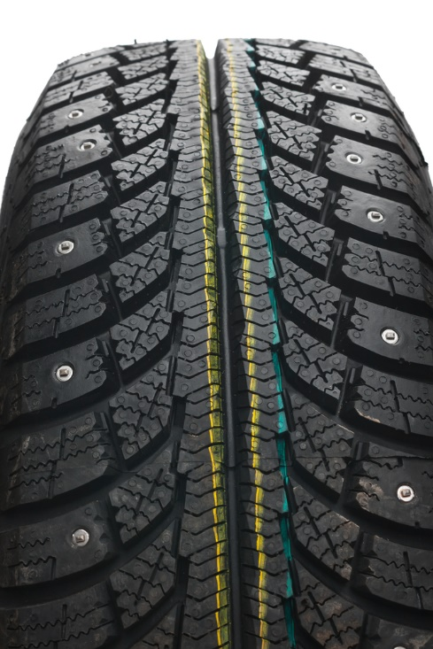
Check and replenish on-board emergency equipment and supplies
Tyre studs:
Sufficient tread depth on tyres to be fitted
Sufficient studs available
Studs correct length as required
Stud gun available
No studs in tyres where not required
(Continued)
Notes:
Trainer continues discussing checks:
Tyre studs – checking:
Tyres have sufficient tread depth – and holes are clean
Sufficient studs are available for the type and number of tyres to be studded
Available studs are correct length to match stud holes in the tyres to be fitted
Stud gun is used to insert studs
Studs are removed from tyres where they are not required – including spare tyre/s.
Classroom Activity (1) – Demonstration and Practical
Trainer shows students how to undertake activities listed on the slide and provides an opportunity for them to do the same.
Classroom Activity (2) – internet Research
Trainer facilitates research and discussion of:
http://www.tyrerack.com/winter/tech/techpage.jsp?techid=151 – Studded tyres for winter driving
http://www.tyrerack.com/winter/tech/techpage.jsp?techid=124 – Stud removal from tyres
https://www.youtube.com/watch?v=BC6Kp-1gtc0 – Studding tyres: GW stud gun.

Slide 157
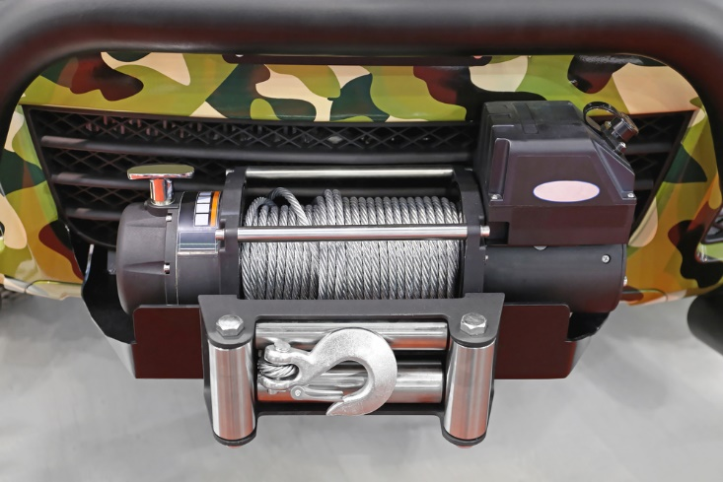
Check and replenish on-board emergency equipment and supplies
Recovery equipment:
Operation of electric winch – where fitted
Presence of recovery/safety blanket for winch cable
Presence of snatch strap, snatch block and shackles
Presence of safety gloves and tree protector
Presence of tyre gauge and rails/racks
Notes:
Trainer continues discussing checks:
Recovery equipment – which may involve checking:
Operation of electric winch and presence of recovery blanket – including hand-held operating unit for winch, all functions
Presence of snatch strap and shackles
Availability of safety/recovery gloves and tree trunk protector
Availability of snatch blocks
Availability of tyre gauge
Availability of rails/tracks.
Classroom Activity (1) – Demonstration and Practical
Trainer shows students how to undertake activities listed on the slide and provides an opportunity for them to do the same.
Classroom Activity (2) – internet Research
Trainer facilitates research and discussion of:
http://www.tjm.com.au/en-oceania/recovery-equipment - Commercial site
http://www.maxtrax.com.au/faq - Commercial site
http://www.arb.com.au/products/recovery-equipment/ - Commercial site.

Slide 158

Check and replenish on-board emergency equipment and supplies
Additional emergency equipment checks:
Fire extinguishers:
Correct type, number and rating
Located in correct position
Have been regularly inspected
Pressure gauge (where fitted) is in green
(Continued)
Notes:
Trainer discusses additional emergency equipment and checks:
Fire extinguishers:
Vehicle is supplied with mandated type/rating and number/s of fire – where applicable, for example for passenger-carrying vehicles/tour vehicles
Extinguisher is located in correct, suitable and accessible position
Extinguishers have been regularly inspected – commonly, every six months by certified officer/nominated agency and these inspections have been logged
Where extinguisher has a pressure gauge, the indicator is in the green section – if not, the extinguisher must be re-charged.
Classroom Activity – Demonstration and Practical
Trainer shows students how to undertake activities listed on the slide and provides an opportunity for them to do the same.

Slide 159

Check and replenish on-board emergency equipment and supplies
Has not been used
Nozzles are clear
All parts present and not damages
Brackets are secure
Maintenance has been documented
Stamped tag attached (as required by local agency)
Notes:
Trainer continues discussing additional emergency equipment and checks:
(Continued) Fire extinguishers:
Extinguisher has not been used – if it has been used it must be re-charged or replaced
Nozzles are clear – and free of obstructions
All parts of the extinguisher are present and are not damaged
Holding brackets are tight/secure and the extinguisher is securely mounted
All maintenance is documented/recorded
Stamped tag is attached to the extinguisher – as required by local agencies.
Classroom Activity – Demonstration and Practical
Trainer shows students how to undertake activities listed on the slide and provides an opportunity for them to do the same.

Slide 160
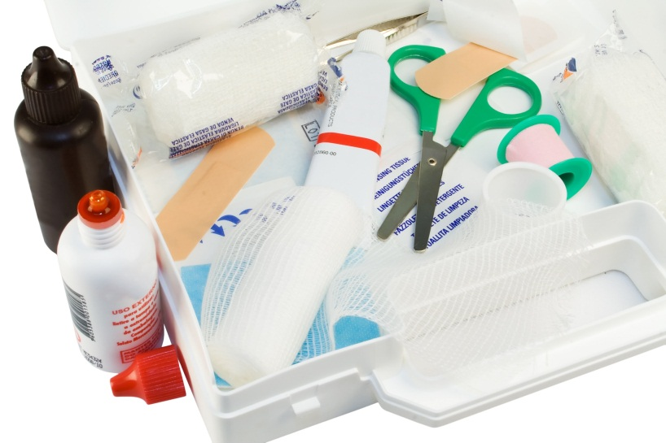
Check and replenish on-board emergency equipment and supplies
First aid kits:
Required number
In correct location
All items present including First Aid book
Add/replace items as required
(Continued)
Notes:
Trainer continues discussing additional emergency equipment and checks:
First aid kits:
Verifying the required number of kits are available – in the designated locations
Confirming presence of all items using a checklist to guide and record the inspection/check
Confirming presence of First Aid book
Confirming presence of disposable gloves and mask
Replacing missing items
Adding new items – in accordance with expected/upcoming vehicle use/tour.
Classroom Activity – Demonstration and Practical
Trainer shows students how to undertake activities listed on the slide and provides an opportunity for them to do the same.

Slide 161

Check and replenish on-board emergency equipment and supplies
EPIRBs:
In position in all vehicles which require them
Have been initially registered
Registrations renewed as required
(Continued)
Notes:
Trainer continues discussing additional emergency equipment and checks:
EPIRBs:
They are provided in/for all vehicles which are designated as needing to use them – such as tour vehicles and those to be used in remote locations
They are registered initially – with the relevant authority/agency
Registrations are renewed as required – such as every two years even where there is no change in the registered owner.
Classroom Activity – Demonstration and Practical
Trainer shows students how to undertake activities listed on the slide and provides an opportunity for them to do the same.

Slide 162
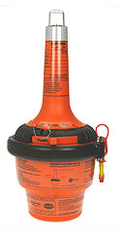
Check and replenish on-board emergency equipment and supplies
Tested in accordance with manufacturer’s instructions
Check/replace battery
Inspect for physical damage
Log details of checks/maintenance
Notes:
Trainer continues discussing additional emergency equipment and checks:
(Continued) EPIRBs:
Testing – in accordance with manufacturer’s instructions taking care not to accidentally initiate a false alarm
Checking battery dates – and:
Replacing before listed expiration date of the battery
Replacing if the unit has been used
Inspecting the unit for physical damage, cracks or other defects
Logging details of the checks, tests and maintenance performed.
Classroom Activity – Demonstration and Practical
Trainer shows students how to undertake activities listed on the slide and provides an opportunity for them to do the same.

Slide 163

Check and replenish on-board emergency equipment and supplies
Maintaining EPIRBs:
They cannot be serviced by users
Where problems are identified:
Send unit to manufacturer or their agent
Replace the unit ensuring replacement unit is registered before use
Notes:
Trainer presents information on EPIRM maintenance noting:
EPIRBs cannot be maintained by users
Where problems are identified with EPIRBS the recommended course of action to:
Forward to the manufacturer or their agent
Replace the unit with a new one ensuring it is registered prior to being put into use.
Classroom Activity – Demonstration and Practical
Trainer shows students how to undertake activities listed on the slide and provides an opportunity for them to do the same.

Slide 164

Make arrangements for external service provision
When considering if external service provision is necessary for a vehicle a combination of the following factors should be taken into account:
Extent of work which needs to be done
Timeframes which apply
Safety issues allied to the work to be done
(Continued)
Notes:
Trainer presents factors to consider in relation to making arrangements for external service provision:
Extent of work which needs to be done – smaller jobs may be handled internally but larger jobs tend to be sent out
Timeframes which apply – where there is a definite or tight timeline for the completion of work, it can be better to have the work done by a professional
Safety issues – anything which relates to matters of safety tends to be undertaken by suitably qualified technicians and service people so as to discharge the common law Duty of Care imposed on businesses.

Slide 165
Make arrangements for external service provision
Complexity of the job
Tools and equipment available
Expertise
Terms of warranties and guarantees
Notes:
Trainer continues presenting relevant factors to consider:
Complexity of the job – simple jobs may be done in-house but the more difficult work tends to be outsourced
Tools and equipment available – where specialist tools and equipment are required for work it can be more economical to get outside businesses to do the job
Expertise – there will just be some jobs where organisational personnel have no experience and no real idea of what to do so there is an obvious imperative for the work to be done by experienced professionals
Terms of warranties and guarantees – in order to maintain the protection/coverage provided by some warranties and guarantees there can be a need for specified work to be done by ‘authorised dealers or agents’.

Slide 166

Make arrangements for external service provision
Steps in the process:
Track use of the vehicle:
Notify management/ administration
Identify relevant service provider
(Continued)
Notes:
Trainer presents steps in the process:
Track use of the vehicle – so:
Odometer readings are monitored – as service times are usually related to distances travelled
Projected date for service can be identified
Advance bookings can be made – with service providers
Notify management or administration – and:
Advise them of the situation and the reason for external service provision
Discuss known details of the work required
Give an estimate of cost, if known
Identify urgency of work that needs to be done
Tell them of any bookings/identified up-coming use for the vehicle
Determine if quotations are required – and if so, how many
Seek and obtain formal approval to proceed
Identify the relevant service provider – this may be:
The organisation from which the vehicle was purchased
The authorised dealer for the make
The preferred service provider as determined by the business
An approved repairer as designated by a recognised motoring body or insurer.
Classroom Activity – Guest Speaker
Trainer arranges for Service Manager from local agency to attend and:
Identify work they can perform and services they can provide together with indicative costs
Suggest protocols for deciding whether external service is required
Describe their preferred actions when making a booking for service/repairs to a vehicle.

Slide 167

Make arrangements for external service provision
Contact provider and discuss required work
Schedule work from perspective of the organisation
Make booking with provider
Take necessary other action
Notes:
Trainer presents steps in the process:
Speak to the selected business by phone or in person – and:
Advise of the nature and extent of work required
Explain urgency of work required and need for vehicle to be returned to service by given date, if applicable
Take the vehicle in to the business – for them to see/inspect
Request quotation for the work to be done – if necessary
Schedule the work – to:
Best integrate repairs with any other work to be done – so as to minimise down-time
Maintain vehicle ‘in service’ for maximum time – providing it is safe to do so
Make a booking for the work to be done – with the chosen provider which may be chosen based on:
Quotation received
Ability to perform the work by required date
Previous experience with the business
Direction from management, warranty/guarantee or insurer
Take necessary other action – which may entail:
Ensuring vehicle is not used until the required repairs have been completed, where safety is a concern
Re-arranging vehicle usage sheets to accommodate absence of the vehicle
Hiring/renting another vehicle to replace the one being repaired
Advising known vehicle users of changes made.
Classroom Activity – Guest Speaker
Trainer arranges for representative from local venue/operator to attend and:
Describe protocols regarding external service provision
Identify factors determining when/if external service will be used
Provide samples of relevant documentation involved
Talk about issues related to having a vehicle taken out of service for maintenance and how that is handled.

Slide 168

Comply with mandated safety requirements
Basic workplace safety requirements:
Take responsibility for personal safety
Be alert to potential for risk
Warn others of hazards
Learn workplace safety requirements
(Continued)
Notes:
Trainer describes basic safety requirements:
Taking responsibility for personal safety – people must take responsibility for their own safety regardless of all other protocols
Being alert to the possibility of risk – due to faulty equipment, risky practice, introduction of a new product or procedure into the workplace: being aware the workplace is a dangerous environment and has the potential to cause injury is the biggest, single factor in taking the initiative for safety at work
Warning others of hazards – so they avoid them
Learning workplace safety policies and procedures – what applied at a previous workplace may not apply at the current workplace.
Classroom Activity – Guest Speaker
Trainer arranges for representative from local workplace safety authority to attend and:
Provide advice on safety when servicing and repairing vehicles
Distribute handouts on workplace safety
Indicate obligations on employers to provide a safe workplace
Emphasise responsibilities/onus on workers for their own safety.

Slide 169

Comply with mandated safety requirements
Understand changing nature/potential of workplace hazards
Realise a fix for one problem can produce another/different risk
Report identified hazards
Keep workplace neat and tidy
(Continued)
Notes:
Trainer continues describing basic safety requirements:
Understanding a hazard can exist today that did not exist yesterday – due to the dynamic nature of work
Realising a remedy for one workplace risk can introduce a new/other workplace hazard
Reporting any workplace risk/hazard – as soon as it is identified
Keeping the work area neat and tidy – as this helps create a safety-oriented mind set: there seem to be fewer accidents and injuries in neat and clean workplaces.
Classroom Activity – Guest Speaker
Trainer arranges for person who services vehicles at local venue/operator to attend and:
Stress need for workplace safety
Advise of safety measures they take
Give examples of workplace safety policies and procedures
Describe accidents and near misses they have experienced.

Slide 170

Comply with mandated safety requirements
Wear clothes which are ‘fit for the job’
Report ‘near misses’ and accidents/injuries
Look out for others
Stop work if it becomes dangerous
(Continued)
Notes:
Trainer continues describing basic safety requirements:
Wearing clothes that are fit for the job – no hanging threads, loose sleeves: wear/provide safe and comfortable clothes
Reporting ‘near misses’ as well as actual accidents/injury – so investigation and preventative action can be taken
Looking out for the safety of others – other staff and members of the public
Immediately ceasing any work as soon as it becomes dangerous – rather than ‘pressing on’ in dangerous conditions.

Slide 171

Comply with mandated safety requirements
Participate actively in workplace safety
Adhere to SOPs, SWPs and manufacturer’s instructions
Wear designated PPE
(Continued)
Notes:
Trainer continues describing basic safety requirements:
Participating in workplace safety discussions, inspections, feedback and management – so workplace safety is consultative
Adhering to SOPs, SWPs and manufacturer’s instructions – as these have been developed with safety in mind
Wearing/using designated PPE as directed – such as eye protection, gloves, steel-capped boots
Using all appliances, equipment, tools as directed – making sure the right tool is used for the right job.
Classroom Activity – Samples
Trainer shows and demonstrates/explains the use of a range of relevant workplace PPE.

Slide 172

Comply with mandated safety requirements
Intervene when necessary
Take care when working
Take practical preventative action
(Continued)
Notes:
Trainer continues describing basic safety requirements:
Intervening when a dangerous workplace situation is identified – to protect people/others against injury
Taking care when working, which includes:
Not rushing
Thinking about what needs to be done
Thinking about how to do what needs to be done
Not doing anything believed to be unsafe
Taking practical action when required, such as:
Picking up items from the floor when they have been dropped
Cleaning up spills immediately – instead of ignoring them or leaving them for someone else to do
Disposing of glass (including broken glass) into designated containers.

Slide 173

Comply with mandated safety requirements
Do a first aid course
Get trained in workplace health and safety
Do not work when not fit to do so
Establish ‘safe place’
(Continued)
Notes:
Trainer continues describing basic safety requirements:
Undertaking a first aid course – so help can be provided if necessary
Being trained in workplace health and safety – as it applies to the workplace, and attending all workplace-based health, safety and welfare training
Not working when unfit to do so – as a result of tyredness, injury, other causes
Seeking to establish a safe place/working environment – rather than relying on employees working in a safe manner.

Slide 174

Comply with mandated safety requirements
Apply safe manual handling
Obtain, read and know location of MSDS
Handle chemicals safely
Abide by applicable legislated safety obligations
(Continued)
Notes:
Trainer continues describing basic safety requirements:
Applying safe manual handling protocols – in relation to moving and lifting objects in the workplace
Ensuring there are MSDS for all chemicals used in the workplace – and they are readily available to workers
Handling chemicals according to established safe chemical handling, storing and usage protocols – as developed by the organisation for the chemicals used within the business
Abiding by the requirements of health, safety and welfare legislation – as it applies locally/nationally.
Classroom Activity (1) – Demonstration
Trainer demonstrates safe manual handling and chemical handling techniques.
Classroom Activity (2) – Handouts
Trainer distributes and discusses sample range of relevant MSDS.

Slide 175

Comply with mandated safety requirements
Ensure ‘safety’ is part of standard ‘Induction and Orientation’
Ensure first aid kit is available
Ensure fire extinguisher is close-by
Notes:
Trainer continues describing basic safety requirements:
Including health and safety training as part of the Induction and Orientation – for all new employees
Ensuring suitable first aid kit is present/available
Ensuring a fire extinguisher is close-by – just in case it is needed.

Slide 176

Comply with mandated safety requirements
External safety-related compliance issues may relate to:
Having vehicles inspected and ‘passed’ by local authorities
Documenting work performed
Notes:
Trainer discusses possible need for external compliance with regard to safety:
Where repairs are made to vehicles (and trailers) – and perhaps where nominated service has to be provided – there can be a need to have this work inspected and ‘passed’ by local transportation, vehicle or road authorities
These requirements may apply to all vehicles, or just to those registered as commercial and/or passenger-carrying
Where these obligations apply it is generally the case:
The vehicle must be taken or driven to the inspection point
It must be inspected, checked and approved by an authorised officer of inspector
A certificate approving the repairs must be issued and obtained to sign-off on the repairs before the vehicle is legally allowed to be driven/used on the roads.

Slide 177

Comply with mandated safety requirements
Safety obligations imposed on employers:
Conduct risk assessments and control identified risks
Ensure safe equipment, workplaces and process
Develop procedures for dealing with emergencies
Provide staff with instruction, training and supervision
Notes:
Trainer explains general safety obligations imposed on employers:
Conduct risk assessments to remove or control risks to workers at the workplace
Maintain safe work facilities and arrangements for the workers at work
Ensure safety in machinery, equipment, plant, articles, substances and work processes at the workplace;
Develop and implement control measures for dealing with emergencies;
Provide workers with adequate instruction, information, training and supervision.

Slide 178

Comply with mandated safety requirements
Safety obligations imposed on employees:
Must follow stated workplace safety procedures and principles
Must not engage in any unsafe act
Must use safety items as/when directed
Must not work in a negligent manner
Notes:
Trainer explains general safety obligations imposed on employees:
Must follow the safe working procedures and principles introduced at the workplace
Must not engage in any unsafe act that may endanger yourself or others working around you
Must use, in proper manner, any personal protective equipment, devices, equipments or other means provided to secure your safety, health and welfare while working. You must not tamper or misuse such items provided
Must not engage in any negligent act that may endanger yourself or others working around you.”

Slide 179

Summary – Element 1
When providing scheduled service to vehicles:
Identify prescribed servicing requirements according to manufacturer’s specifications/vehicle manual
Refer to previous service history of the vehicle
Talk to vehicle users
Factor in relevant legislated requirements
(Continued)
Notes:
Trainer provides a recap of the Element asking questions to check trainee understanding and responding to questions from trainees, as required.

Slide 180

Summary – Element 1
Observe warranty obligations
Visually inspect the vehicle for indications of leaks, problems, damage and defects
Use a vehicle inspection checklist to record and detail findings of the inspection
(Continued)
Notes:
Trainer provides a recap of the Element asking questions to check trainee understanding and responding to questions from trainees, as required.

Slide 181

Summary – Element 1
Check and adjust vehicle structure and lighting
Check and adjust vehicle vision-related items and vehicles entrances and exits
Check and adjust vehicle interior and miscellaneous items
(Continued)
Notes:
Trainer provides a recap of the Element asking questions to check trainee understanding and responding to questions from trainees, as required.

Slide 182

Summary – Element 1
Check and adjust vehicle brakes and steering
Check and adjust vehicle exhaust
Check and adjust vehicle towing connections and load restraints
Check and replenish on-board emergency equipment and supplies
Notes:
Trainer provides a recap of the Element asking questions to check trainee understanding and responding to questions from trainees, as required.

Slide 183

Element 2 – Diagnose minor vehicle faults
Performance Criteria for this Element are:
Identify minor faults
Determine cause of faults
Notes:
Trainer identifies for trainees the Performance Criteria for this Element, as listed on the slide.
Class Activity – General Discussion
Trainer leads a general class discussion by asking questions such as:
What does ‘diagnose’ mean?
How can you go about diagnosing faults/what do you do to diagnose them?
What experience have you had in doing this?
Give me some examples of vehicles you have diagnosed faults on and what those faults were.

Slide 184

Identify minor faults
Four basic ways to identify vehicle faults:
Talking to those who have driven or been in the vehicles
Test driving the vehicles to replicate/induce the fault
(Continued)
Notes:
Trainer explains there are four basic ways to identify vehicle faults:
Talking with those who have operated/driven or been in a vehicle
These people may be drivers or passengers
Actions required include:
Asking open and closed questions
Asking probing questions
Using terminology appropriate to the individual – such as avoiding complex automotive terms if the person does not understand them
Listening to what is said
Getting them to point to locations
The discussion should aim to:
Identify type and nature of fault
Describe the fault if it cannot be identified
Explain whereabouts it is located (if appropriate)
Describe symptoms and indicators
Give an idea of frequency of the problem
Identify conditions under which fault occurs/presents
Test driving the vehicle – to:
Attempt to induce the fault – which can often be a frustrating experience as a problem ‘on tour’ often fails to manifest itself on return
Listen to sounds made by the vehicle
Get a feel for the vehicle – and how it handles and responds
Smell any odour which may be generated by the fault
Duplicate causal conditions which were known to trigger the problem
Compare the way it is ‘now’ to how it normally behaves – in some cases a ‘fault’ with a vehicle as identified by someone else can simply be a ‘lack of performance’ which is really not a fault but simply the standard operating parameters of the vehicle.

Slide 185

Identify minor faults
Running the vehicle stationary to induce/replicate faults
Read relevant vehicle-related reports
Notes:
Trainer continues identifying ways to identify vehicle faults:
Running stationary vehicle to induce fault – which may involve:
Applying handbrake and/or chocking vehicle
Running vehicle from a cold start
Starting vehicle from a hot start
Running vehicle with nominated accessories turned ’on’ (and/or ‘off’) as required
Running vehicle for nominated period of time
Monitoring/observing vehicle from inside and/or outside of the vehicle
Reading reports which have been prepared on the vehicle – such as:
Roadworthy/unroadworthy certificates
Vehicle defect notices
Service reports
Daily vehicle inspection checklists
End of Tour reports
Damage reports
Maintenance requests
Usage log.
Classroom Activity – Handouts
Trainer distributes and discusses examples of reports/documents identified on the slide.

Slide 186

Determine cause of faults
In reality the process of identifying cause of faults (‘diagnosing faults’ or ‘troubleshooting’):
Is often not straight-forward
Can be very time consuming
Can be difficult in terms of replicating the problem so the fault/cause can be identified
Can be more difficult than actually fixing the problem
Notes:
Trainer provides context stating:
Identifying the cause of faults may also be known as:
‘Diagnosing’ faults
‘Troubleshooting’
In many cases the reality of this stage is:
It is not straight-forward
The process can be very time consuming
It is difficult to re-produce the fault so the cause can be found
It can be harder to determine the cause than it is to fix the fault.

Slide 187

Determine cause of faults
SOPs for diagnosing faults:
Analysing available information (‘evidence’) as obtained from the fault identification process
Using diagnostic flowcharts
Using on-board diagnostics
(Continued)
Notes:
Trainer presents SOPs for diagnosing faults:
Analysing available information (‘evidence’) as obtained from the fault identification process to provide a list of tests to perform in order to:
Generate/cause the fault
Test options
Eliminate possible causes in a structured and sequential, one-at-a-time basis
Identify causes
Using diagnostic flowcharts – as provided by manufacturers for different parts/components of the vehicle
Using on-board diagnostics (OBD) – which require a purpose-built scanning tool to (reader) be plugged into the on-board computer to display and interpret a Diagnostic Trouble Code which describes the fault.
Classroom Activity – Demonstration and Practical
Trainer shows students how to undertake activities listed on the slide and provides an opportunity for them to do the same.

Slide 188

Determine cause of faults
Referring to service and operator manuals:
Seeking additional advice from the manufacturer
Referring to personal experience
(Continued)
Notes:
Trainer continues presenting SOPs for diagnosing faults:
Referring to service and operator manuals – as most minor faults can be determined with reference to these books
Seeking additional advice from the manufacturer – which may take the form of:
On-line advice – using:
Free, password protected access to contracted assistance provided as part of new vehicle purchase
Fee-for-service specialist advice
Over the phone assistance – from the manufacturer or the agent/business that sold the vehicle
In-person help – which may include:
Talking face-to-face with the Service Manager at the agency
Taking the vehicle in to the business for one of the mechanics to look at and give free-of-charge advice on – this is a viable option where the organisation purchases significant vehicles from the one car dealership and/or where a ‘preferred supplier’ arrangement exists with the business
Referring to personal experience – the more experience a person has in diagnosing faults, the greater their pool of experience becomes
This personal experience generates a useful source of information as it is based on ‘legitimate’, first-hand practice.
Classroom Activity – Demonstration and Practical
Trainer shows students how to undertake activities listed on the slide and provides an opportunity for them to do the same.

Slide 189
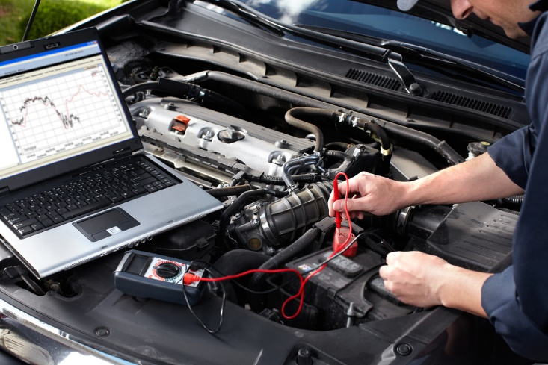
Determine cause of faults
Loading vehicle onto jacks, stands or a hydraulic lift:
Using applicable sensory appraisal to help determine cause
Monitoring on-board instrument panel
Monitoring externally attached equipment
(Continued)
Notes:
Trainer continues presenting SOPs for diagnosing faults:
Loading vehicle onto jacks, stands or a hydraulic lift – in order to:
Get a better look at the vehicle and be able to see ‘up and under’ it and the engine bay Certainly, raised vehicles always make it easier to identify the location of leaks and drips; Free up certain suspension components;
Make it easier to manipulate other parts of the vehicle
Using applicable sensory appraisal to help determine cause – this is similar to using the senses to help identify a fault in the first place, and can (depending on the issue) rely on:
Sight; Feel; Smell; Hearing
Monitoring on-board instrument panel – which can mean watching and interpreting the readings of:
Temperature gauges; Tachometers; Oil pressure; Battery charge
Monitoring externally attached equipment – such as:
Various diagnostic tools; Battery/alternator testers; Vacuum and fuel pump testers; Electronic brake service tool; Compression test; Circuit testers and multi-meters.
Classroom Activity – Demonstration and Practical
Trainer shows students how to undertake activities listed on the slide and provides an opportunity for them to do the same.

Slide 190

Summary – Element 2
When diagnosing minor vehicle faults:
Talk to vehicle operators
Test drive the vehicle
Run the vehicle
Read vehicle reports
(Continued)
Notes:
Trainer provides a recap of the Element asking questions to check trainee understanding and responding to questions from trainees, as required.

Slide 191

Summary – Element 2
Identify location and nature of the fault
Analyse available information to determine cause/s of the fault
Use diagnostic tools to assist with diagnosis
Seek help when necessary
Notes:
Trainer provides a recap of the Element asking questions to check trainee understanding and responding to questions from trainees, as required.

Slide 192

Element 3 – Undertake minor repairs to vehicles
Performance Criteria for this Element are:
Remove, repair and/or refit vehicle components
Use correct tools and follow manufacturer’s instructions
Make arrangements for external repair provision where requirements cannot be accommodated internally
Comply with mandated safety requirements while undertaking repairs
Notes:
Trainer identifies for trainees the Performance Criteria for this Element, as listed on the slide.
Class Activity – General Discussion
Trainer leads a general class discussion by asking questions such as:
What experience do you have in undertaking minor repairs?
Where have you performed these repairs?
What vehicles did you work on and what repairs did you complete?

Slide 193

Remove, repair and/or refit vehicle components
Important information:
Performing repairs to vehicles which are still under warranty can void the warranty
The actual work required may differ between makes and models of vehicles
Always be prepared to read Owner’s manual or Workshop manual
Obtain the right parts before starting the job
(Continued)
Notes:
Trainer provides important background information to this Element:
Performing repairs to vehicles which are still under warranty can void the warranty – so there is a need to check this before proceeding any further
The actual work required may differ between makes and models of vehicles – the procedures listed in the notes are indicative only
Always be prepared to read Owner’s manual or Workshop manual
Obtain the right parts before starting the job.

Slide 194

Remove, repair and/or refit vehicle components
Obtain and use the right tool/s for the job
Work steadily – never rush a job
Check the surrounding areas/sections for debris and/or damage at the same time
Never be afraid of asking for help from a more qualified or experienced person
Notes:
Trainer provides important background information to this Element:
Obtain and use the right tool/s for the job
Work steadily – never rush a job
Check the surrounding areas/sections for debris and/or damage at the same time – and respond as indicated
Never be afraid of asking for help, advice or direction from a more qualified or experienced person.

Slide 195

Remove, repair and/or refit vehicle components
Basic repairs can include:
Replacing a light globe
Replacing a reflector
Replacing a lens
Replacing a light unit
(Continued)
Notes:
Trainer identifies range of basic repairs to be made:
Replacing a light globe
Replacing a reflector
Replacing a lens
Replacing a light unit.
Classroom Activity (1) – Demonstration and Practical
Trainer shows students how to undertake activities listed on the slide and provides an opportunity for them to do the same.
Classroom Activity (2) – internet Research
Trainer facilitates research and discussion of:
http://www.supercheapauto.com.au/how-to/Outside-the-Car/Checking-and-Changing-an-Automotive-Light-Globe.aspx?id=79 – Checking and changing an automotive light globe
https://www.youtube.com/watch?v=6hURsa46t4M – How to change a headlight bulb
https://www.youtube.com/watch?v=jk1kFc56dwk – How to replace headlight bulbs
https://www.youtube.com/watch?v=cB99QN1AYBU – How to install replace front lower side reflector
https://www.youtube.com/watch?v=mgGWFqPe0Ms – Headlight bulb replacement service: 2005 Honda CRV
https://www.youtube.com/watch?v=5F31wzh60zo – How to replace taillight
https://www.youtube.com/watch?v=9POigqpLxQc – How to replace fog light and bulb.

Slide 196
Remove, repair and/or refit vehicle components
Replacing a fan belt
Replacing a fuse
(Continued)
Notes:
Trainer continues identifying range of basic repairs to be made:
Replacing a fan belt
Replacing a fuse.
Classroom Activity (1) – Demonstration and Practical
Trainer shows students how to undertake activities listed on the slide and provides an opportunity for them to do the same.
Classroom Activity (2) – internet Research
Trainer facilitates research and discussion of:
https://www.youtube.com/watch?v=4hnOUs9eiN4 – Change a fan belt
http://www.supercheapauto.com.au/how-to/Servicing-Mechanical/Replacing-a-Drive-Belt.aspx?id=76 – Replacing a drive belt
https://www.youtube.com/watch?v=Wg1AX77xEBQ – How to replace a serpentine belt
https://www.youtube.com/watch?v=01J3Fp9_bMA – How to replace a serpentine belt: Toyota Corolla
https://www.youtube.com/watch?v=XD0LNkFYPGQ – Toyota timing belt
http://www.wikihow.com/Change-an-Automotive-Belt.
https://www.youtube.com/watch?v=kOXeo-kqg68 – How to replace a blown fuse in a car
https://www.youtube.com/watch?v=faWZmG0fXy8 – How to find and replace a blown fuse in your car or truck.

Slide 197
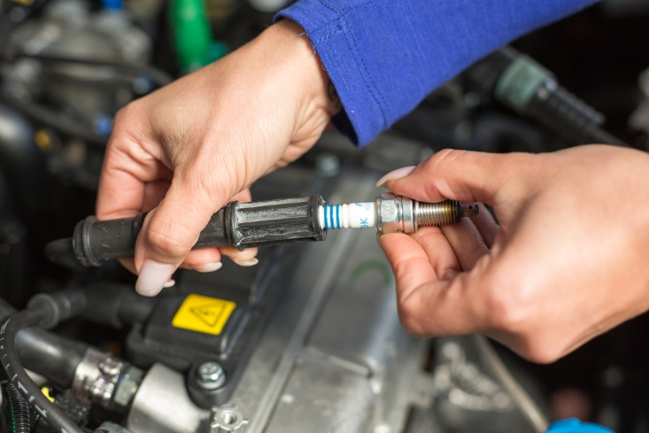
Remove, repair and/or refit vehicle components
Replacing spark plugs
Replacing glow plugs
(Continued)
Notes:
Trainer continues identifying range of basic repairs to be made:
Replacing spark plugs
Replacing glow plugs.
Classroom Activity (1) – Demonstration and Practical
Trainer shows students how to undertake activities listed on the slide and provides an opportunity for them to do the same.
Classroom Activity (2) – internet Research
Trainer facilitates research and discussion of:
http://www.supercheapauto.com.au/how-to/Servicing-Mechanical/Replacing-Spark-Plugs.aspx?id=68 – Replacing spark plugs
https://www.youtube.com/watch?v=jj06A6UdHvI – Changing spark plugs and replacing plug wires
https://www.youtube.com/watch?v=RCcmN-r5Z9M – Replacing glow plugs in a Mitsubishi Delica L400
https://www.youtube.com/watch?v=4Po_1pNHE1Y – Glow plug change
https://www.youtube.com/watch?v=4Po_1pNHE1Y – Easy and complete glow plug test.
http://autorepair.about.com/od/enginerelateddiyjobs/l/aa081404a.htm - How to replace your diesel glow plugs

Slide 198

Remove, repair and/or refit vehicle components
Replacing mirrors
Replacing coolant hoses
(Continued)
Notes:
Trainer continues identifying range of basic repairs to be made:
Replacing mirrors
Replacing coolant hoses.
Classroom Activity (1) – Demonstration and Practical
Trainer shows students how to undertake activities listed on the slide and provides an opportunity for them to do the same.
Classroom Activity (2) – internet Research
Trainer facilitates research and discussion of:
https://www.youtube.com/watch?v=U-1y8NIEhKM – Auto side mirror replacement
https://www.youtube.com/watch?v=77lBQ_CRqdo – Replace your passenger side mirror
https://www.youtube.com/watch?v=d8ASeN4rgek – Plastic backed mirror glass installation
https://www.youtube.com/watch?v=D6j8fwGCrHs – Side mirror glass replacement
https://www.youtube.com/watch?v=AGmQ50naiGg – How to replace a radiator hose (upper and lower)
https://www.youtube.com/watch?v=C64z0L9816A – Replacing radiator hose
https://www.youtube.com/watch?v=xH0D22ITjQU – How to replace the upper radiator hose.

Slide 199

Remove, repair and/or refit vehicle components
Changing tyres
Repairing punctures
Notes:
Trainer continues identifying range of basic repairs to be made:
Changing tyres
Repairing punctures.

Slide 200

Use correct tools and follow manufacturer’s instructions
Need to use right tools and follow manufacturer’s instructions:
Saves time and avoids damage
Reduces chance of personal injury
Retains warranties/guarantees
Optimises life of part/vehicle
Ensures part works correctly with other parts
Notes:
Trainer identifies reasons to use correct tools and follow manufacturer’s instructions:
Save time
Save damage to the item being fitted and/or vehicle
Reduce potential for personal injury
Retain parts warranties and guarantees
Optimise service life of part being fitted
Ensure part integrates fully/properly with other items.

Slide 201

Use correct tools and follow manufacturer’s instructions
Hand tools:
Wrenches – metric and standard (SAE)
Adjustable wrench
Combination wrench
(Continued)
Notes:
Trainer identifies range of tools which may be used:
Hand Tools
Wrenches Wrenches come in various sizes and designs. Adjustable, open-end, box-end, combination, and specialty wrenches are important tools to have when performing basic maintenance and repair. Both metric and standard (aka SAE) fixed jaw wrenches should be included in a basic tool kit.
Wrench Size Metric sizes commonly increase by 1 millimeter (mm) for each wrench size increase. For example, a metric wrench set may have the following sizes: 7mm, 8mm, 9mm, 10mm, 11mm, 12mm, 13mm, 14mm, 15mm, etc. Standard wrenches commonly increase by 1/16” for each wrench size increase. Note: A quote mark ( ” ) is a symbol for inch units. For example, a standard wrench set may have these sizes: 1/4”, 5/16”, 3/8”, 7/16”, 1/2”, 9/16”, 5/8”, 11/16”, 3/4”, etc. The size corresponds to the distance between the two jaws in an open-end wrench.
Adjustable Wrench An adjustable wrench is versatile. The jaw can be adjusted to fit metric or standard nuts and bolts. However, it does not fit as snugly on the fastener as a fixed sized jaw wrench. In addition, the head of an adjustable wrench may not fit in all locations and is not as strong. An adjustable wrench is sometime called a Crescent wrench (an industry brand name). If you are going to have only one wrench in your tool box, choose an adjustable wrench.
Combination Wrench The two most common types of wrench ends are box and open. A combination wrench will have a box-end on one end and an open-end on the other. The box-end usually has 6-points or 12-points. Use the box-end 6-point when a great amount of torque is required to reduce the chance of stripping the fastener (i.e., a nut or bolt). An open-end is handy when the fastener position will not allow access with the box-end.
Classroom Activity – Example, Demonstration and Practical
Trainer presents example/s of items identified on the slide, demonstrates their use when repairing vehicles and gives students an opportunity to do the same.

Slide 202
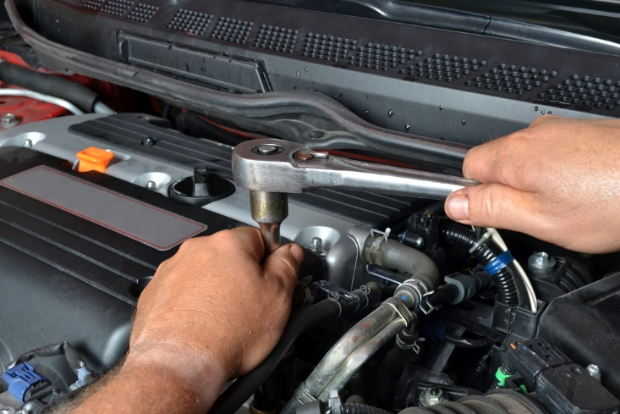
Use correct tools and follow manufacturer’s instructions
Ratchets
Standard sockets
Spark plug sockets
Impact sockets
(Continued)
Notes:
Trainer continues identifying range of tools which may be used:
Ratchets Ratchets in combination with sockets are used to quickly turn nuts and bolts. A ratchet is basically a lever with a pivoting mechanism. The pivoting mechanism allows the user to tighten or loosen a fastener without removing the tool. Ratchets are sized according to the square driver head. For example, 1/4” drive ratchets have driver heads that are 1/4” x 1/4”. Common ratchet sizes are 1/4”, 3/8”, and 1/2”. A 3/8” ratchet is the most common size that many do-it-yourselfers include in their basic tool kit.
Standard Sockets Sockets can be directly connected to the ratchet or first connected to a universal joint or driver extension. Sockets are classified as regular or deep well. Deep well sockets can fit over the threads of a long bolt. Sockets, like wrenches, have points inside that fit over the fastener and come in both metric and standard sizes. Common sockets will have either 6-points or 12-points.
Spark Plug Sockets Some sockets are specially designed. For example, spark plug sockets have rubber boot inserts to protect the plug from cracking and to keep it centered.
Impact Sockets Impact sockets should be used to avoid shattering standard sockets in situations where high torque and speed are needed, especially when using an electric or pneumatic (air powered) impact wrench. Impact sockets can be identified by their black color and thicker sides.
Classroom Activity – Example, Demonstration and Practical
Trainer presents example/s of items identified on the slide, demonstrates their use when repairing vehicles and gives students an opportunity to do the same.

Slide 203

Use correct tools and follow manufacturer’s instructions
Slip joint pliers
Locking pliers
Groove joint pliers
Needle nose pliers
Diagonal cutting pliers
(Continued)
Notes:
Trainer continues identifying range of tools which may be used:
Pliers Pliers are handy adjustable tools that can be used in a variety of situations. Pliers are used to grab, turn, cut, or bend. Several types include: slip joint, locking, groove joint, needle nose, and diagonal cutters. Pliers consist of two levers that pivot at one point. This pivoting point is called a fulcrum.
Slip Joint Pliers Slip joint pliers are one of the most basic and versatile hand tools. However, do not use slip joint pliers in situations where a wrench would be better (e.g., turning a nut or bolt). Trying to loosen a stubborn nut with slip joint pliers can strip the head or if the pliers slip, bruise your knuckles.
Locking Pliers Locking pliers are sometimes called Vise-Grips, a brand name in the industry. Locking pliers are used to tightly grip and then lock on the fastener. These pliers come in handy when a bolt or nut is already stripped beyond the point where a wrench no longer works. Grabbing onto flat pieces of metal or oddly shaped items are additional functions of locking pliers.
Groove Joint Pliers Also called adjustable pliers or Channellocks (an industry brand name), groove joint pliers adjust to a wide range of sizes. These are especially useful for gripping cylindrical objects, like pipes.
Needle Nose Pliers Needle nose pliers have long pointed jaws. These can be used to grip or pull objects that are in hard-to-reach areas. Next to the fulcrum is also a cutting mechanism to cut wire or other objects.
Diagonal Cutting Pliers Also called side cutters, diagonal cutters have sharp cutters instead of gripping jaws like most pliers. They are commonly used for cutting wires.
Classroom Activity – Example, Demonstration and Practical
Trainer presents example/s of items identified on the slide, demonstrates their use when repairing vehicles and gives students an opportunity to do the same.

Slide 204
Use correct tools and follow manufacturer’s instructions
Screwdrivers
Hammers
Pry bars
Notes:
Trainer continues identifying range of tools which may be used:
Screwdrivers Just about everyone is familiar with screwdrivers. They turn screws or other fasteners. Some screwdrivers have magnetic tips to help with positioning fasteners in tight spaces. The head of a fastener determines the type and size of screwdriver tip that is needed. The proper tip will fit in a fastener head snugly. Damage or tool slippage may occur if an incorrect sized tip is used. Common types of screwdriver tips include Phillips, slotted, square, Allen, Torx, and hex. Various types of screwdriver tips are also made as bits that can be placed in a 1/4” socket for ratcheting in tight places.
Hammers Sometimes what you are working on needs a little more persuasion. Using the correct hammer will ensure that you don’t damage components. A ball peen hammer, a favorite hammer by many technicians, is commonly used to drive a chisel or a punch. A rubber mallet, a hammer with a rubber head, comes in handy to drive on stubborn wheel covers and other parts without damaging them.
Pry Bars Pry bars are long bars with handles that come in a variety of sizes and styles. They can be useful when trying to leverage a component that is heavy or stuck.
Classroom Activity – Example, Demonstration and Practical
Trainer presents example/s of items identified on the slide, demonstrates their use when repairing vehicles and gives students an opportunity to do the same.

Slide 205
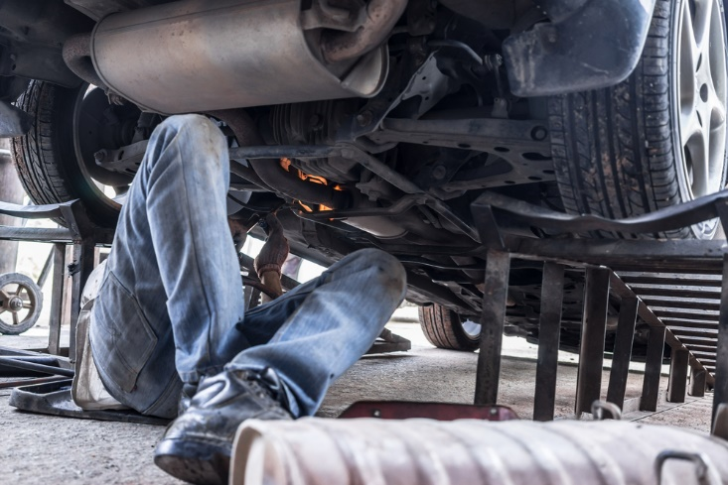
Use correct tools and follow manufacturer’s instructions
Lifting tools:
Floor jacks
Ramps
Wheel chocks
Jack stands
Notes:
Trainer continues identifying range of tools which may be used:
Lifting Tools When performing work under a vehicle it is often necessary and convenient to raise the vehicle off the ground with a floor jack and jack stands or drive-on ramps. Work safely by using lifting equipment on a surface that is solid and chock at least one wheel still on the ground. Warning: Lifting equipment ratings should exceed the weight of the vehicle being lifted.
Floor Jack A floor jack is used to lift a vehicle. Be sure to place the jack’s lifting pad under the frame or other solid chassis component. Lifting the vehicle by the body’s sheet metal underbody will damage the vehicle and make it more likely to fall off the jack. Warning: To prevent serious injury or death jack stands should be used. Do not go under a vehicle that is only supported by a jack.
Ramps Drive-on ramps can make raising one end of your vehicle very easy. All you need to do is line the ramps up in front of your tyres, drive onto them, set your emergency brake, and chock one wheel remaining on the ground. Since the vehicle is still resting on its tyres, don’t plan on doing any wheel work. Ramps are convenient for oil changes and undercarriage inspections.
Wheel Chocks To prevent a vehicle from moving forward or backward, wheel chocks are used to block a wheel when jacking. Place the wheel chocks in front and in back of a wheel that is not being lifted.
Jack Stands Jack stands are used to hold a vehicle up after a jack has raised it. Warning: Do not use concrete blocks or other non-approved stands to hold up a vehicle.
Classroom Activity – Example, Demonstration and Practical
Trainer presents example/s of items identified on the slide, demonstrates their use when repairing vehicles and gives students an opportunity to do the same.

Slide 206
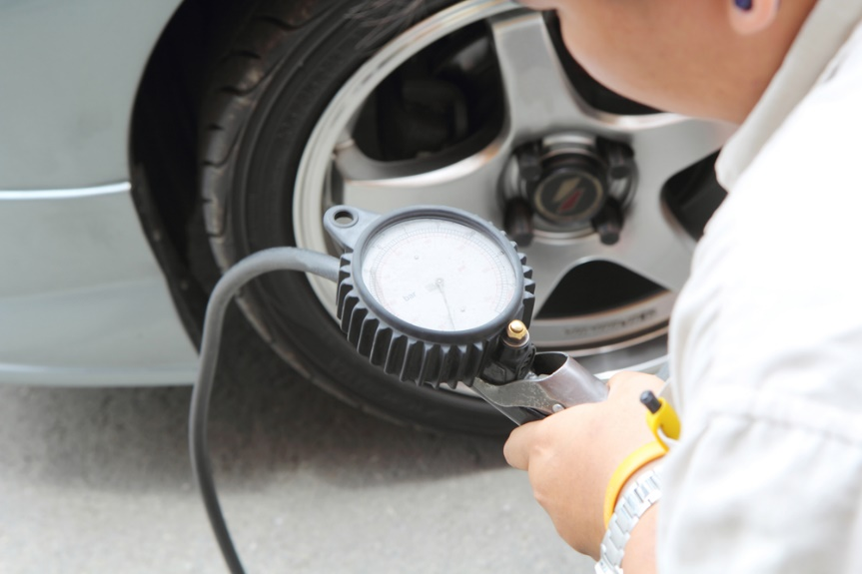
Use correct tools and follow manufacturer’s instructions
Tyre tools:
Tyre pressure gauge
Tread depth gauge
Tyre plug tools
Bottle and scissor jacks
4-way tyre tool
Notes:
Trainer continues identifying range of tools which may be used:
tyre Tools tyre Pressure Gauges tyre pressure is measured with tyre pressure gauges and should be checked often. A dial gauge is more accurate than a stick gauge. A recommended tyre pressure is calculated according to the tyre type, vehicle weight, and the desired ride. Look in your driver’s side door for a tyre placard that lists the correct tyre pressure. Maintaining the recommended tyre pressure is critical to minimizing tyre wear and optimizing handling stability. For every 10 degrees temperature drop, tyre pressure drops by 1 psi. The inverse also occurs as temperature rises.
Tread Depth Gauge A tread depth gauge is a simple measuring devise to help determine the actual amount of tread remaining on your tyres. It provides a depth reading within 1/32nd’s of an inch from the top of the tread surface to the bottom of the tread groove. When that reading is less than 1/16th of an inch, new tyres are needed.
tyre Plug Tools tyre plug tools make it possible to plug holes smaller than 1/4” in diameter in the tread of a tyre without taking the tyre off the rim. The plug rasp tool prepares the hole for the plug and the insert tool installs the plug.
Bottle and Scissor Jacks Most newer vehicles have a scissor or bottle jack stored in the trunk for emergency tyre changes. These manufacturer supplied jacks are not as easy or as safe to use as a hydraulic floor jack. Save them for roadside emergencies and invest in a hydraulic jack for your garage.
4-Way tyre Tool A 4-way tyre tool is more versatile for removing lug nuts than the basic manufacturer lug wrench (aka tyre iron) supplied with your vehicle. A 4-way has a different sized wrench on each end. It is also easier to use because the design provides more leverage and you can spin the lug nuts off quicker.
Classroom Activity – Example, Demonstration and Practical
Trainer presents example/s of items identified on the slide, demonstrates their use when repairing vehicles and gives students an opportunity to do the same.

Slide 207
Use correct tools and follow manufacturer’s instructions
Measuring tools – metric/international and English/customary:
Rulers and tapes
Torque wrench
Coolant tester
Spark plug gauge
Precision measuring tools – feeler gauges, calipers, micrometers
Notes:
Trainer continues identifying range of tools which may be used:
Measuring Tools Measuring accurately requires the use of measuring tools like rulers, gauges, and micrometers. In the United States two systems of measurement are often used: the metric (aka International) system and the English (aka Customary) system.
Rulers Rulers are used to measure linear distances. Measuring tapes are used to measure large distances whereas small rigid rulers are used to measure short linear distances.
Torque Wrench A torque wrench, either beam or clicker style, can be used to tighten a fastener to a specific amount of force. For example, wheel lug nuts should be tightened to the manufacturer’s specifications. Lug nuts that are not tight enough could loosen over time, while lug nuts that are too tight are hard to remove, can warp brake rotors, and can damage the stud’s threads. A torque wrench is critically important when completing internal engine repairs. Coolant Tester A coolant tester measures specific gravity to determine if the cooling system contains the correct mixture of antifreeze to water. To draw coolant up into the tester, squeeze the bulb while the tube end is inserted in the radiator. An indicator inside the tester floats to give a reading based on the percentage of antifreeze in the coolant.
Spark Plug Gauge A spark plug gauge tool has various diameter wires for checking the electrode gap and benders to adjust the gap. The gap is the distance between the center and side electrodes on the spark plug. A spark must arc across the gap in order to ignite the air-fuel mixture in a cylinder. The correct gap is located on the EPA sticker in the engine compartment.
Precision Measuring Tools Feeler gauges, calipers, micrometers, and dial indicators are used to obtain very precise measurements. These tools can provide measurements to the nearest thousandths (0.001) of an inch or to the nearest hundredths (0.01) of a millimeter. Feeler gauges consist of flat metal blades that are a specific thickness. You can put several feeler blades together to obtain a desired thickness. For example, if you needed to obtain a thickness of 0.045”, you could put the 0.025” and 0.020” together. A caliper is an especially versatile measuring tool able to measure inside, outside, and depth dimensions. However, when extremely precise measurements are required consider using a micrometer. Micrometers are particularly good for measuring the diameter of objects.
Classroom Activity – Example, Demonstration and Practical
Trainer presents example/s of items identified on the slide, demonstrates their use when repairing vehicles and gives students an opportunity to do the same.

Slide 208
Use correct tools and follow manufacturer’s instructions
Tools to maintain the electrical system:
Multi-meter
Fuse puller
Wire strippers
Battery load tester
(Continued)
Notes:
Trainer continues identifying range of tools which may be used:
Electric Tools If you plan to maintain a vehicle’s electrical system some electrical tools will be necessary. At the very least every vehicle should carry a set of jumper cables.
Multimeters Multimeters make a great addition to any toolbox. Multimeters can be used to measure voltage, resistance, and amperage.
Fuse Puller Fuses are fairly small, very close to one another in a fuse junction block, and often tightly held making it difficult to pull them out. A fuse puller is a small plastic device designed to grasp a fuse so it can be pulled out easily.
Wire Strippers Wire strippers can be used to remove wire insulation, cut wires, and to crimp solderless connectors and terminals.
Battery Load Tester A battery load tester is a specialty tool used to evaluate a battery’s condition. The tester should be set to the battery’s temperature and cold-cranking amperage (CCA) rating to receive accurate results. Note: Some automotive part stores will test your battery for free.
Classroom Activity – Example, Demonstration and Practical
Trainer presents example/s of items identified on the slide, demonstrates their use when repairing vehicles and gives students an opportunity to do the same.

Slide 209

Use correct tools and follow manufacturer’s instructions
Jumper cables
Battery terminal puller
Battery brush
Battery terminal spreader
Notes:
Trainer continues identifying range of tools which may be used:
Jumper Cables A battery can discharge simply by leaving your lights on or a door ajar. You should know how to properly hook up jumper cables in case of an emergency. For step-by-step procedures on safely hooking up jumper cables see your owner’s manual and the Jump-Starting Activity. Warning: Incorrectly jump-starting a battery can be dangerous. If cables are hooked up incorrectly the battery could explode or electrical components could fry.
Battery Terminal Puller The battery terminal puller is designed to remove a stubborn or corroded battery terminal clamp, after the battery terminal nut has been loosened, without causing damage to the battery terminal post. The lower jaws of the puller are placed under the battery terminal clamp and then the top lever is turned to lower the center screw onto the terminal post until it forces the clamp free. This type of puller is only used on top post batteries.
Battery Brush Once the battery terminal clamps have been disconnected from the battery posts, use battery brushes to scrape off any visible white or light colored corrosive powder. Rotate the external wire battery brush inside each clamp and the internal wire battery brush over each post.
Battery Terminal Spreader The battery terminal spreader is specially designed to spread battery terminal post clamps. They can also be used to scrape corrosion from the inside of terminal clamps.
Classroom Activity – Example, Demonstration and Practical
Trainer presents example/s of items identified on the slide, demonstrates their use when repairing vehicles and gives students an opportunity to do the same.

Slide 210
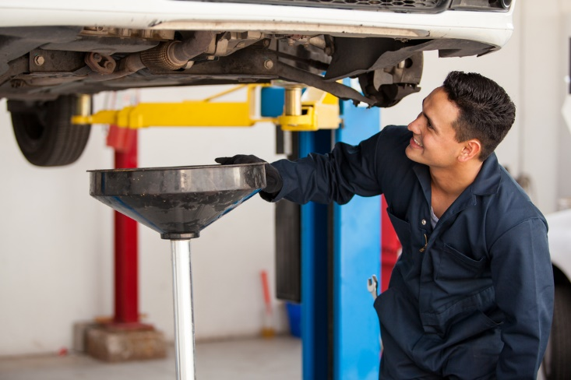
Use correct tools and follow manufacturer’s instructions
Oil change and lube tools:
Oil drain pan
Oil filter wrench
Funnel
Grease gun
Notes:
Trainer continues identifying range of tools which may be used:
Oil Change and Lube Tools To perform an oil change and lubrication you will need a socket or wrench to remove the drain plug, lifting equipment, an oil drain pan, an oil filter wrench, a funnel, and a grease gun.
Oil Drain Pan An oil drain pan helps to keep used oil from spilling on the floor. A good oil pan will have a wide collection area, a place for the oil filter to set while draining, enough capacity to hold at least one oil change, and a cap to prevent spilling during transportation to an oil recycling facility. Used oil is considered a hazardous waste.
Oil Filter Wrenches There are mainly two styles of oil filter wrenches. The band filter wrench is made to adjust to several different sized filters within a range. For hard to reach filters get a filter wrench with a swivel handle. The cup oil filter wrench is used with a ratchet for leverage. Select the cup size that fits snugly on your filter.
Funnel A funnel helps prevent spills when adding oil to the engine. Always make sure the funnel is clean so you don’t contaminate the engine with other fluids or dirt.
Grease Gun A grease gun, containing a grease cartridge, is used to lubricate steering, suspension, and drivetrain components. A vehicle’s service manual should identify the location of lubrication fittings (if there are any) and the type of grease recommended. As technology advances more automotive parts are being manufactured with a permanent seal, so grease can’t be added.
Classroom Activity – Example, Demonstration and Practical
Trainer presents example/s of items identified on the slide, demonstrates their use when repairing vehicles and gives students an opportunity to do the same.

Slide 211

Use correct tools and follow manufacturer’s instructions
Cutting and grinding tools:
Hacksaw
File
Chisel
Punch
Grinder
Notes:
Trainer continues identifying range of tools which may be used:
Cutting and Grinding Tools Sometimes it is necessary to remove a piece of metal such as an exhaust pipe or a rusted bolt. To do this, cutting and grinding tools come in handy.
Hacksaw Hacksaws cut metal using thin blades. Blades commonly have 18, 24, or 32 teeth per inch. Blades with more teeth per inch cut cleaner and slower. Point the teeth away from the handle to cut mainly on the forward stroke.
File A file can be used to smooth, shape, and de-burr surfaces by removing metal. Common machinist files come in square, flat, half-round, and round types.
Chisel To use a cold chisel place the chiseled end on an object, such as a seized/rusted nut or rivet, and hit the blunt end with a hammer.
Punch Punches can be used to drive parts during removal or installation, mark points, or align objects. To use a punch, place the pointed end on the object you want to drive and hit the blunt end with a hammer.
Grinder An electric grinder can be used to remove metal much faster than a file. Warning: Grinding metal can create sparks. Be sure that all flammable materials are away from the grinding area and do not grind so that sparks go near the vehicle’s fuel tank. It is also important to wear the appropriate safety gear, including a full face shield.
Classroom Activity – Example, Demonstration and Practical
Trainer presents example/s of items identified on the slide, demonstrates their use when repairing vehicles and gives students an opportunity to do the same.

Slide 212

Make arrangements for external repair
Issues/factors which can influence the need for external repairs:
Extent of work required
How soon the repairs are needed
Safety issues
(Continued)
Notes:
Trainer presents issues which can influence the need to take a vehicle to an external repairer for work may include:
Extent of work which needs to be done – smaller jobs may be handled internally but larger jobs tend to be sent out
Timeframes which apply – where there is a definite or tight timeline for the completion of work, it can be better to have the work done by a professional
Safety issues – anything which relates to matters of safety tends to be undertaken by suitably qualified technicians and service people so as to discharge the common law Duty of Care imposed on businesses.

Slide 213

Make arrangements for external repair
Complexity of work to be done
Terms and warranties applying to vehicles
Tools and equipment available
Expertise of employees
Notes:
Trainer continues presenting issues which can influence the need to take a vehicle to an external repairer for work:
Complexity of the job – simple jobs may be done in-house but the more difficult work tends to be outsourced
Terms of warranties and guarantees – in order to maintain the protection/coverage provided by some warranties and guarantees there can be a need for specified work to be done by ‘authorised dealers or agents’
Tools and equipment available – where specialist tools and equipment are required for work it can be more economical to get outside businesses to do the job
Expertise – there will just be some jobs where organisational personnel have no experience and no real idea of what to do so there is an obvious imperative for the work to be done by experienced professionals.

Slide 214

Make arrangements for external repair
Steps in the process:
Notify management/administration
Identify repairer to be used
Speak to the provider/repairer
(Continued)
Notes:
Trainer identifies steps in the process:
Notify management or administration – and:
Advise them of the situation and the reason for external service provision
Discuss known details of the work required
Give an estimate of cost, if known
Identify urgency of work that needs to be done
Tell them of any bookings/identified up-coming use for the vehicle
Determine if quotations are required – and if so, how many
Seek and obtain formal approval to proceed
Identify the relevant repairer/s – this may be:
The organisation from which the vehicle was purchased
The authorised dealer for the make
The preferred service provider as determined by the business
An approved repairer as designated by a recognised motoring body or insurer
Speak to the selected provider/s by phone or in person – and:
Advise of the nature and extent of work required
Explain urgency of work required and need for vehicle to be returned to service by given date, if applicable
Take the vehicle in to the business, if possible or required – for them to see/inspect
Request quotation for the work to be done – if necessary.

Slide 215

Make arrangements for external repair
Schedule the work
Make a booking with the repairer
Take other necessary action to cover absence of the vehicle
Notes:
Trainer continues identifying steps in the process:
Schedule the work – to:
Best integrate repairs with any other work to be done – so as to minimise down-time
Maintain vehicle ‘in service’ for maximum time – providing it is safe to do so
Make a booking for the work to be done – with the chosen provider which may be chosen based on:
Quotation received
Ability to perform the work by required date
Previous experience with the business
Direction from management, warranty/guarantee or insurer
Take necessary other action – which may entail:
Ensuring vehicle is not used until the required repairs have been completed, where safety is a concern
Re-arranging vehicle usage sheets to accommodate absence of the vehicle
Hiring/renting another vehicle to replace the one being repaired
Advising known vehicle users of changes made.

Slide 216

Comply with mandated safety requirements while undertaking repairs
Safety signage usually international in shape and colour:
Red with diagonal line = Do Not …
Blue = something must be done
Yellow = warning/be aware that …
Green = assistance/directional/advice
Red = fire equipment and exits
Notes:
Trainer refreshes previous safety information provided on earlier slides and then adds new information regarding:
Safety signage observing safety signs are usually international in shape and colour:
A red circle with a diagonal line indicates ’No’/’Do Not ... Smoke/Enter’
Blue indicates something must be done – such as wear hearing protection, boots, safety glasses
Yellow/orange is used for warning signs – be aware that …
Green is used for assistance and directional signage – showing the location of First Aid, Emergency exits
All red signs indicate fire equipment/exits.

Slide 217

Comply with mandated safety requirements while undertaking repairs
Notes:
Trainer asks class to interpret signs:
Do not use cell phones in this area.

Slide 218

Comply with mandated safety requirements while undertaking repairs
Notes:
Trainer asks class to interpret signs:
No smoking

Slide 219

Comply with mandated safety requirements while undertaking repairs
Notes:
Trainer asks class to interpret signs:
Be aware/Danger

Slide 220

Comply with mandated safety requirements while undertaking repairs
Notes:
Trainer asks class to interpret signs:
Electrical risk

Slide 221

Comply with mandated safety requirements while undertaking repairs
Notes:
Trainer asks class to interpret signs:
Location of eye wash station

Slide 222

Comply with mandated safety requirements while undertaking repairs
Notes:
Trainer asks class to interpret signs:
Location of first aid kit

Slide 223

Comply with mandated safety requirements while undertaking repairs
Notes:
Trainer asks class to interpret signs:
Location of fire hose

Slide 224

Comply with mandated safety requirements while undertaking repairs
Notes:
Trainer asks class to interpret signs:
Location of fire alarm

Slide 225

Comply with mandated safety requirements while undertaking repairs
Notes:
Trainer asks class to interpret signs:
Location of fire extinguisher

Slide 226

Comply with mandated safety requirements while undertaking repairs
Timing of need to comply with manufacturer’s instructions:
Before using the part/item
When actually using items/equipment
After use
When maintaining equipment/items
Notes:
Trainer identifies times when there is a need to comply with manufacturer’s instructions:
Prior to using the item – to:
Check it is safe to use
Verify all parts of the item are present
When actually using the equipment for its intended purposes – by ensuring workers:
Do not exceed load levels, pressures, speed, temperature, run times etc
Never use the item for a task it was not intended/designed for
Use/wear the necessary PPE – where/if applicable
Use the correct attachments/tools for the different actions the equipment is being asked to perform
After using the equipment – by:
Cleaning the item as required
Storing/stowing the equipment
Maintaining the equipment – by:
Providing service as set out in the instructions
Changing/replacing parts (filters, O-rings, springs, spacers and other components as identified) at designated times
Only having repairs to nominated tools and equipment undertaken by qualified and authorised service technicians
Using only genuine parts for service.

Slide 227

Comply with mandated safety requirements while undertaking repairs
Keys in following manufacturer’s instructions:
Obtain the instructions
Read the instructions
Use items/equipment as directed
Stop use IMMEDIATELY a problem is identified
Notes:
Trainer presents keys in following manufacturer’s instructions:
Obtain a copy of the manufacturer’s instructions – by:
Contacting supervisor and requesting a copy
Talking to the Purchasing Officer at the workplace – they often remove instructions from the item when it is delivered and keep them on file for future reference
Speaking to the training department – as they often have these instructions for training purposes
Contacting the manufacturer and asking for a copy – ring the supplier, or speak to the representative and ask them to forward a copy
Going on the internet and visiting the website of the manufacturer – many businesses provide operating instructions for free download
Looking on the intranet – the employer may have loaded the instructions onto a section called ‘Manufacturer’s instructions’
Photocopy the instructions so there is a spare copy
Read the instructions – and ensure understanding of them: ask questions where necessary to clarify ambiguities
Use equipment as instructed – which means avoiding taking short-cuts and/or avoiding the belief a better way of doing things has been found
Stop using the item immediately a problem has been detected – unusual vibration, strange smell, different noise.

Slide 228

Comply with mandated safety requirements while undertaking repairs
A system exists for classifying and labelling chemicals:
Features workplace signage
Used around the world
Warns workers of dangers/risks
Notes:
Trainer introduces safety signage regarding chemicals asking students to identify signs on slide
Globally Harmonised System of Classification and Labelling of Chemicals (GHS)
Background
The Globally Harmonised System of Classification and Labelling of Chemicals (GHS) is a United Nations (UN)-developed system for chemical classification and hazard communication through harmonized provisions for standardized labels and safety data sheets (SDS). It is developed from various existing systems in the US, EU, Canada, and from the UN’s own research and study of universal standards.
The GHS was endorsed by the UN World Summit for Sustainable Development in 2002. At the 14th APEC Ministerial Meeting in Oct 2002, APEC Trade Ministers also set its stamp of approval on the GHS for APEC-wide implementation by 2006. This target date was rescheduled to 2008 at the APEC Chemical Dialogue meeting in 2006.
GHS in a Nut Shell
The GHS is documented in the UN publication - GHS Document (commonly known as the “Purple Book”).
The GHS is essentially a hazard communication system for identifying and conveying chemical hazards, and for providing information related to chemical hazards and their control and prevention.
The GHS requires chemicals to be classified based on their inherent properties or hazards and in accordance with certain classification criteria. The classified chemicals are assigned to a fixed set of GHS pictogram(s), signal word, hazard and precautionary statements.
Classroom Activity (1) – internet Research
Trainer facilitates research and discussion of:
http://www.unece.org/trans/danger/publi/ghs/implementation_e.html.
http://www.unece.org/trans/danger/publi/ghs/ghs_rev03/03files_e.html
Classroom Activity (2) – Handout
Trainer distributes and discusses examples of GHS Pictograms as presented in the Trainee Manual.

Slide 229

Summary – Element 3
When undertaking minor repairs to vehicles:
Take care not to void warranties
Refer to owner/workshop manuals for direction and advice
Obtain the required parts before starting the job
Obtain and use the right tools for the job
(Continued)
Notes:
Trainer provides a recap of the Element asking questions to check trainee understanding and responding to questions from trainees, as required.

Slide 230
Summary – Element 3
Work safely
Check for other problems with the vehicle at the site where work is being done
Perform basic repairs on-site where possible and practicable
Arrange for external repairs where matters cannot be resolved internally
Notes:
Trainer provides a recap of the Element asking questions to check trainee understanding and responding to questions from trainees, as required.

Slide 231
Element 4 – Complete documentation
Performance Criteria for this Element are:
Ensure vehicle inspection checklists are completed, dated, signed and filed
Complete internal documents to record provision of service and repairs
Adhere to requirements in relation to the completion and maintenance of vehicle service and repair documentation
Notes:
Trainer identifies for trainees the Performance Criteria for this Element, as listed on the slide.
Class Activity – General Discussion
Trainer leads a general class discussion by asking questions such as:
What records might need to be completed?
Why are these records needed/kept?
Who completes them?
What happens to them after they have been completed?

Slide 232
Ensure vehicle inspection checklists are completed
Standard practices in relation to completing documentation:
Obtain necessary checklists
Cary and use checklists when inspecting vehicle
Undertake inspections at required times/intervals
(Continued)
Notes:
Trainer presents standard practice for completing vehicle inspection checklists:
Obtain the necessary checklist – there may be different checklists for different types of vehicles, based on factors such as makes, models, carrying capacity, vehicle configuration or registration number
Other operators may use a generic inspection checklist where users are required to enter relevant details (registration number, make and model) to identify the vehicle being inspected
Checklists also exist for trailers
Carry and use the checklist while inspecting the vehicle – do not inspect the vehicle and rely on memory to fill in the form
Undertake the inspection at the required times – which may be:
Before a vehicle departs for a tour
Every morning before a vehicle is used while on tour
Weekly for office vehicles.
Classroom Activity – Handout
Trainer distributes and discusses sample vehicle inspection checklist.

Slide 233
Ensure vehicle inspection checklists are completed
Inspect vehicle following sequence printed on Inspection Checklists
Undertake all listed checks
Tick off items as they are inspected
(Continued)
Notes:
Trainer continues presenting standard practice for completing vehicle inspection checklists:
Inspect the vehicle in the sequence of the checks listed on the checklist – the items to be checked should be listed in a logical and sequential manner that:
Facilitates an ordered/structured inspection
Minimises the amount of time needed to do the inspection
Undertake all the listed inspections – never skip any of them
Inspect the vehicle in the ways required by the checklist – which may be:
Stationary and not running
Stationary and running
Operating/moving
Tick off the items (✓) as they are inspected – to show they have been checked and are acceptable/OK.

Slide 234

Ensure vehicle inspection checklists are completed
Put crosses in checkboxes where there are issues
Add information to describe problems
Take unsafe vehicles out of service
Record odometer reading
(Continued)
Notes:
Trainer continues presenting standard practice for completing vehicle inspection checklists:
Place a cross (X) in the tick boxes where a problem is identified – and add some written comment:
Explaining/describing the problem
Identifying the urgency of the need for maintenance or repairs
Being honest and accurate in the responses and information provided/written down
Place unsafe/un-roadworthy vehicles out-of-service – so they cannot be used
Write down the odometer reading – this is a standard requirement for most vehicle checklists.
Classroom Activity – internet Research
Trainer facilitates research and discussion of:
http://www.atyourbusiness.com/vehicleinspection.php - Sample vehicle inspection report forms
www.adtasa.com.au/forms/Vehicle_checklist_2011.doc - Vehicle inspection checklist
http://www.ehs.gatech.edu/general/weekly_vehicle_inspection_checklist.pdf - Weekly motor vehicle inspection checklist.

Slide 235
Ensure vehicle inspection checklists are completed
Date the checklist
Sign it
Process the form
Notes:
Trainer continues presenting standard practice for completing vehicle inspection checklists:
Date the completed checklist – to give a point of reference
Sign the form (there may also be a need to print name) – so others know who did the inspection
Process the completed form – which may involve:
Forwarding the form to the nominated person or department so it can be auctioned as needed according to internal protocols 9where maintenance or repairs are necessary)
Arranging repairs and service by external businesses – where the problems cannot be fixed internally
Filing the form for future reference
Using/providing/accessing the form when work needs to be performed on the vehicle.
Classroom Activity – Demonstration and Practical
Trainer demonstrates how to use vehicle inspection checklist and provides opportunity for students to do the same.

Slide 236
Complete internal documents to record provision of service and repairs
Completing documents can involve:
Use approved form/template
Identify vehicle being serviced/repaired
Complete form as work progresses or immediately after
(Continued)
Notes:
Trainer explains standard practice as part of the process for providing service and repairs to organisational vehicles is to complete a ‘Service Report’ form/log or similar and completing this documentation includes:
Using the approved template/form – where businesses require this information to be recorded they will provide a document especially for the purpose
The document is commonly hard copy but may be electronic
Identifying the vehicle which has been serviced/repaired – as required by the business, which require:
Registration number
Make and model
Odometer reading
Completing the form immediately after the work has been completed – or as the work progresses, rather than the next day or at the end of the week.
Classroom Activity – Handout
Trainer distributes and discusses sample record document.

Slide 237
Complete internal documents to record provision of service and repairs
Describe repairs/service provided
Note matters for future attention
Record items used
(Continued)
Notes:
Trainer continues to present requirements when recording service/repairs:
Describing service and repairs provided – in sufficient detail to allow others to interpret and understand the work that was undertaken. Keys are:
Write clearly
Be honest
Cover all work done
Use recognised abbreviations and acronyms
Cross-reference to parts used
Noting matters that will/may require attention at the next service – so that:
Vehicle users/operators are aware of this – and can factor it into their use of the vehicle
Management/administration are made aware of significant/costly issues which are imminent
Necessary resources, parts and other requirements are purchased/obtained in advance of the next scheduled service session
Recording the action taken for cost and stock control purposes – which may require:
Listing items used – parts and fluids
Costing each unit/item
Including hours spent on the job
Calculating totals – for parts and labour involved in service and/or repair provision.
Classroom Activity – internet Research
Trainer facilitates research and discussion of:
download.microsoft.com/download/9/d/c/.../Vehicle_Repair_Log.xlt – Vehicle repair log
http://www.vertex42.com/ExcelTemplates/vehicle-maintenance-log.html - Vehicle maintenance log.

Slide 238

Complete internal documents to record provision of service and repairs
Update next scheduled service date/odometer reading
Attach relevant documents together
Return vehicle to service
Notify others
Process paperwork
Notes:
Trainer continues to present requirements when recording service/repairs:
Updating next scheduled service for the vehicle – in terms of (as appropriate):
Date when service is required
Odometer reading when service is required
This update might be required:
in a central Service Index – kept to monitor service dates for all vehicles
In the manual for the vehicle – kept in the glove box/similar in the vehicle
On a sticker placed on the windscreen of the vehicle
Attaching the inspection checklist (or copy) which initiated/triggered the work to the completed ‘Service Report’ – if required
Returning the vehicle to its normal location – to return it to service
Notifying personnel who may be waiting on the vehicle – that it is now ready
Processing paperwork – forwarding it as required to administration/management.
Classroom Activity – Demonstration and Practical
Trainer demonstrates how complete service/repair record and provides opportunity for students to do the same.

Slide 239

Adhere to other service and repair documentation requirements
Need to complete documentation:
Meet a range of internal operational needs:
Comply with legislated requirements
(Continued)
Notes:
Trainer explains the need to record the completion and maintenance of vehicle service and repairs may include:
A range of host enterprise requirements - which can relate to:
Monitoring costs
Tracking vehicle use
Identifying vehicle service dates
Identifying vehicle dates
Calculating economy
Need to comply with legislated requirements – especially:
Vehicle registration in the correct (‘commercial’) category
Mandatory insurance
Roadworthiness.
Classroom Activity – Guest Speaker
Trainer arranges for relevant Service Manager or Business owner/manager to attend and:
Identify records needing to be kept
Provide examples of same
Explain completion of same.

Slide 240

Adhere to other service and repair documentation requirements
Satisfy requirements of:
External clients
Insurers and auditors
Taxation agency
Notes:
Trainer continues identifying need to complete these records:
Requirements imposed on the business by clients such as tour operators, venues and site operators who contract the use of vehicles – as these apply to:
Cleaning of vehicles ready for use
Maintaining service of vehicles for operational reliability and safety
Ensuring availability of vehicle at times they are required/booked/contracted
Recording use by external parties
Capturing usage facts for administration and charging purposes
Requirements imposed on the business by third parties such as insurers and auditors – such as:
Advising of incidents and accidents, as/if necessary
Notifying of repairs and/or modifications
Maintaining insurance coverage
Ensuring vehicles are maintained in a condition (operational, appearance, comfort, safety, facilities) that complies with the standard demanded by the code/system being audited
Requirements imposed by Taxation agency for the country – in terms of:
Maintaining records to show usage information of the vehicle/distance travelled and other data as may be required to demonstrate legitimate business-related use – for example:
Times and dates
Destinations
Purpose/reason for travel
Retaining evidence/receipts of work performed on vehicle and fuel for it.

Slide 241

Summary – Element 4
When completing documentation:
Fill in vehicle inspection checklists as and when required
Date and sign documentation
Ensure all required information is provided and sufficient detail is recorded
Fill in internal documentation to record and describe service and repairs performed on vehicles
(Continued)
Notes:
Trainer provides a recap of the Element asking questions to check trainee understanding and responding to questions from trainees, as required.

Slide 242
Summary – Element 4
List resources used when servicing and repairing vehicles
Identify issues needing attention in the future as part of the document completion process
Up-date scheduled servicing records following completion of a service
Comply with externally-imposed compliance requirements
Notes:
Trainer provides a recap of the Element asking questions to check trainee understanding and responding to questions from trainees, as required.
Trainer thanks trainees for their attention and encourages them to apply course content as required in their workplace activities.

